Slide 1
A Blind Man Who Insisted On Seeing Jesus
Some blind eyes see 20/20 (John 9)

Slide 2
Mk.10:46-52
Providence of God brings sinners and Savior together
Large crowd going to Passover
Road from Jericho to Jerusalem (Lk.10)

Slide 3
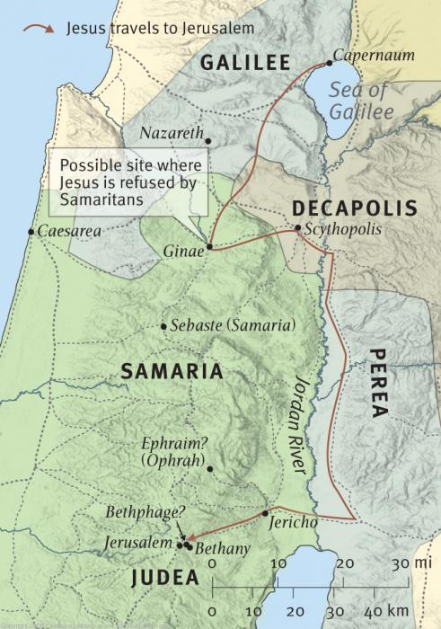

Slide 4
I. Wanted To Receive His Sight, 46-47

Slide 5
Opportunity to see . . .
“Maybe one of these days”?
Wordplay: ‘Bar’▪Timeus – ‘Bar’▪David
Bartimaeus set himself up see BarDavid
“Son of David” (Mt.1:1; 21:9)

Slide 6
Lost without revelation
Cornelius, Ac.10
Philosophers, Ac.17
Gentile
Gentiles
Truth seeker
“Something new”
Infl. by synagogue/OT
Infl. by porch
Saved, Ac.10:14
Lost, Ac.17:27
Ro.1:16-17
Ro.1:18-24

Slide 7
I. Wanted To Receive His Sight, 46-47
II. Willing To Cause A Stir To Get It, 48

Slide 8
People preferred he stay blind . . .
Bother Jesus?
Delay their journey?
Not their priority?
Interrupt conversation?
Bother them?
They are okay with his blindness
Jesus heard, stopped, invited
Would we take the time?

Slide 9
I. Wanted To Receive His Sight, 46-47
II. Willing To Cause A Stir To Get It, 48
III. Would Not Let Crowd Decide His Future, 48-49

Slide 10
If you were blind, what would you do?
He made lots of noise (47-48)
He trusted Jesus, not others
1. People are fickle
2. People are wrong (48)
3. ‘Many’ (majority) did not hinder him
Be quiet! (48)
Cheer up! (49)

Slide 11
I. Wanted To Receive His Sight, 46-47
II. Willing To Cause A Stir To Get It, 48
III. Would Not Let Crowd Decide His Future, 48-49
IV. Went To Jesus Eagerly, 50-52

Slide 12
We know it was important to him
Let nothing hinder him, 50
Went to Jesus, 50 (Rabboni)
Great desire: “I want to see!” 51
His ‘faith’ made him well, 52

Slide 13
He had faith before he . . .
met Jesus...
called out to Jesus...
went to Jesus...
requested his sight
Only after these things did his faith cure him
Agent of healing: Jesus (Who)
♦Mt.20:34
♦Lk.18:42-43
Means of healing: Faith (When)
♦Nu.21
♦Ac.2

Slide 14
I. Wanted To Receive His Sight, 46-47
II. Willing To Cause A Stir To Get It, 48
III. Would Not Let Crowd Decide His Future, 48-49
IV. Went To Jesus Eagerly, 50-52
V. Walked With Jesus Gratefully, 52

Slide 15
His gratitude influenced others (Lk.18:43)
Jericho – last town before Jerusalem
A day’s walk away from city of suffering and death

Slide 17
The beggar | The sinner
He was blind | We were lost
Jesus alone could heal | Jesus alone can save
If Jesus leaves w/o healing, he stays blind | If we leave world w/o Jesus, we stay lost
He wants mercy – something undeserved | We can’t buy mercy (Is.55:1; 1 Tim.1)

Slide 18
Lessons (1)
This is a student passage (52)
Calls to, 47-48
Casts away, 50 [contrast 17-22]
Continues with, 51
Mk.8:34-35
call
come after
deny self, follow Me

Slide 19
Lessons (2)
This is a student passage
This is a servant passage
Disciples chose power over piety (42-45)
Jesus shows them humble service
Draws focus away from Himself to blind beggar – a ‘nobody’
Ph.2:5-8 – to save other beggars

Slide 20
Lessons (3)
This is a student passage
This is a servant passage
This is a salvation passage
I’m glad Jesus cares for nobodies
Every soul is important. Ac.10:34-35

