Slide 1
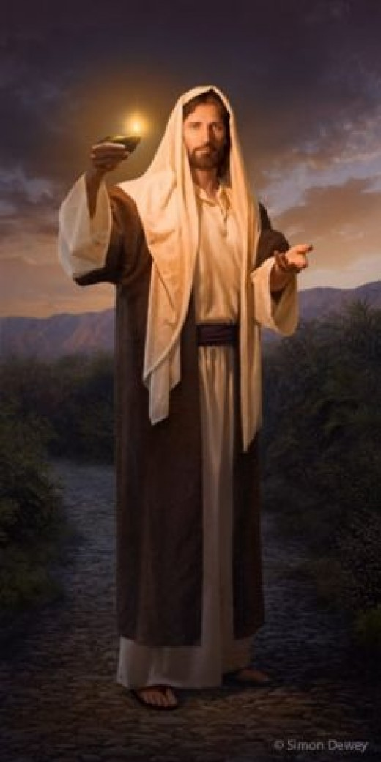
Love
Peace
Grace
Humility
Forgiveness
Honesty
Purity
Compassion
Sacrifice
Justice
Patience
Faith

Slide 2
Rude
Dishonest
Impure
Egotistical
Vengeful
Violent
Depressed
Disobedient
Loud
Angry

Slide 3
Our Consumption of Media

Slide 4
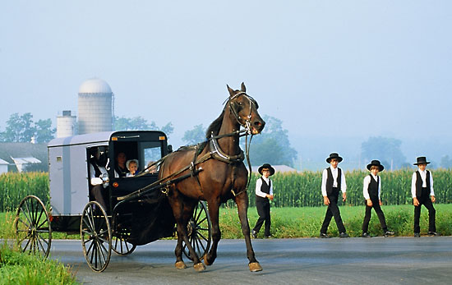

Slide 6
James 4:4
“You adulterous people! Do you not know that friendship with the world is enmity with God? Therefore whoever wishes to be a friend of the world makes himself an enemy of God.”

Slide 7
1st John 2:15
“Do not love the world or the things in the world. If anyone loves the world, the love of the Father is not in him.”

Slide 8
Romans 12:2
“Do not be conformed to this world, but be transformed by the renewal of your mind, that by testing you may discern what is the will of God, what is good and acceptable and perfect.”

Slide 9
1st Corinthians 15:33
“Do not be deceived: "Bad company ruins good morals."

Slide 10
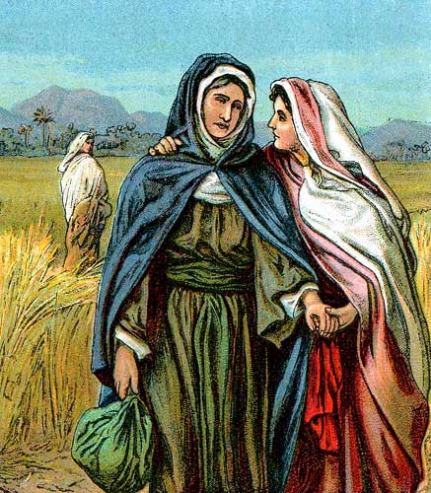
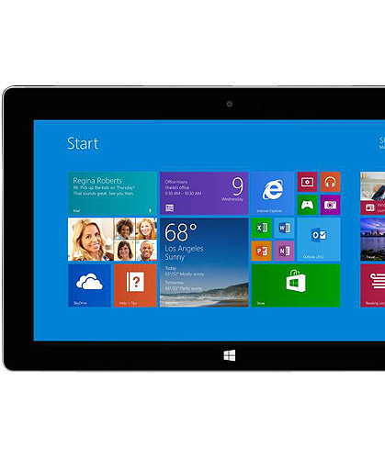
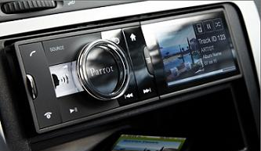
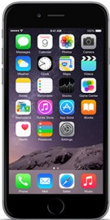
Friends With The World

Slide 11
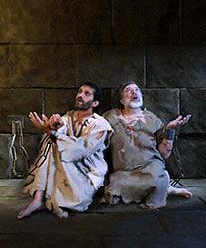
Acts 16:18-30
What we listen to will have a measurable impact on what we become

Slide 12
The Ways of the World
Bad Attitudes
Rampant Materialism
Loose Morality
Deviant Sexuality

Slide 13
Jesus’ DVR

Slide 14
Entertainment
We live in a world where we crave to be entertained
The morality in the world’s entertainment has dropped significantly
Who produces the content we consume? What is their purpose?
What are some common themes in movies or TV shows?
Violence
Revenge
Materialism
Bad Language
Belittling Others
Inappropriate Sexuality
Crude Humor

Slide 15
Entertainment Effects
We become desensitized to it
We accept it
We practice it

Slide 16
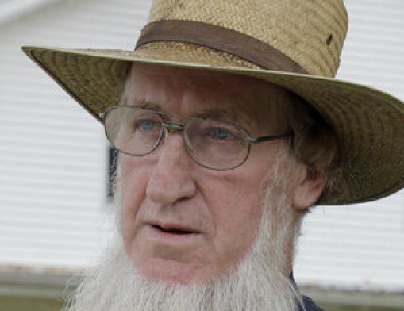
The Entertainment Solution
A Lot
Less is better than a lot!

Slide 17
Jesus’ DVR
Jesus’ Playlist

Slide 18
Music Effects
Colossians 3:16
We learn from music
Music turns our emotions
Music inspires us to greater things
God commanded its use because of its measurable effects
Top 40
Music of today obviously reflects the values of its writers
Hatred for authority
Drunkenness and revelry
Promiscuity/sexuality
Anger
Selfishness and arrogance
Profanity

Slide 19
Jesus’ DVR
Jesus’ Playlist
Jesus’ News

Slide 20
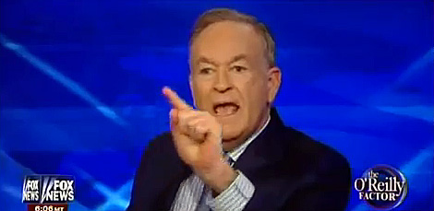
News Effects
We care a lot about the world
Describe how you feel after watching the news:
Depressed
Hopeless
Angry
Distrusting
Philippians 4:8 - Finally, brothers, whatever is true, whatever is honorable, whatever is just, whatever is pure, whatever is lovely, whatever is commendable, if there is any excellence, if there is anything worthy of praise, think about these things.

Slide 21
The Solution To Media
Matthew 5:30 - And if your right hand causes you to sin, cut it off and throw it away. For it is better that you lose one of your members than that your whole body go into hell.
Everything in Moderation

Slide 22
2nd Corinthians 6:17
“Therefore go out from their midst, and be separate from them, says the Lord, and touch no unclean thing; then I will welcome you, and I will be a father to you, and you shall be sons and daughters to me, says the Lord Almighty."

