Slide 1
A Picture of Love In A House of Loathing
1 Corinthians 13

Slide 2
1 Co.12-14
Where love should dominate
1 Co.13 –
a. 1-3: without love, greatest gifts are piddling
b. 4-7: love personified (person▪ify)
c. 8-13: love is permanent
2. “Love” – an act of the will…
Enables us ‘to love what is not naturally lovable: lepers, criminals, enemies…’
But: 2 Sm.13 . . . / . . . 1 Co.16:13

Slide 3
I. Casualty Of Love (Love Dies, 1-3)

Slide 4
Corinthians measured worth by possession of superior gifts
Love had nothing to do with it
►Paul examines ‘greatest gifts’: without love – zero
►Three times: ‘and have not love’

Slide 5
13:1: tongues
►Cleopatra (Plutarch)
► Dionysus Temple in Corinth worshipped gods with cymbals
►Tongues of angels (2 Co.12:4)
►1:7 –Corinthians have greatest gifts (but some have no love)
Most carnal, immature church of NT!

Slide 6
13:2: prophecy
►Balaam; donkey; Caiaphas – without love, no better than these
Mt.7:22
“prophesied in Your name…”
Mt.7:23
Lk.9:54
“fire from heaven…”
Faith. Love?

Slide 7
13:3: charity
►Give greatest gift to someone in need…but without love
Acts 5:1-11, sizeable contribution
Not even martyrdom counts without love. –Ignatius. –Tertullian.

Slide 8
I. Casualty Of Love
Characteristics Of Love (Love survives, 4-7)

Slide 9
1. Love suffers long
Long-tempered; opposite of short-tempered or resentful
Slow to anger, slow to take offense, slow to inflict punishment
Mt.18:26…29…
2 Co.12:20
Patience with people
Impatient charges
Counter-charges
Anger issues
Immaturity

Slide 10
2. Love is kind
Gracious, friendly
Longsuffering [passive]: does not retaliate
Kindness [active]: bestows benefits
Some endure offenses out of fear... [Stoicism; angry on inside; hold in]
1 Co.6:7, we can overlook slights… (Prov.19:11)
Ep.4:32 → 5:1. 1 Co.11:21-22

Slide 11
2. Love is kind
Kindness of God offers . . .
Provisions for all sinners, Mt.5
Pity for worst sinner, 1 Tim.1
Kindness follows God’s example
Wife would trade handsome for kind
Kindness would solve many church problems

Slide 12
3. Love does not envy
Unpleasant feelings because of advantages of others
When love dies, jealousy, envy, hatred, and strife grow
Two kinds of jealousy:
Phil.1:15-18
¹Wants what others have. “Me too!”
²Wishes others did not have it. “Me, not you!”

Slide 13
3. Love does not envy
Fruits of envy put . . .
Joseph in slavery
David in exile
Daniel in lion’s den
Jesus on cross (Mt.27:18)
Corinth in division (3:1-3)

Slide 14
4. Love does not parade itself
From ‘braggart’; ‘windbag’
Ostentatious boasting; showoff
1 Co.4:7
Jg.7:2
Mt.6:1, 5, to be seen. Lk.18
Origen: esp. of intellectual pride.
Cicero: of rhetorical display.

Slide 15
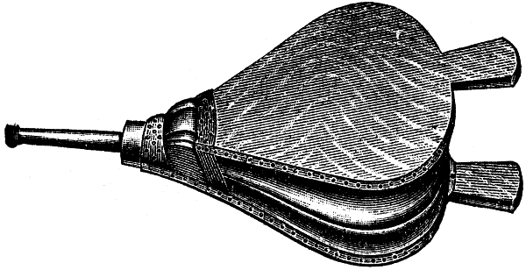
5. Love is not puffed up
To puff oneself out like a pair of bellows
Inflated concept of own importance
Pr.6:17, proud look [haughty eyes]
True love is not as impressed with itself as with others.

Slide 16
A portrait of Christ.
Only He demonstrated each trait flawlessly
How would this love affect . . .
1. Congregation?
2. Family?
3. Me? 1 Co.16:14, 22

