Slide 1
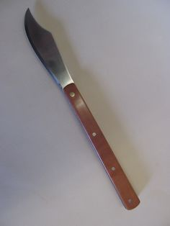
Jehoiakim’s Shredder
Jeremiah 36

Slide 2
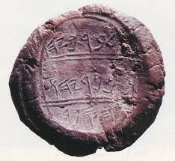
Seal of Baruch (1978)

Slide 3
God Gave Us Scripture

Slide 4
36:2
2 Pt.1
No prophecy originates with man
All prophecy originates with God through Holy Spirit moving men
²⁰ knowing this first, that no prophecy of Scripture is of any private interpretation, ²¹ for prophecy never came by the will of man, but holy men of God spoke as they were moved by the Holy Spirit.

Slide 5
36:2
2 Pt.1
1 Th.2
¹³ For this reason we also thank God without ceasing, because when you received the word of God which you heard from us, you welcomed it not as the word of men, but as it is in truth, the word of God, which also effectively works in you who believe.

Slide 6
36:2
2 Pt.1:20-21
1 Th.2:13
“Couldn’t religious geniuses have composed the Scriptures just as gifted artists & writers have created unique masterpieces?”
‘Natural inspiration’
Personality of Christ surpasses anything in human literature…
How to explain predictions…?

Slide 7
God Gave Us Scripture
II. Why did God Give Us Scripture?

Slide 8
To reveal Himself to man, 3, 7
His fury shows He hates sin, loves sinners.
Therefore consider the goodness and severity of God: on those who fell, severity; but toward you, good-ness, if you continue in His good-ness. Otherwise you also will be cut off – Ro.11:22

Slide 9
To reveal Himself to man, 3, 7 To reveal man to man, 3, 7, 8-15
They learned . . .
1. they were sinners, 3. Bible shows us as we are.
2. they must repent, 3, 7. Lk.16:14
‘Now the Pharisees, who were lovers of money, also heard all these things, and they derided Him’

Slide 10
To reveal Himself to man, 3, 7 To reveal man to man, 3, 7, 8-15
They learned . . .
1. they were sinners, 3. Bible shows us as we are.
2. they must repent, 3, 7. Lk.16:13f.
3. only God’s word can meet their deepest needs, 8-15

Slide 11
To reveal Himself to man, 3, 7 To reveal man to man, 3, 7, 8-15 To reveal certainty of things of God, 16-18
Jeremiah does NOT say . . .
1. God may not like their sins
2. God may punish them
Luke 1:4, that which cannot fall
‘…that you may know the certainty of those things in which you were instructed’

Slide 12
God Gave Us Scripture
II. Why Did God Give Us Scripture?
III. How People React To Scripture

Slide 13
1. Baruch: obeyed, 8
Ch.45
Baruch’s pitiful protest
God’s rebuke and reassurances
Ro.6:17
Obedience can be costly

Slide 14
2. People of Jerusalem: heard, but unresponsive, 10
Ja.1:22
‘But be doers of the word, and not hearers only, deceiving yourselves’

Slide 15
3. Princes: fear without repentance, 13-19
25, tried to save word of God . . . but not themselves.
Ac.24:24-25

Slide 16
4. Jehoiakim: scorn, 20-26
Son of Josiah!
Josiah finds Book of Law – reads, responds, restores.
Law finds Jehoiakim – reads, rejects, removes.
Josiah consults Huldah
Jehoiakim condemns Jeremiah

Slide 17
4. Jehoiakim: scorn, 20-26
Slow methodical destruction of scroll
Keeps pace with the reading
Ac.3-5, persecutors
Ro.2:19-20, religious scholars
1 Co.1:26, worldly wise
Jer.36:27-32 [22:18-19]

