Slide 1
Myrmecology
Proverbs 6:5-11; 30:24-25

Slide 2
We learn from little creatures
Know any ant watchers?
Nature is our teacher, Ps.19
Jesus taught with flowers, birds, snakes, wolves, etc., Mt.6

Slide 3
I. The Ant’s Motivation, 1, 6

Slide 4
Context, Proverbs 6
Address: 1, son; 6, sluggard, for benefit of son.
Aim: consider, observe (sit at feet of ant)
Action: go to the ant, consider…
Advantage: be wise

Slide 5
I. The Ant’s Motivation
II. The Ant’s Manners

Slide 6
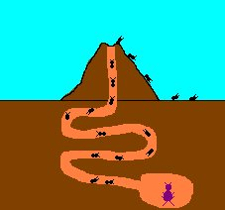
Ants in Action (Prov.6)
7: no captain.
8: provides
8: supplies in summer
Urgency. Mt.9:36-38; Mt.5:6; Hb.5; 1 Pt.2
Winter coming: Lk.16; Ja.4
8: gathers her food. Ja.5
8: in harvest. Danger!
Rebukes lazy
(9-10)
Acts: conse-quences (11)
(9-10)

Slide 7
Ants in Action (Prov.30:25)
A People (united) Ec.9:10; Ph.2
Not strong
Yet they prepare…
Prepare food. 1 Co.15
Their food. Jd.3; Ep.6:10-12
In summer. Mk.4:37-38

Slide 8
I. The Ant’s Motivation
II. The Ant’s Manners
III. The Ant’s Message

Slide 9
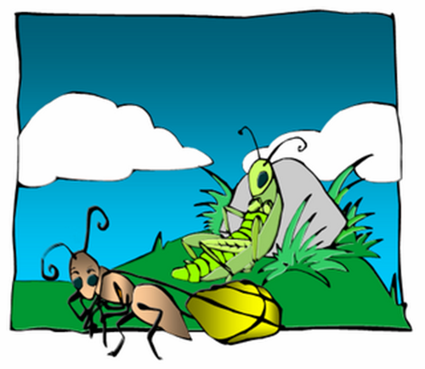
1. Work
John 9:4; 2 Cor.12:15

Slide 10
1. Work 2. Work during summer of life
Jer.8

Slide 11
1. Work 2. Work during summer of life 3. We will regret lost opportunities
Mt.25:14-30
Ga.6:9
2 Th.3:6-14

Slide 12
1. Work 2. Work during summer of life 3. We will regret lost opportunities 4. Don’t store valuables where they can be robbed
Mt.6:19-21
1 Tim.6:17

Slide 13
1. Work 2. Work during summer of life 3. We will regret lost opportunities 4. Don’t store valuables where they can be robbed 5. Finish the job
Many start…
Ph.2:12

