Slide 1
Why Do You Judge People?
Matthew 7:1

Slide 2
I. Two Assumptions On The Passage

Slide 3
Assume ALL judgment must be left with God (period).
Assume NO judgment can be left with man (period).

Slide 4
I. Two Assumptions On The Passage
II. What Is Wrong With The ‘Usual’ View Of Mt.7:1?

Slide 5
1. The accuser condemns himself
Joe condemns Jim for ‘judging’ others.
Joe argues that it is wrong to argue.
The Position:
It is wrong to judge [correct] people in sin.
Compare:
It is wrong to say the word ‘judge’

Slide 6
2. Would cancel God’s judgment
If first part is absolute (never judge) ... so is second (no future judgment)
¹Judge not [never!] . . .
²that you be not judged [never!]

Slide 7
3. Contradicts context (Mt.7:1-16)
Near context:
3-4: see speck in another’s eye; overlook log in own; faultfinder
5a: hypercritical against others’ sins; ignore own
5b: kingdom citizens must deal with sin in others
6, 15, 16: requires judgment

Slide 8
3. Contradicts the context
Near context
Remote context:
Mt.22, Sadducees
Mt.23, Pharisees
Mt.24, Jewish nation
Mt.25, all nations
Ac.13:46, self-judges
Ro.3:1-8, their condemnation is just
Rv.2:2, tested…found them liars

Slide 9
4. Prevent us from obeying Lord and apostles
Jn.7:24
1 Co.5:1-5 . . . 12-13
Corinthians were non-judging –as world wants us to be.
Lord condemned them for it.

Slide 10
5. Encourages sin and false doctrines
Child who is never corrected . . .
¹Beloved, do not believe every spirit, but test the spirits, whether they are of God; because many false prophets have gone out into the world . . . ⁵They are of the world. Therefore they speak as of the world, and the world hears them. ⁶We are of God. He who knows God hears us; he who is not of God does not hear us. By this we know the spirit of truth and the spirit of error – 1 Jn.4.

Slide 11
6. Forbids love of erring brothers
Brethren, if a man is overtaken in any trespass you who are spiritual restore such a one in a spirit of gentleness, considering yourself lest you also be tempted – Gal.6:1

Slide 12
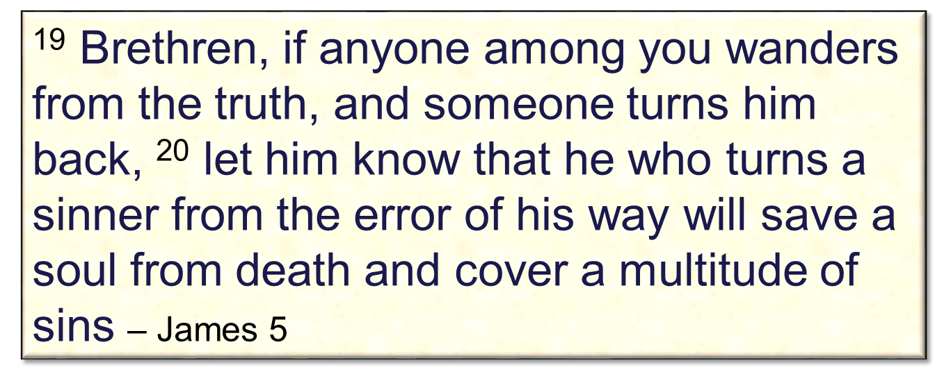
6. Forbids love of erring brothers

Slide 13
I. Two Assumptions On The Passage
II. What Is Wrong With The ‘Usual’ View . . .?
III. What Does The Passage Teach?

Slide 14
Problem:
Righteous man may become self-righteous.
¹ Therefore you are inexcusable, O man, whoever you are who judge, for in what-ever you judge another you condemn your-self; for you who judge practice the same things. ² But we know that the judgment of God is according to truth against those who practice such things – Ro.2

Slide 15
Prohibition:
‘Judge not’
Tattler at school…
Mt.7 forbids hypercritical spirit, destructive criticism . . .
Assumes worst instead of learning the facts
Hypocrite (5) – great pretender

Slide 16
Prohibition:
‘Judge not’
Hypocrite (5) – great pretender. Why?
1. Shows himself superior to object of his attack.
2. Enjoys cutting someone down to size.
3. Overlooks his own sins.
4. Appears holy. Mt.5:20

Slide 17
Prevention:
‘That you be not judged’
Way we judge determines way God judges us (v.2). Cf. 6:14-15.
John 7:48-49
And do you think this, O man, you who judge those practicing such things, and doing the same, that you will escape the judgment of God? – Ro.2:3

Slide 18
Purpose:
‘Examine self’ (3-4)
Eye: most sensitive part of body?
Jude 22-23
The speck must first be removed (3-4) but NOT by doctor with log in own eye.

Slide 19
Procedure:
David clearly sees sins in others; not in himself, 2 Sm.12:1-7.
Later: Ps.51:3 . . . 13
a. Clearly sees his sins
b. Helps other sinners
‘First . . . Then . . .’ (5)
First: remove beam from own eye.
Mt.26:6-13
Then: eye health (four words)
3: look: stare at his fault; take notice
3: consider: observe carefully (not)
4: look! behold! [Self-examination]
5: see clearly: stare…look intently

Slide 20
Parallel:
1 Co.13
Judgmental spirit is opposite of love
Some callously judged Paul, 1 Co.4:3-5

Slide 21
Analysis of the Text
¹Judge not, that you be not judged.
Context: Chap.6, negative attitude…
Bad habit: hasty, negative judgments
‘Do not judge’ – pres. tense
‘That…not judged’ – point action
Not telling us to quit thinking (v.6)

Slide 22
Analysis of the Text
¹Judge not, that you be not judged. ²For with what judgment you judge, you will be judged, and with the measure you use, it will be measured back to you.
For: the reason
Chrysostom
We are held to same standard we impose on others
Measure: instrument for measuring

Slide 23
Analysis of the Text
¹Judge not, that you be not judged. ²For with what judgment you judge, you will be judged, and with the measure you use, it will be measured back to you. ³And why do you look at the speck in your bro-ther’s eye, but do not consider the plank in your own eye?
Speck: small piece of straw, chaff…
Plank: heavy timber, beam of wood.
Do not consider: finds small wrong in bro-ther compared to sin God sees in him.

Slide 24
Analysis of the Text
¹Judge not, that you be not judged. ²For with what judgment you judge, you will be judged, and with the measure you use, it will be measured back to you. ³And why do you look at the speck in your brother’s eye, but do not consider the plank in your own eye? ⁴Or how can you say to your brother, ‘Let me remove the speck from your eye’; and look, a plank is in your own eye?
How can you say?: cannot be taken seriously
Rebukes hypocritical judging (5) – what the ‘do not judge’ people do!

Slide 25
Analysis of the Text
¹Judge not, that you be not judged. ²For with what judgment you judge, you will be judged, and with the measure you use it will be measured back to you. ³And why do you look at the speck in your brother’s eye, but do not consider the plank in your own eye? ⁴Or how can you say to your brother, ‘Let me remove the speck from your eye’; and look, a plank is in your own eye? ⁵Hypocrite! First remove the plank from your own eye, and then you will see clearly to remove the speck from your brother’s eye.
First . . . Then . . . Conclusions:

Slide 26
Analysis of the Text
⁵Hypocrite! First take the plank from your own eye, and then you will see clearly to take the speck from your brother’s eye.
First remove plank...then... See clearly…
Remove speck from brother’s eye (ct. v.3)
One brother to help another (most ignore this fact)
Even smallest defect must be corrected
Using Scripture to correct others is not my judging, but the Lord’s. 1 Co.7:10

