Slide 1
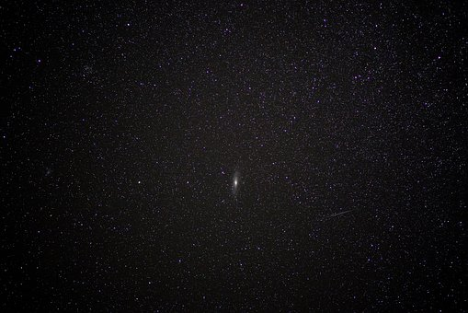
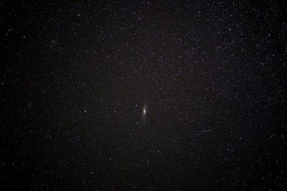
God, Word, Faith, Creation
(Genesis 1:1 – 2:3)

Slide 2
Genesis: origin
Genesis 1:1, In the beginning . . . (Ps.90:2)
Passage assumes God’s –
a. Existence (God creates). 35x
b. Eternity (He is before all things)
c. Omnipotence (creates universe…)
d. Absolute freedom
e. Infinite wisdom (cosmos)
f. Goodness (no evil)

Slide 3
God
Plural: one Godhead; plurality of Persons
Herbert Spencer: Five ultimate ideas: encompass all that exists in universe –
1. Time
2. Force
3. Action
4. Space
5. Matter

Slide 4
God
Plural: one Godhead; plurality of Persons
Herbert Spencer: Five ultimate ideas: encompass all that exists in universe –
1. Time – ‘in the beginning’
2. Force – ‘God’
3. Action – ‘Created’
4. Space – ‘Heavens’
5. Matter – ‘Earth’
No scientist itemized list until 19th Century

Slide 5
Created
Universe is not eternal
Gn.1 affirms:
Before time…
God began His creative work…
Not from pre-existing materials…
But out of nothing
“Create”: describes something that only God does.

Slide 6
Verse 2 describes earth of v.1
Without form: formlessness, emptiness, as Jer.4:23
Void: emptiness, as Jer.4:23
Earth immediately after creation was unproductive and uninhabited
God’s making and filling (days 4-6) removed the emptiness

Slide 7
Verse 2 describes earth of v.1
Darkness
Deep: waters over earth’s surface (9-10)
Spirit of God: Dt.32:11. Mt.3:16

Slide 8
Let there be light (3)
“God said” (ten times, Gn.1)
Spoke masterpiece into existence
Connection between creation by a word, and Christ the Word (Creator) Jn.1:1-3
“Let there be light” – first creative words
“And there was light” – not evolved…

Slide 9
Light … good (4)
“Good” (seven times, Gn.1)
Divided light from darkness (alternation / succession of one to other)
Without light, no life (wind, water cycle, ocean waves cease, etc.)

Slide 10
Light … day, darkness … night (5)
Light precedes sun. 1 Jn.1:5
“Day” – two senses
Light portion of 24 hour period
Entire 24 hours
Evening concludes the day; morning concludes the night . . . (six days)
‘The interpretation of yom as aeon, a favorite resource of harmonists of science and revelation, is opposed to the plain sense of the passage and has no warrant in Hebrew usage’ – John Skinner

Slide 11
Firmament (6-7)
Expanse
LXX: firm, solid structure
Vulgate: firmamentum
KJV: firmament
Used interchangeably of . . .
1. Open expanse of heavens where birds fly, atmosphere, 6-7, 20.
2. Place where God put lights of heaven, 14, 17.

Slide 12
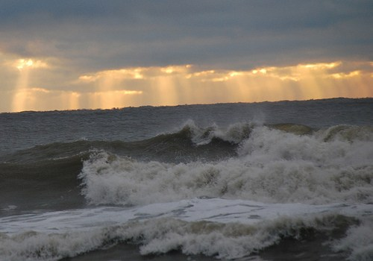
Firmament (6-7)
Expanse
6: divide … waters from waters (7)
7: “made” (different from v.1).
“And it was so”
“Heaven” – root, to heave

Slide 13
Waters, dry land (9-10)
Waters under heavens ‘gathered’
Dry ground … earth (2 Pt.3:5)

Slide 14
Waters, dry land (11-13)
Earth … grass
“According to its kind” (nine times, Gn.1)
“And it was so” (six times, Gn.1)

Slide 15
Lights (14-19)
“Let there be” – not merely appear (9)
Lights in firmament (expanse) (6).
Earth existed before sun, moon, stars
Sun radiates light
Moon reflects light
Divide day | night
For signs | seasons
For days | years

Slide 16
Lights (14-19)
Signs: banner; wonder, mighty act of God (Ex.4:8). Mt.16:3.
Seasons: appointed time (Lv.23:4). Jer.8:7. Ac.14:17.
Days and years
Lights (15) in firmament
Greater, lesser (16)
“And it was so” not “started to become so”

Slide 17
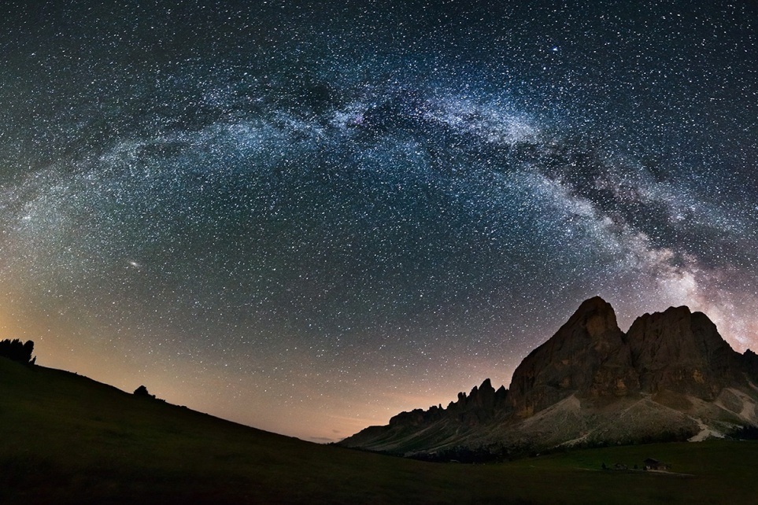
Lights (17-19)
Some claim long periods for starlight to show
Gn.1 deals with the miraculous
He spoke universe into existence…
Grown man / woman
Trees bearing fruit (11, 29-30)
Evening, morning… (19)

Slide 18
Living creatures (20-23)
As earth brought forth plants (11-12) . . .
Living creatures populate waters(20)
Winged creatures populate expanse
Cancels ‘void’ (2)
Grown birds: ability to fly
Great sea creatures (21); sea monsters
“According to its kind” (nine times, Gn.1)
Reproduction, not change into other kinds
“Good” – instantaneous, not eons of time
“Fruitful…multiply”

Slide 19
Living creatures (24-25)
Cattle, livestock – domestic animals
Creeping things
Beasts – wild animals, game

Slide 20
Man (26-27)
Let ‘US’ … ‘OUR’ image … ‘OUR’ likeness
Plural
Godhead (1:2; Jn.1:1-3)
Make man (5:2; Dt.4:32)
In our image. Ja.3:9. Unique fellowship.
No animal can evolve into God’s likeness
Dominion. Ps.8:5-7

Slide 21
Man (26-27)
Created male / female (27)
Blessed (28) – gifts, purpose (22; 2:3).
Fruitful: powers of reproduction; marriage
Subdue… dominion over animals

Slide 22
God said (29-31)
God said…and it was so
Food (29-30). All creatures depend on plants
Very good (31)

Slide 23
Finished (2:1)
Host: of angels, stars (probably here)
Finished: come to an end, put stop to

Slide 24
God ended (2:2)
Ended His work (creative process). Hb.1:3
Rested
Not tired; retired, but task is completed (Hb.4:10, …ceased)
Ceased, Gn.2:2. No revisions necessary.
Contrast Deism. Jn.5:17
Threefold emphasis (1-3): finished, ended, rested

Slide 25
God blessed (2:3)
Did not command people to observe seventh day until Ex.20
Created and made (synonyms)
NOT: ‘simple organisms progressed through natural processes into more complex species

Slide 26
I. Genesis 1 Contradicts Errors
A. Polytheism. Ac.17:…23, unknown God
B. Eternity of matter. Ac.17:24, made world
C. Gnosticism (evil matter). Ac.17:24-25
D. Theistic evolution (dirt and rocks created). (Ac.17:26-28 )

Slide 27
II. It’s About Time
Geo. Wald, Harvard neurobiologist, acknow-ledged the absurdity that chance created universe: “One has only to contemplate the magnitude of this task to concede that the spontaneous generation of a living organism is impossible…”
“Yet here we are – as a result, I believe of spontaneous generation.” How?
“Time is in fact the hero of the plot… Given so much time, the ‘impossible’ becomes possible…time itself performs the miracles”

Slide 28
II. It’s About Time
Accounts of origin of life in other religions are trivial, silly.
There is nothing childish or silly in Bible.
“If we say, as was said long ago, ‘In the beginning was mind,’ we may be expressing or trying to express a great truth, but we have gone BEHIND SCIENCE in the two words” – J. Arthur Thomson, The Outline of Science.

