Slide 1
Abortion

Slide 2
Edmund Burke
“An event has happened, upon which it is difficult to speak, and impossible to be silent”
Many of the most disgusting sins in U.S. concern children –
1. Millions slaughtered before birth
2. Thousands who live are abused, enslaved
3. Multitudes deceived by agenda-driven teachers, indoctrinated to believe errors about God, morals, politics…

Slide 3
Abortion
The deliberate termination of a human preg-nancy after, accompanied by, resulting in, or closely followed by the death of the embryo or fetus.

Slide 4
I. What Is In The News?

Slide 5
Abortion, Infanticide
1. NY law / VA law / VT law
2. Feminist propaganda
3. Faith leaders bless abortion clinic
4. Senator Tim Kaine, et al.

Slide 6
I. What Is In The News?
II. What Is In The Womb?

Slide 7
A comparison
Gn.2:7, creation of life (Adam).
Gn.4:1, procreation [conception] of life (Cain)
Conceived “Cain” – not merely a “fetus”
Bore “Cain” – identical to what was conceived

Slide 8
Bible has no unique word for unborn child
Ex.21:22-23, a fight…children come out
Called “children” before they come out
Come out – here because of violence
Gn.25:25, Esau
Jer.20:18, Jeremiah
No harm (injury): either mother or child
Harm (injury): 22-23, life for life

Slide 9
Unborn baby is viewed as just as much a human being as its mother
“ Then from Tirzah, Menahem attacked Tiphsah, all who were there, and its territory. Because they did not surrender, therefore he attacked it. All the women there who were with child he ripped open – 2 K.15:16

Slide 10
Amos
“Thus says the LORD: ‘For three transgres-sions of the people of Ammon, and for four, I will not turn away its punishment, Because they ripped open the women with child in Gilead, That they might enlarge their territory’” – Am.1:13

Slide 11
Bible has no unique word for unborn child
“Thus says Hezekiah, This day is a day of distress, and rebuke, and blasphemy; for the children have come to birth, but there is no strength to bring them forth” – 2 K.19:3

Slide 12
Bible has no unique word for unborn child
Job 3:3, 11, 16
3: born…male child…conceived…
11: ‘I’…die…at birth…perish…from womb
16: infants who never saw light (pre-birth)

Slide 13
Bible has no unique word for unborn child
Lk.1:36…
Conceived a son
Lk.1:41…
Baby leaped in womb
Baby: an unborn child, embryo, fetus; a newborn child, an infant, a babe – Th., 105.

Slide 14
Bible has no unique word for unborn child
Lk.2:12, find a “baby” …
Lk.18:15, infants…
Ac.7:19, babies…
2 Tim.3:15, childhood…
The difference between the unborn and the new born is …time, not worth

Slide 15
I. What Is In The News?
II. What Is In The Womb?
III. What Is A Child In The Womb Worth?

Slide 16
Psalm 139: Scripture’s ultrasound
1-6: from God’s knowledge to us
[Lk.16, future; Ps.139, past]
View: see what God has done
Emphasis: LORD – His knowledge of us, His omniscience
7-12: His omnipresence.

Slide 17
Psalm 139
13-16: formation of baby in womb
He formed baby, 13: create, bring forth, give birth to a baby – an activity of God
Continuity of life from conception to birth; not a ‘blob of protoplasm.’ His property.
He knitted baby, 13: cause biological body to form and grow. Figure: weave together
Fearfully, wonderfully made, 14: wonder of God’s makeup leads to praise. Gn.2:7

Slide 18
Psalm 139
13-16: formation of baby in womb
Frame (bones) 15: Gn.8:6; Ex.25:10f.
Work of art in mom’s womb, done in secret
All-seeing eye of God saw preborn child, 16: embryo.
God’s thoughts, 17 [v.2]
God has purpose for His little one, even in conception.
Purpose, aim.
Precious plan.

Slide 19
Psalm 139
Heart: 22 days; pumps baby’s own blood
40 pairs of muscles are developed: 4 weeks
Skeleton is complete; reflexes: 6 weeks
Experience pain from 6th week
Brain waves detectable in 6 weeks (43 days)
Palm/fingerprints form after 8 weeks; hearing
Squints, swallows, retracts tongue 9^{th-}10th wk.
Arms / legs move; sucks thumb; inhales / exhales amniotic fluid
All organ systems present: sleeps, wakes, tastes after 12 wks. / 20 weeks: mom’s voice

Slide 20
Eccl.11:5
What if Jeremiah’s mother had aborted him…?
Who are we to play God??
“As you do not know what is the way of the wind, Or how the bones grow in the womb of her who is with child, So you do not know the works of God who makes everything.”
Jeremiah 1:5
“Before I formed you in the womb I knew you; Before you were born I sanctified you; I ordained you a prophet to the nations.”

Slide 21
Mt.7:12
“Therefore, whatever you want men to do to you, do also to them, for this is the Law and the Prophets.”
Hysterotomy (C section): baby left to die
Salt poisoning: about one hour
Dilation and curettage
Suction
Partial birth abortion

Slide 22
Romans 1:31
“Without natural affection” – Th.
“Hard-hearted, unfeeling, without regard for others in a catalogue of vices” – BDAG.
“Without normal human affection, without love for others” – L-N.
Abortion … Exposure … Infanticide

Slide 23
James 2:26
“For as the body without the spirit is dead, so faith without works is dead also.”
Body - spirit = death.
Both + spirit = life.
A new living creature at conception – spirit is present.

Slide 24
Edmund Burke
“The only thing necessary for the triumph of evil is for good men to do nothing.”
Isa.58:1: “Cry aloud, spare not; Lift up your voice like a trumpet; Tell My people their transgression, And the house of Jacob their sins.”

Slide 25
The Silent Scream, 1984
Produced by Bernard Nathanson, former abortionist.
Allowed people to see abortion from perspective of the victim.
He called abortion, ‘the most atrocious holocaust in the history of the United States.’

Slide 26
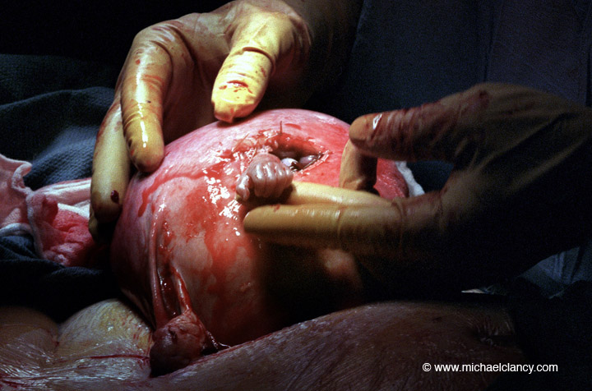
Prenatal spina bifida surgery, 1999
21 weeks old; baby survived

Slide 27
