Slide 1
Terrible Lizards – So What?

Slide 2
Teacher tells students…
13.7 billion years ago . . . big bang
4.8 billion years ago . . . lightning struck
He does not explain existence of earth, chemical soup, bang, trigger, etc.
Protein cannot reproduce itself; it must have a host cell to produce it.

Slide 3
Students’ reaction – my parents taught me a lie?
What about the Bible?
Teacher: good book, but old…not science book
Flat earth (four corners) Is.11:12.
Corner: wing. Four corners of garment refers to its entirety.
Is.40:22, earth is a sphere.
Sun rises and sets. (Meteorologists)

Slide 4
I. Would Evolutionists Deceive?

Slide 5
Piltdown Man, 1912-1953
Teeth artificially ground down.
Scratches left by abrasive agent.
Tops of teeth flattened at different angles.
Rejected offers to examine; rejected facts when shown.

Slide 6
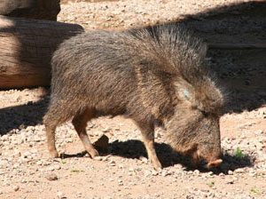
Nebraska Man, 1922
“It looks 100% anthropoid…the first anthropoid ape of America has been found” – Henry Fairfield Osborn
Five years later: wild pig-like tooth

Slide 7
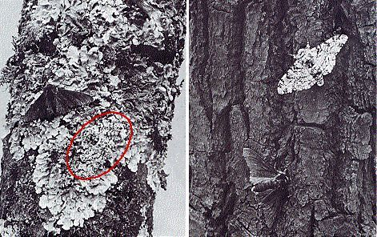
Peppered moth
95% white…
5% black
Industrial Revolution: reversed.
Kettlewell: “the most striking evolutionary change ever witnessed by man”

Slide 8
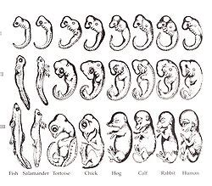
Ernst Haeckel
Darwin’s book
1874: embryos trace evolution.
Doctored.
FRAUD

Slide 9
Richard Dawkins
Even within evolutionary science community, evolutionist / agnostic Richard Dawkins has faced charges of pseudo-science and of committing elementary errors.

Slide 10
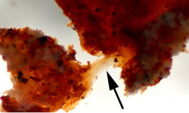
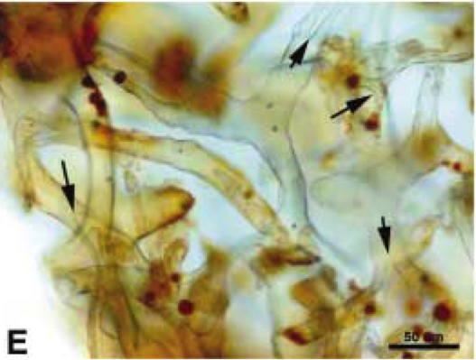
Mary Schweitzer, 2011
Fossils / eggs (Jack Horner).
Blood vessels and red blood cells in ‘68 million year old dinosaur’??
She, an evolutionist, old-earther, fired!

Slide 11
Mark Armitage, 2013
CSUNorthridge: soft tissues in triceratops fossil found in Montana…
4000 years ago…
Fired!
“We will not tolerate religion in this department!”

Slide 12
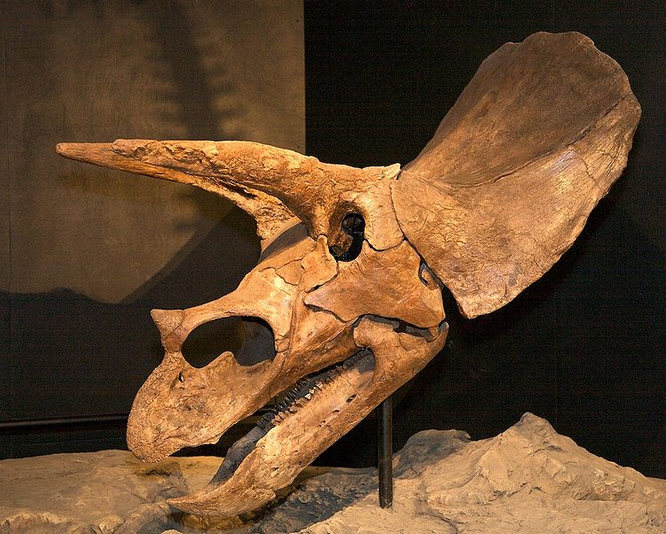
Mark Armitage: 4000 year old triceratops
CSUN, 2013
Found soft tissues in triceratops
Montana: 4000 years ago

Slide 13
Dishonest tactics
College professor challenges believer:
1. How can you see distant starlight in a young universe? 2. If a global flood, where did all the water come from? …where did it go?
If fail to answer, belief in Bible is irrational.
What if . . .
How did life come from non-living chemicals?
If fail to answer, belief in evolution is . . . ?

Slide 14
I. Would Evolutionists Deceive?
II. Were Dragons Real?

Slide 15
Job 7:12
Sea monster, sea-dragon, i.e., serpent-like monster …dragon, i.e., a serpent-like monster that lives on land …possibly a sea monster.
Is.27:1, In that day the Lord with His severe sword, great and strong, Will punish Leviathan the fleeing serpent, Leviathan that twisted serpent; And He will slay the reptile that is in the sea.
Ezk.32:2, “Son of man, take up a lamentation for Pharaoh king of Egypt, and say to him: ‘You are like a young lion among the nations, And you are like a monster in the seas, Bursting forth in your rivers, Troubling the waters with your feet, And fouling their rivers.’”

Slide 16
World Book
“Dragons of legend are strangely like actual creatures that have lived in the past. They are much like the great reptiles which inhabited the earth long before man is supposed to have appeared on earth. Dragons were generally evil and destructive. Every country had them in its mythology. Dragons were generally evil and destructive. Every country had them in its mythology.” They are drawn and described with uniformity.

Slide 17
Alexander, India, 330 BC
“Brought back reports of a great hissing dragon living in a cave, which people were worshiping as a god.’ One of his lieutenants (Onesicritus) said the Indian king Abisarus kept serpents 120-210 feet long. Subsequent Greek rulers are said to have brought dragons back alive from Ethiopia.”.

Slide 18
Marco Polo
Travelled through Asia, Persia, China, Indonesia (1271-1291). His book details varieties of animals. Ch.49: a dragon he found in a province named Karajan. People of the area killed them. ‘Here are found snakes and huge serpents, 10 paces in length, 10 spans in girth (50’ long, 100’ around). They have two short legs, each with 3 claws, eyes larger than a loaf and very glaring. The jaws are wide enough to swallow a man; the teeth are large and sharp; their whole appearance is so formid-able that neither man, nor any kind of animal can approach them without terror.

Slide 19
Worldwide Flood
If flood altered earth’s canopy vapor, dinosaurs (and man) may have shrunk in size / longevity.
Gn.1:2, 7-8
Gn.2:5-6, no rain (7:11-12; 8:2). 9:12-17.
Gn.6:4, Nephilim . . . race of giants
Gn.11:10ff, life span dropped
Ps.90:10
Animals too?

Slide 20
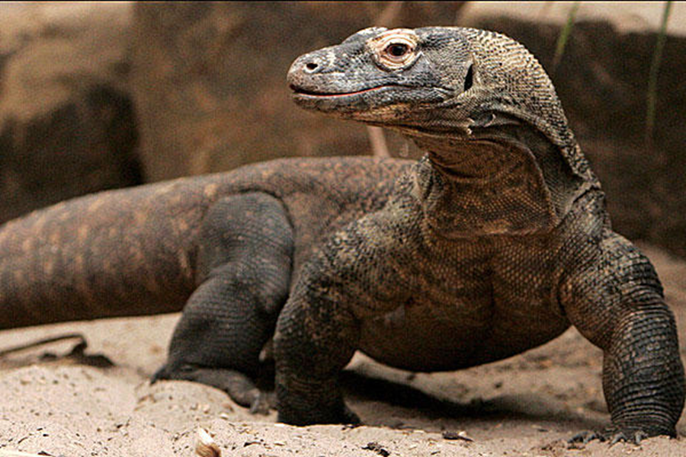
Worldwide Flood
If flood altered earth’s canopy vapor, dinosaurs (and man) may have shrunk in size / longevity.
99% of earth’s species are extinct?
History points to one special cause.
Terrible lizard?

Slide 21
I. Would Evolutionists Deceive?
II. Were Dragons Real?
III. What Should This Mean To Me?

Slide 22
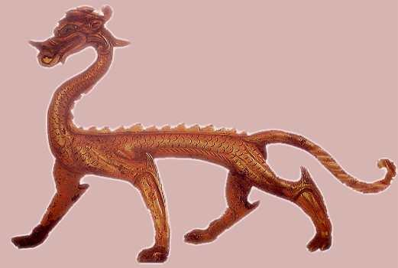
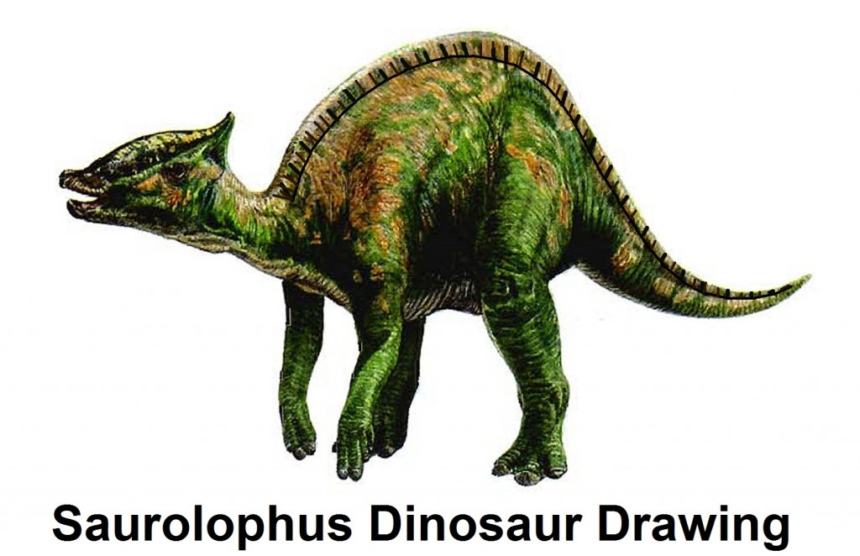
1. God’s creatures are fearfully / wonderfully made, Ps.139:14
Includes dragons, dinos, birds, bombardier beetles, etc.
Ps.148:1, 7, 10…
Made In China
Shang dynasty (1766-1122)

Slide 23
2. Unbelievers have always challenged God, His word, His people
Our situation is not new.
1 Tim.6:20 . . . 2 Tim.3:13
We see satan’s forces at work before our very eyes, Ep.6.
Uniformitarianism vs Catastrophism. 2 Pt.
Some will not accept evidence. Mt.13; Ro.1

Slide 24
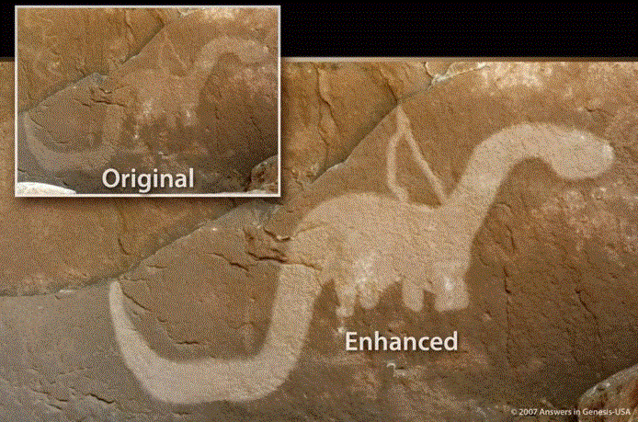
3. Even the stones cry out. Lk.19:40
Drawings: stone
Fossils: very rare; most bodies decay, are eaten, etc.
N. American Anasazi Indians, Utah territory, between 150 BC and AD 1200.

Slide 25
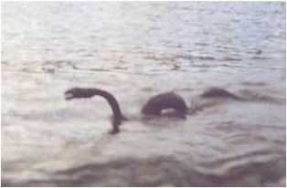
4. Many sightings (value of eye-witness testimony)
Argentine Andes, Lake Nahure, 1975

Slide 26
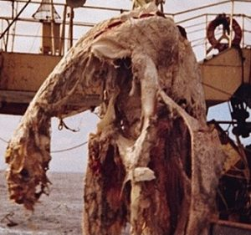
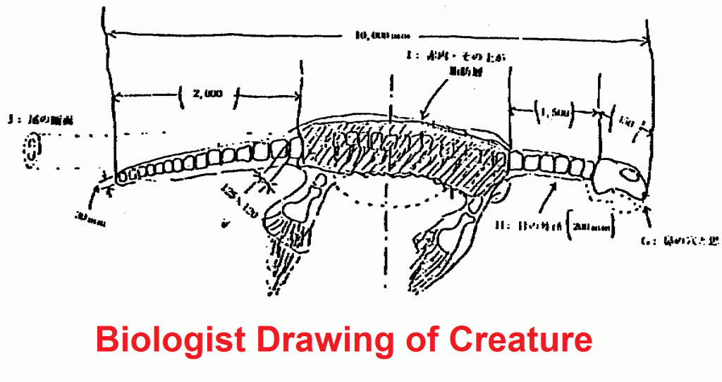
4. Many sightings (value of eye-witness testimony)
Zuiyo-Maru ‘catch’ 1977.
Japanese fishing boat.
Biologist drawing

Slide 27
5. We don’t need these things to believe Bible
Bible stands on its own…but Bible invites us to examine evidence for ourselves (Lk.1:1-4)
1. Ps.8:1…6-8, 9 (Gn.1:28)
2. Job 38:39-40, lion
3. Job 38:41, raven. Mt.6:26; Lk.12:24
4. Job 39:1-4, mountain goats
5. Job 39:5-8, wild donkey
6. Job 39:9-12, wild ox

Slide 28
5. We don’t need these things to believe Bible
Bible stands on its own…but Bible invites us to examine evidence for ourselves (Lk.1:1-4)
7. Job 39:13-18, ostrich
8. Job 39:19-24, horse
9. Job 39:26, hawk
10. Job 39:17-30, eagle. Pr.30:19; Mt.24:28
11. Job 40-41, Behemoth and Leviathan

