Slide 1
One More Thing
2 Peter 3

Slide 2
Brevity of life
We ‘come’ before Lord does
Eternity – 2 Pt.3
We prepare for the future (eternity) by remembering lessons of the past.

Slide 3
I. Peter’s Passion, 1-2

Slide 4
Souls of loved ones at stake
Beloved (8, 14, 15, 17)
Love: the greatest motive.
We warn loved ones of danger.

Slide 5
Souls of loved ones at stake
Beloved (8, 14, 15, 17)
Now – time sensitive.
Procrastination steals souls.
‘Tomorrow’ – a thief.
He planned to be all that a Christian should be – tomorrow

Slide 6
Souls of loved ones at stake
Beloved (8, 14, 15, 17)
Now – time sensitive.
Stir up – in both epistles
Not enough to ‘know’; must do.
Preparation for eternity requires action – Mt.25.

Slide 7
Souls of loved ones at stake
Beloved (8, 14, 15, 17)
Now – time sensitive.
Stir up – in both epistles
Pure minds –
Sincere, without hidden motives or pretense.

Slide 8
Souls of loved ones at stake
Beloved (8, 14, 15, 17)
Now – time sensitive.
Stir up – in both epistles
Pure minds – sincere
Remembrance –
We forget things we are not passionate about.
1 Co.11
Mt.26

Slide 9
I. Peter’s Passion, 1-2
II. Peter’s Plea, 2…

Slide 10
1-2nd epistles remind and repeat
We do not get everything the first time.
Even if we understand, we get more next time.
Repetition: ‘a key learning aid’ (3:15-16)
Peter repeats himself … and Paul.
‘It is frequent repetition that produces a natural tendency’ – Aristotle

Slide 11
I. Peter’s Passion, 1-2
II. Peter’s Plea, 1-2
III. Peter’s Purpose, 2…

Slide 12
Words spoken by holy prophets…
1:5-11 – eternal goals, spiritual growth.
1:16-21 – evidence: basis of faith; word of eyewitnesses.
1:12-15, willing to undergo torture, die…
3:…14-18 – endurance.
2: remember prophets
3-6: reject phonies
5: realize people will distort facts

Slide 13
Words spoken by holy prophets…
Word and water in Creation, 5 (the beginning)
Word and water in Flood, 6 (end of the beginning)
Word and fire in End, 7 (beginning of the end)

Slide 14
Words spoken by holy prophets…
3:8 –God is not bound by time.
Explains apparent delay (3-4).
Does not give rule for interpreting prophecy. If so . . .
His delay should not cause doubt, but devotion –
Giving time for all to repent (9).
8a: proves one day is 1000 years
8b: proves 1000 years is one day

Slide 15
Words spoken by holy prophets…
3:9 –God is not slow; time serves His purpose.
Gn.3:15 – 4000 years

Slide 16
Words spoken by holy prophets…
3:10-12 –earthly life, heavens, earth – all temporary.
10: pass away. Compare Mt.24:35
10: melt – dissolved; destroyed.
To reduce something into its components. Of the parts of the universe, as it is broken up and destroyed in the final conflagration 2 Pt.3:10-12 –BDAG.
[Used three times: 10, 11, 12.]

Slide 17
Words spoken by holy prophets…
3:10-12 –earthly life, heavens, earth – all temporary.
10: pass away. Compare Mt.24:35
10: melt – dissolved; destroyed.
10: fervent heat – consumed by heat, burn
10: burned up – burn up completely…
11: what’s the point? Earth days numbered
Big bang
Global warming
Endangered species…

Slide 18
Words spoken by holy prophets…
3:10-12 –earthly life, heavens, earth – all temporary.
10: pass away. Compare Mt.24:35
10: melt – dissolved; destroyed.
10: fervent heat – consumed by heat, burn
10: burned up – burn up completely…
11: what’s the point? Earth days numbered
12: heavens on fire, dissolve; elements (heavenly bodies) melt with fervent heat.
When: day of God … 7: day of judgment

Slide 19
Words spoken by holy prophets…
3:10, ASV ftnt: most ancient MSS: discovered.
{D} rating
What would discovered mean in context?
So I will break down the wall you have plastered with untempered mortar, and bring it down to the ground, so that its foundation will be uncovered; it will fall, and you shall be consumed in the midst of it. Then you shall know that I am the Lord – Ezk.13:14

Slide 20
Words spoken by holy prophets…
3:10: ASV ftnt: most ancient MSS: discovered.
{D} rating
What would discovered mean in context?
“Therefore I will make Samaria a heap of ruins in the field, Places for planting a vine-yard; I will pour down her stones into the valley, And I will uncover her foundations” – Mic.1:6

Slide 21
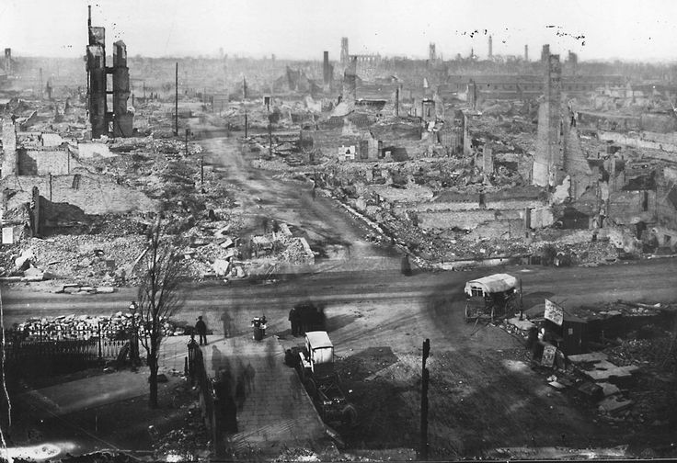
Fire

Slide 22
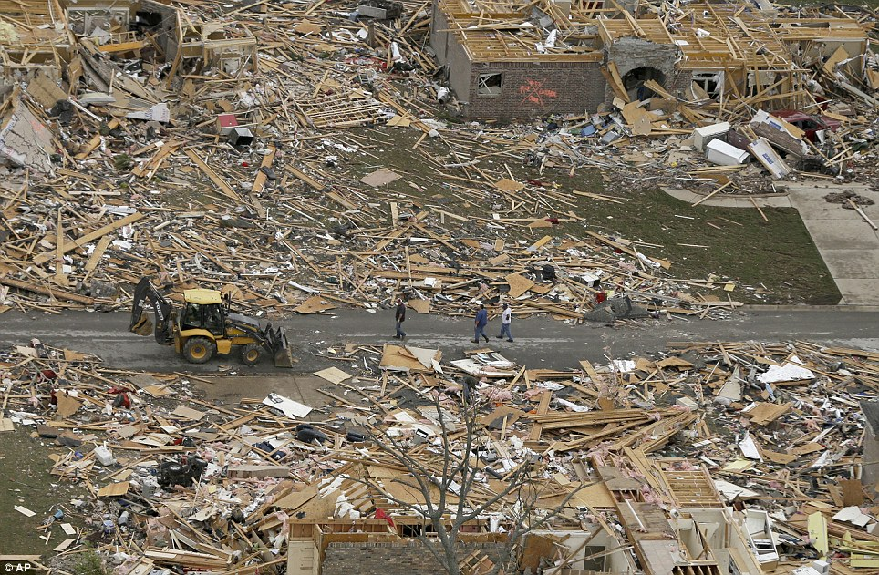
Tornado

Slide 23
Words spoken by holy prophets…
3:13 –His promise; our look for (hope)
Col.1:5, ‘the hope which is laid up for you in heaven.’
Mt.6:20, ‘lay up for yourselves treasures in heaven…’
2 Pt.3:13
‘look for new heavens and new earth’
1 Pt.1:4
‘inheritance …reserved in heaven for you’

Slide 24
Words spoken by holy prophets…
3:14 –our goal: peace, without spot, blemish
3:17 –forewarned is forearmed.
Danger: being “led away” … (Ga.2:13)
Paul’s word for Barnabas: “led away…”
“Beloved” (v.15)
3:18 –spiritual growth is surest defense against apostasy.

