Slide 1
The Pursuit Of Happiness
Psalm 1

Slide 2
Beatitudes
Twenty-six beatitudes in Psalms
Ps.1 begins with blessing
Ps.2 concludes with blessing

Slide 3
Structure of Psalm 1
A The way of blessedness, 1
B Endurance in Lord’s law, 2
C Enduring fruit tree, 3
C’ Excluded chaff, 4
B’ Not standing in judgment, 5
A’ The way of perishing, 6

Slide 4
Concerns
1. Who has our ear?
2. What do we like?
3. How do we spend our time?
4. How do we want to end?
5. What does God want us to do?

Slide 5
I. The Righteous Man, 1-3 (6)

Slide 6
1: Exclaims – Blessed!
Why is he blessed? He does NOT . . .
Walk
Stand
Sit
} conduct
Counsel
Path
Seat
} choices
Wicked
Sinners
Scornful
} company

Slide 7
1: Exclaims – Blessed!
He excludes (does NOT . . .)
He avoids . . .
Walking (council of wicked): practical atheist; rejects advice…
Do not listen to them
Standing: a way of life; choices. 1 Pt.4:3-4.
Do not live like them
Sitting: fellowship. 1 Co.15:33; Gn.19:14
Do not linger with them
Walk
Stand
Sit
} conduct

Slide 8
1: Exclaims – Blessed!
He excludes . . .
Counsel: thinking, advice, purpose (Ps.33:10)
Path: way of life, behavior (Prov.1:15)
Seat: influence, assembly (Ps.26:5)
Walk
Stand
Sit
} conduct
Counsel
Path
Seat
} choices

Slide 9
1: Exclaims – Blessed!
He excludes . . .
Wicked: there is a standard
Sinners: attitude and actions matter
Scornful: scoff at God, truth, holy things…
Walk
Stand
Sit
} conduct
Counsel
Path
Seat
} choices
Wicked
Sinners
Scornful
} company

Slide 10
Exclaims – blessed 2: Expects – strength
Studying Scripture brings strength…
V.1, he does NOT; v.2, BUT he does . . .
Delight in God’s law
Not just study, but obedience.
Mt.19.
Ps.42:1-4.
Meditate
Growl, mutter… speak in low tones.
‘The man’ (v.1)
Day - Night
Analyze
Memorize
Personalize

Slide 11
Exclaims – blessed Expects – strength 3: Excels – like a tree
‘By rivers’ – ([irrigation] channels).
1 K.18:5. Ps.52:8. Ps.92:12-14. Ga.5.
Root … Fruit … Leaf: not wither
Planted (nutrients)
Water (means)
Ep.3:17.
A brook is to a tree what Word is to one who meditates on it.
Law – meditation
Consistent, steady life

Slide 12
Exclaims – blessed Expects – strength 3: Excels – like a tree
Prospers (thrives): not by skin of his teeth
Tale of two ships
Solomon
1 K.9:…26-28
Grew rich; left God
Jehoshaphat
1 K.22:48
Shipwreck; blessing

Slide 13
I. The Righteous Man, 1-3 (6)
II. The Ungodly Man, 4-6

Slide 14
The comparison, 4
Life chaff blowing in wind.
Moves a lot – one sin to another
Chaff
No worth; wasted life (Lk.15).
No root, no fruit… (Ro.6:21; Jd.12)
No comfort (only attached to wheat). Gn.6; 19…
End: (v.4). Mt.3:12.

Slide 15
The comparison, 4 The Condemnation, 5
Hb.10:27
‘Ungodly’ (wicked) will not stand in judgment
Those who shun company of righteous on earth are justly separated from them in eternity (Num.16)

Slide 16
The comparison, 4 The condemnation, 5 The contrast, 6
Lord knows (approves, watches over) way of righteous
Way of ungodly will perish
‘Our way’ determines our destiny
One way leads to life (Jn.14:6)

Slide 17
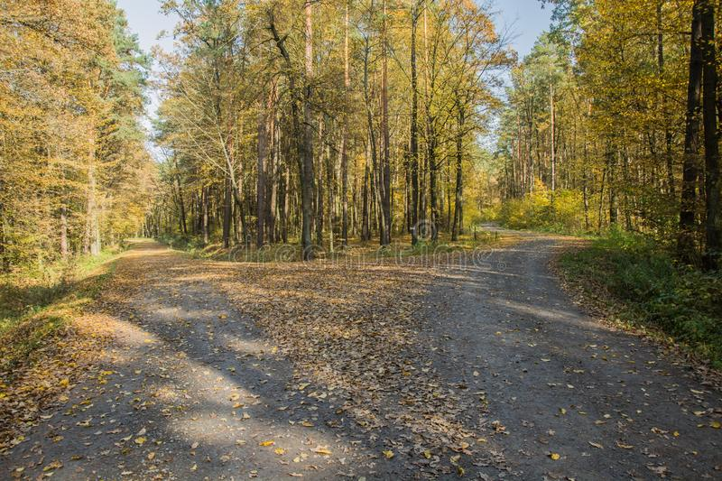
The comparison, 4 The condemnation, 5 The contrast, 6
Our destiny is determined by our response to different . . .
1. Associations. Chaff thrown to wind.
2. Views of the Law. Love it or loathe it.
3. Lives. Either in world or of world.
4. Relationship to God. 1, blessed; 6, perish.

Slide 18
Concerns
1. Who has our ear?
2. What do we like?
3. How do we spend our time?
4. How do we want to end?
5. What does God want us to do?
Mt.7:23
“I never knew you…”
Mt.25:12
Close does not count

