Slide 1
Murder At A Party

Slide 2
Herod heard about John (Mark 6)
14: some thought Jesus was a resurrected John, Lk.9:7-8. (Jn.10:41)
15: everyone had his opinion
16: emphatic: “I” beheaded John…
17: how / why it happened
Herod’s real problem:
not John, but himself

Slide 3
I. Strike One, 17-18
– Doctrinal / Moral

Slide 4
What’s the problem here?
John’s preaching
Herodias’ pull
1. John’s mission: prepare people for Lord, Mk.1:3-4.
2. John’s message: same as Lord’s, Mt.19:3-6.
John:
“not lawful” – what law?
Lv.20:21, brother’s wife
ALSO…

Slide 5
What is John’s message? (I)
John’s message: same as Lord’s, Mt.19:3-6.
  Jesus opposed Pharisee position (7-9) – they justified MDR on basis of Dt.24
    John’s baptism of repentance prepared people for Jesus, Ac.19:4
    Mt.19:8: Jesus returned to Gen.1-2.
    Would John not agree?

Slide 6
What is John’s message? (II)
John’s message: same as Lord’s, Mt.19:3-6.
Mt.19:9, divorce, marry another = adultery
Herod: bound to one, joined to another (Ro.7)
Pharisees:
is divorce lawful…? (Mt.19:3)
Jesus:
what God joins, do not separate (4-6; Gn.1-2)
Pharisees:
Moses’ command… (Mt.19:7; Dt.24)
Jesus:
hard hearts; return to beginning (4-6, 8-9)

Slide 7
I. Strike One, 17-18 – Doctrinal / Moral
II. Strike Two, 19-20
– Personal

Slide 8
Herodias wants to kill John (19)
‘No one talks to me like that!’
Ignore message: kill conscience.
Attack John: fight against God.
Day coming when Christians will be perse-cuted for teaching truth.

Slide 9
Herodias wants to kill John (19)
Herod feared John (20)
Herod respected John (just, holy prophet)
Herod protected John (from Herodias)
Herod heard John often
Herod . . . (variants):
  1. was perplexed (respect for John vs passion for Herodias?) . . . or . . .
  2. did many things . . .
Herod heard John gladly (liked to listen…)

Slide 10
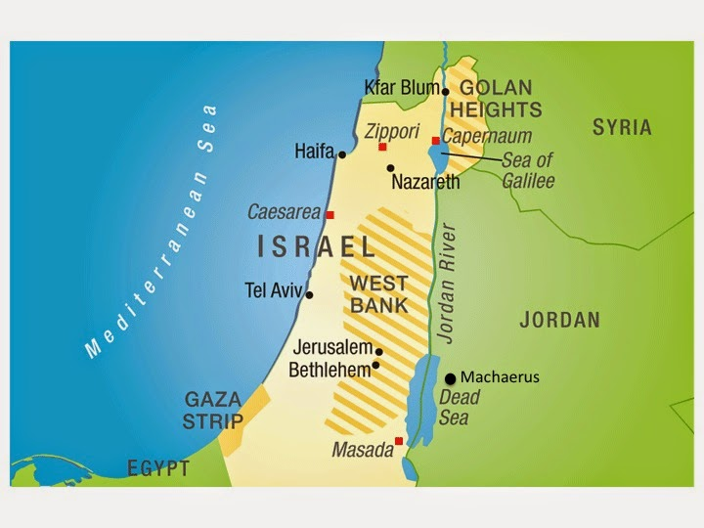
Herod’s fortress, Machaerus

Slide 11
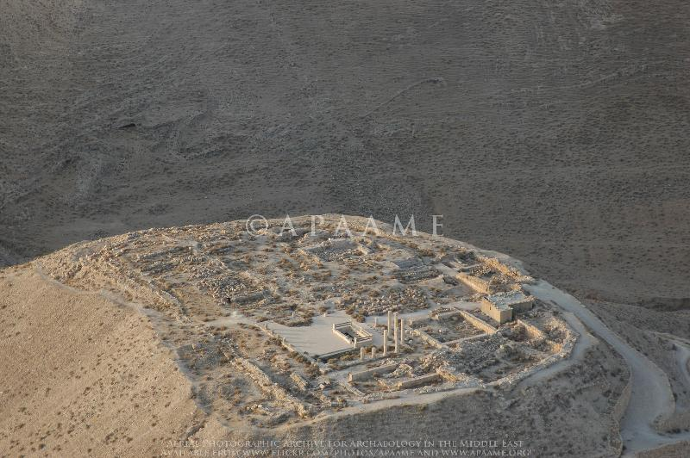
Herod’s fortress, Machaerus

Slide 12
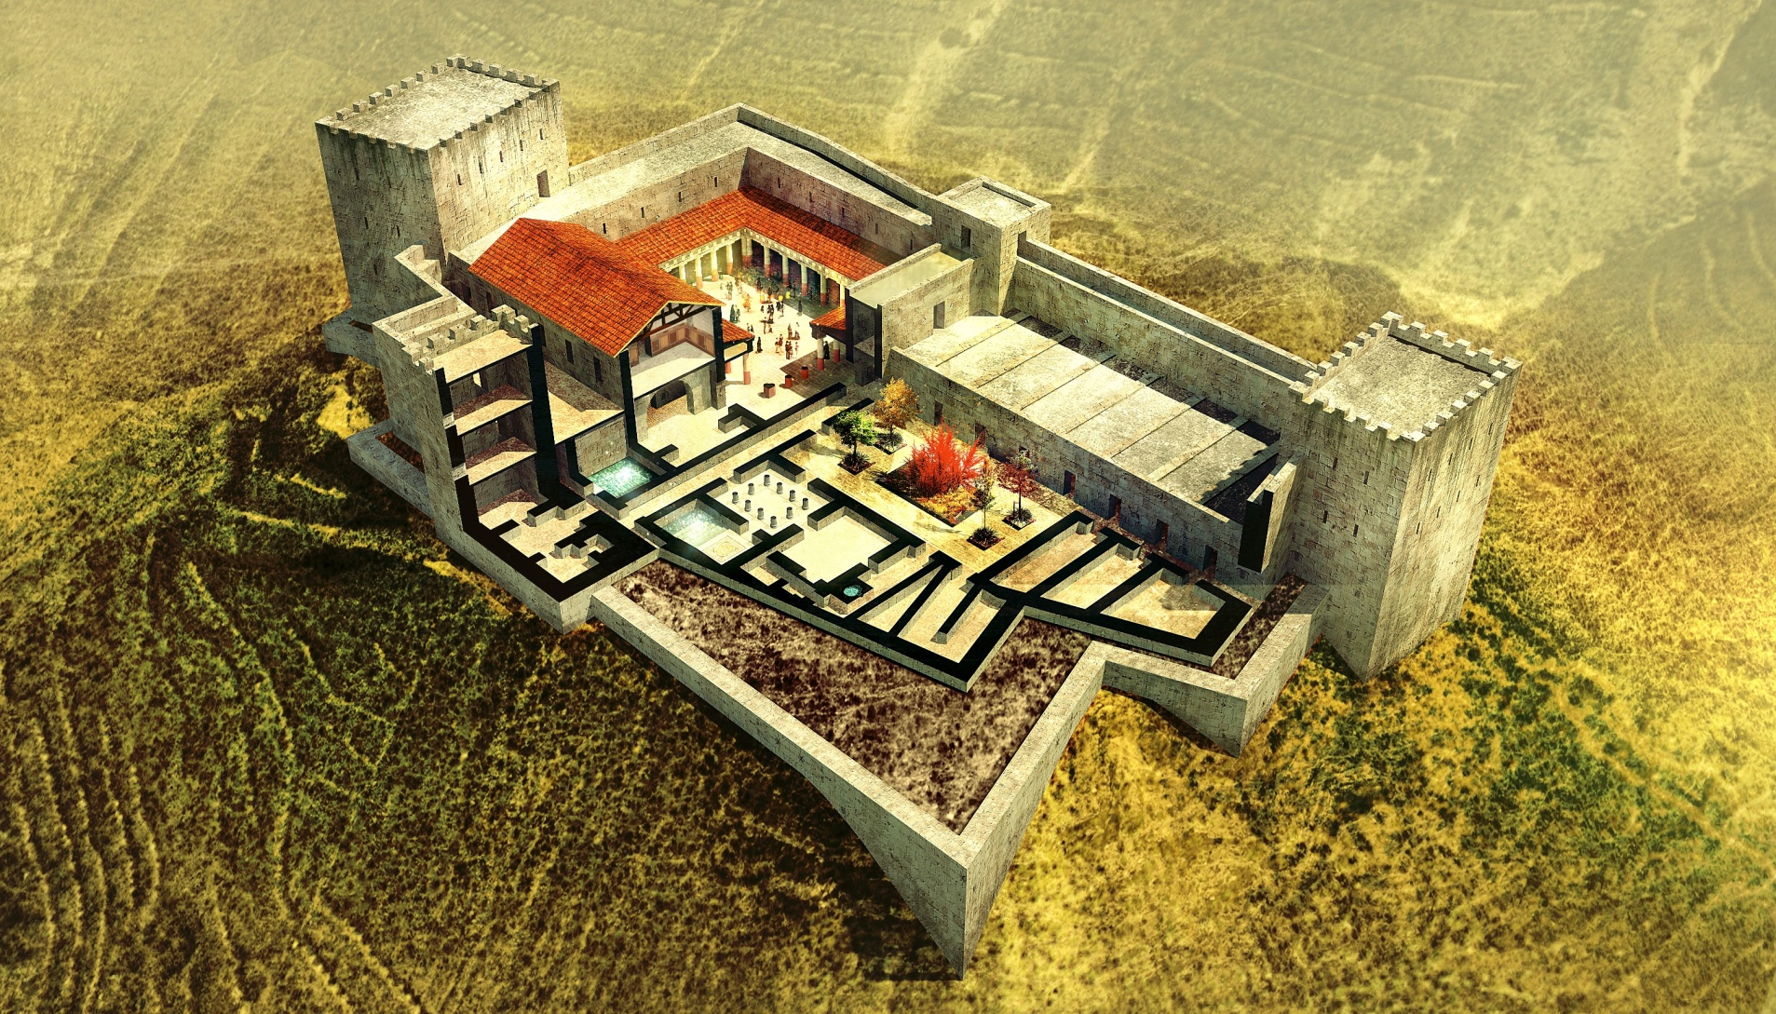
Herod’s fortress, Machaerus

Slide 13
Herod
Desert fortress, palace, 3800 feet
Married daughter of Aretas (Arabia, Petra)
Visiting brother Philip at Rome, stole his wife, Herodias (Herod’s niece / sister-in-law)
She hated truth, thus despised John
Herodias had passion to make Herod king
His appeal for a throne ended in misery of Lyons (Gaul) at command of Caligula

Slide 14
I. Strike One, 17-18 – Doctrinal / Moral
II. Strike Two, 19-20 – Personal
III. Strike Three, 21-29
– Murder

Slide 15
Should have been a happy occasion
Herod could kill prophet, but not own conscience (yet) 14, 16.
Sinned against light he had, 17-20.
Herod’s birthday bash…lascivious daughter, 21-22.
Foolish oath (Herod lost his head, then John’s) 23. Tetrarch, not king (1/4 king?)

Slide 16
Should have been a happy occasion
Sinful desire, 24.
Folly of revenge, 24-25.
Pride led to compromise, sin, judgment, 24f.
John ruined? No, 25-28.
Celebrate as eternal misery awaits, 21-29.

Slide 17
Summary:
Herod: ‘my way’ leads to eternal disaster.
Herodias: revenge is a boomerang.
She manipulates her husband /
daughter – kills John . . .
But Jesus lives! Ps.2:4

Slide 18
I. Strike One, 17-18 – Doctrinal / Moral
II. Strike Two, 19-20 – Personal
III. Strike Three, 21-29 – Murder
IV. John’s Upward Blessing
– Promotion

Slide 19
John fulfilled prophecy.
John fulfilled his mission.
  From active, productive life to sudden stop
  Mt.11 – why does Jesus do nothing?
    Elijah also became discouraged, 1 K.19
  John loves souls, thus obeys: dangerous sermons
John applied truth to situation. 1 + 1 = 2. BUT: 1 + 1 = 1 (marriage)
1 + 1 – 1 + 1 (adultery)

Slide 20
John fulfilled prophecy.
John fulfilled his mission.
John applied truth to situation.
John confined…God overruled.
Character: Mt.11:11, none greater.
Eternity rights all wrongs.

Slide 21
So what?
1. John’s death – bitter woman, immoral girl, spineless king
a. John, the second Elijah, meets Herodias, the second Jezebel
b. God’s people are not exempt from bad things in this life. Mk.10:29-30

Slide 22
So what?
1. John’s death – bitter woman, immoral girl, spineless king
2. John’s death was quick; Lord’s was long
“Truth forever on the scaffold.
Wrong forever on the throne.
Yet that scaffold sways the future,
and, behind the dim unknown,
Standeth God within the shadow, keeping watch, above His own”
–The Present Crisis, James Russell Lowell

Slide 23
So what?
1. John’s death – bitter woman, immoral girl, spineless king
2. John’s death was quick; Lord’s was long.
3. Herod finally met Jesus – Lk.23:6-11
  Herod/Pilate: cordial agreement of wicked men at Lord’s crucifixion. [Ac.4:24-28]
  Caligula banished Herod (Herodias) to Gaul; they will meet Jesus again, as judge.
  There is a difference in ‘good living’ and ‘living good.’

