Slide 1
“I Can’t Help It” or
“I Can Do It”?

Slide 2
Weakness is no excuse for not doing what we can
Common excuse for losing spiritual battle: ‘I can’t help it”
Some focus on their weakness, not on God’s strength

Slide 3
I. “I Can’t Help It” – An Excuse to Lose

Slide 4
I Can’t Help It
Gen.31:…35, Rachel
Ruth 4:…6, next of kin
Lk.11:…7, could not get up
Lk.16:3, could not dig

Slide 5
I. “I Can’t Help It” – An Excuse to Lose
II. “I Can Do All Things” – A Reason to Win (Ph.4:13)

Slide 6
1. We can change our priorities
Mt.22:37-38, greatest commandment deserves greatest priority
Lord said, love (not obey)
Love: one of strongest forces

Slide 7
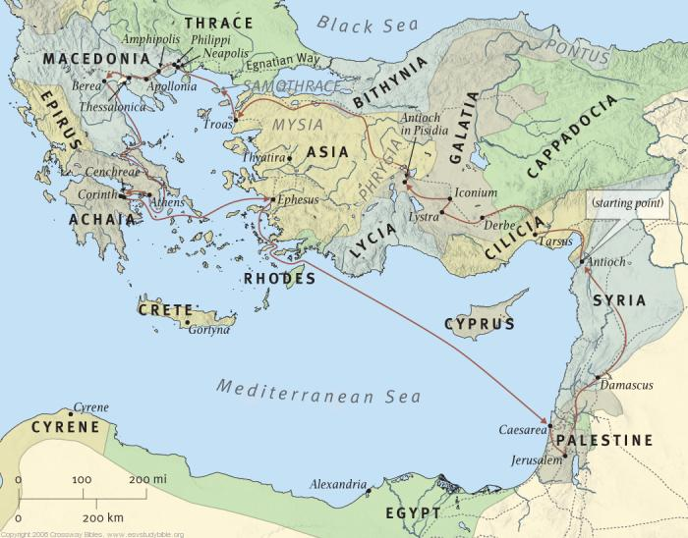
1. We can change our priorities
Mt.22:37-38, greatest commandment
2 Co.8:1-5, begins with example of giving
Paul’s second journey: Ac.15-18 – Macedonia, Greece. History of rivalry…
Barbarians

Slide 8
1. We can change our priorities
Mt.22:37-38, greatest commandment
2 Co.8:1-5, begins with example of giving
Paul used Macedonians to teach Corinth!
1: grace of God (7, 9)
2: Thessalonica: two obstacles
3: concern; gave beyond ability
3-4: choice: freely willing; not pressure
5: conviction: first gave themselves to Lord (Mt.22)

Slide 9
2. We can allow Bible to have its way…
Josh.1:8
Merely knowing what to do is not enough.
Nu.13-14 revisited: Israel fears giants
Nu.21:4-9, new generation, not perfect
Nu.21:21-35, giants…
Lk.10:37, study / meditate . . . Act on it.

Slide 10
3. We can depend on power of God
1 Co.10:13
2 Pt.2:…9
“God will not let us go beyond what is safe”?
Contrast Lot
Angels fell
Pre-flood people fell
Sodomites…
Mrs. Lot…
2 Pt.2:1-3

Slide 11
4. We can conquer temptation
1 Co.15:33, wrong companions, deception
Hb.11:7
No word about peer pressure
Noah’s conduct judged their sin
Worldly people love compromisers, Hb.11:7

Slide 12
5. We can take one day at a time
Mt.6:32-34
Personal Bible study:
1. One day at a time.
2. One step at a time.

Slide 13
6. We can replace bad habits with good
Mt.12:43-45
Nature hates a vacuum
Our life is not a spiritual void. Something will fill it.
Ep.4:22-24…
‘Nothing is stronger than a habit’ – Ovid
Changing habits to please God is always determined by choice.

Slide 14
Coram Deo
Gn.6:11, The earth also was corrupt before God, and the earth was filled with violence.
Ac.10:33, Now therefore, we are all present before God to hear all the things commanded you by God.

