Slide 1
The Good Samaritan (Lk.10:25-37)

Slide 2
Background
21: wise don’t get it
25-29 illustrates
25: lawyer … teacher of Mosaic Law
1. Tested Him: test, try, tempt…
2. Teacher: word of honor
3. Inherit: Mt.25:34
4. Eternal life: admirable. 18:18, 22

Slide 3
Background
26: Jesus lets him answer his own question
27: correctly cites Dt.6:5 / Lv.19:18 – essence of true religion . . .
You shall love the Lord your God with all your heart, with all your soul, and with all your strength – Dt.6:5
You shall not take vengeance, nor bear any grudge against the children of your people, but you shall love your neighbor as yourself: I am the Lord – Lv.19:18

Slide 4
Background
26: Jesus lets him answer his own question
27: correctly cites Dt.6:5 / Lv.19:18 – essence of true religion.
LOVE
1) God with all heart (phylacteries)
2) neighbor as self (= Mt.7:12)

Slide 5
Background
28: Jesus commends answer; urges obedience; promises life.
“This do”
29: justify – Lk.16:14-15 (self) … 7:29 (God)
Jew: NO Gentile is a neighbor.
Pharisee: no non-Pharisee…
Essene: hated all sons of darkness (Mt.5:43; Jn.7:49).
Who is my neighbor?

Slide 6
I. The Parable (He relates a story)

Slide 7
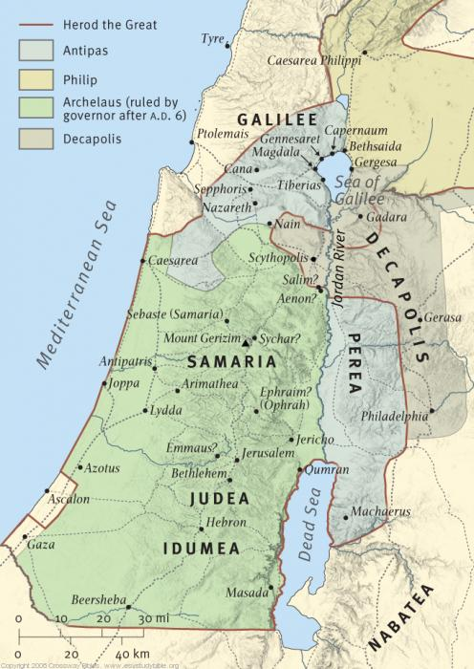
30: victim
Traveler from Jerusalem to Jericho (17m.)
Many caves
Safe haven
“Robbers”
“A man”

Slide 8
31: priest
Right place … time
Passed by on other side
Excuses?
I’m no doctor
If I were lying there, no one would help me
I’m in danger, too
If he dies, defiles me

Slide 9
32: Levite
Another religious man
Teacher of the Law
Did he teach Mic.6:8?
Who could expect him to do what priest had avoided?
Poor victim was slighted by those he thought were pious friends.
He has shown you, O man, what is good; And what does the Lord require of you But to do justly, To love mercy, And to walk humbly with your God?

Slide 10
33: Samaritan
Origin: 2 K.17:24
Gentiles intermarried with Israelites in Samaria; half-breeds (Hebrews + Gentiles)
2 K.17:25-29: God + idolatry
Opportunists . . . Outsiders
Ezr.4:10, Osnapper sent Assyrian colonists to Samaria; “Samaritans” –
Lk.9:…53 [17:16-18] Jn.4:4-9 / 8:48
“Compassion” – 7:13. Gn.43:26-30

Slide 11
34: first aid on road, care at inn
Spent time / money on total stranger
Oil, Is.1:6. . . . Fermented wine
35: Two denarii: two days wages
“I” is emphatic
Does not abandon him at inn

Slide 12
36: the question: who was “neighbor”?
NOT: who is my neighbor? (29)
BUT: am I a neighbor?
37: he would not say “Samaritan”
“Go and do likewise”

Slide 13
I. The Parable
II. The Purpose
(He recommends a Samaritan)

Slide 14
1. People have not changed
Robbers: might makes right
Priest / Levite: mind your own business; don’t get involved
Samaritan: Mt.7:12

Slide 15
2. It is possible to be religious but out of practice
Ja.1:27
Some hear without doing
Lk.19:10
If the greatest need is spiritual, the greatest neglect is spiritual

Slide 16
3. Be more concerned about being a neighbor than having one
27, 29, 36
Some justify apostasy because of neglect.
Ro.15:2

Slide 17
4. Avoid the characteristics of priest and Levite
Excuses –
1. “I’m no preacher; I don’t know enough…”
2. “They may get angry”
3. “They probably won’t change anyway”

Slide 18
5. Imitate the Samaritan
1. Sympathetic
2. Courageous
3. Merciful. Ac.16:9
4. Unselfish
5. Went 2nd mile. Mt.5:41
Lawyer debates doctrine, but does not do duty.
“It is not place but love that makes a neighbor.”

