Slide 1
Hypothermia

Slide 2
I. Seriousness of Hypothermia

Slide 3
Rv.2:4, left first love
Started well
Lost quality that makes others useful: love
(1 Co.13)
  Positive: demand sound teaching
  Negative: fight heresy
Mt.24, dangers –
¹¹ Then many false prophets will rise up and deceive many. ¹² And because lawlessness will abound, the love of many will grow cold.

Slide 4
Unhealthy climate in congregation –
Brotherly love no longer thrives – group of loners
Evil suspicions cause distrust
Love for God becomes ritual – war mentality – study just to answer error
  Ephesus (Rv.2:4) love grew cold…
  Stale marriage: against divorce, but with-out affection

Slide 5
Evidence of losing our first love (1/2)
1. Delight in Lord no longer as great…
2. Do not desire times of rich fellowship…
3. Thoughts in leisure do not include Lord
4. Claim to be ‘only human’
5. Do not willingly, cheerfully give
6. Do not treat every other Christian as we would the Lord

Slide 6
Evidence of losing our first love (2/2)
7. View commands of Christ as restrictions…
8. Inwardly strive for acclaim of world…
9. Fail to make gospel known for fear of rejection
10. Refuse to give up activity that harms another
11. Become complacent in sinful conditions
12. Unable to forgive another for offending me

Slide 7
Rv.2:4, left first love
Rv.3:1-3
Formalists or hypocrites or both
  No reference to impostors
  Satan found it unnecessary to threaten them with heresy
  They could not distinguish peace of well-being from peace of death

Slide 8
Rv.2:4, left first love
Rv.3:1-3
Rv.3:15-17
Hot: intense, zealous vs Cold: indifferent
Lukewarm: enough religion to inoculate them from real thing
  Self-satisfaction deceives
²³ Woe to you, scribes and Pharisees, hypo-crites! For you pay tithe of mint and anise and cummin, and have neglected the weightier matters of the law: justice and mercy and faith. These you ought to have done, without leaving the others undone – Mt.23

Slide 9
I. Seriousness of Hypothermia
II. Symptoms of
Hypothermia – widespread

Slide 10
Worship loses joy
Malachi 1:13 You also say, Oh, what a weariness! And you sneer at it, Says the Lord of hosts. And you bring the stolen, the lame, and the sick; Thus you bring an offering! Should I accept this from your hand? Says the Lord.

Slide 11
Financial support of church slacks
Malachi 3:8 Will a man rob God? Yet you have robbed Me! But you say, In what way have we robbed You? In tithes and offerings.
2 Cor.8:10 And in this I give advice: It is to your advantage not only to be doing what you began and were desiring to do a year ago . . .

Slide 12
Prayers decrease in frequency; become a formality
Mt.6:5 And when you pray, you shall not be like the hypocrites. For they love to pray standing in the synagogues and on the corners of the streets, that they may be seen by men. Assuredly, I say to you, they have their reward.
Ja.4:2 You lust and do not have. You murder and covet and cannot obtain. You fight and war. Yet you do not have because you do not ask.

Slide 13
Hypercriticism
Ac.6:1 Now in those days, when the number of the disciples was multiplying, there arose a complaint against the Hebrews by the Hellenists, because their widows were neglected in the daily distribution.

Slide 14
Discontentment; growing desire for something new
Ac.15:1 And certain men came down from Judea and taught the brethren, Unless you are circumcised according to the custom of Moses, you cannot be saved.
Ac.20:29-30
Gal.1:6-9

Slide 15
Worldliness grows stronger
2 Tim.4:10 Demas has forsaken me, having loved this present world, and has departed for Thessalonica.

Slide 16
Irritating sermons
Hebrews 4:12 For the word of God is living and powerful, and sharper than any two-edged sword, piercing even to the division of soul and spirit, and of joints and marrow, and is a discerner of the thoughts and intents of the heart.

Slide 17
Hobbies replace Bible study
Hebrews 5:12 For though by this time you ought to be teachers, you need someone to teach you again the first principles of the oracles of God; and you have come to need milk and not solid food. 13 For everyone who partakes only of milk is unskilled in the word of righteousness, for he is a babe. 14 But solid food belongs to those who are of full age, that is, those who by reason of use have their senses exercised to discern both good and evil.

Slide 18
Absenteeism
Hebrews 10:25 not forsaking the assem-bling of ourselves together, as is the manner of some, but exhorting one another, and so much the more as you see the Day approaching.

Slide 19
Sympathy for error and worldliness
1 Jn.4:1 Beloved, do not believe every spirit, but test the spirits, whether they are of God; because many false prophets have gone out into the world. . . . 6 We are of God. He who knows God hears us; he who is not of God does not hear us. By this we know the spirit of truth and the spirit of error.

Slide 20
I. Seriousness of Hypothermia
II. Symptoms of Hypothermia
III. Salvation From Hypothermia [1 Peter]

Slide 21
Peter
Fall, Lk.22:54-61
Recovery, Lk.22:62
Return, Jn.21
Commission, Lk.22:31-32

Slide 22
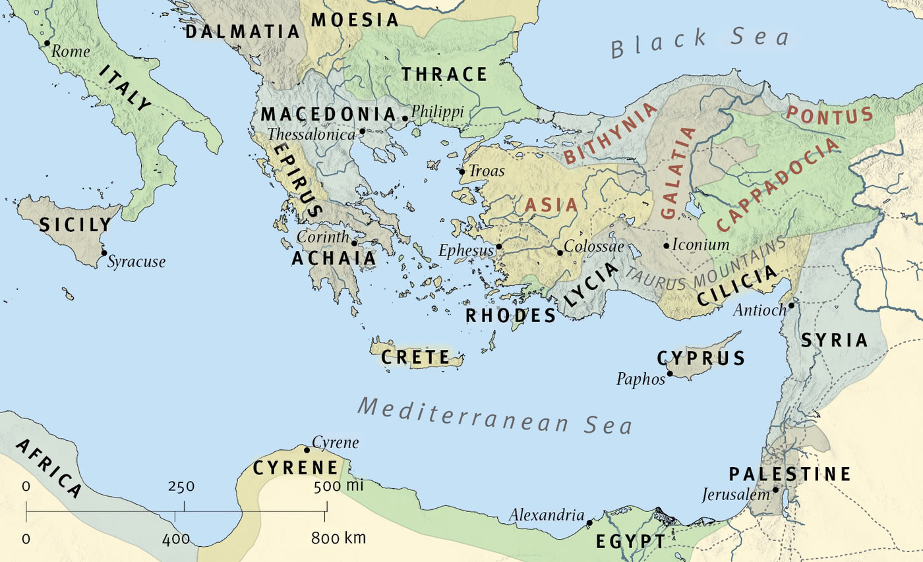
Peter’s original audience

Slide 23
How could Peter save anyone from spiritual hypothermia?
1. Leading example, 1 Pt.1:1
  Peter – man who fell down a lot?
  Have we not?
  He recovered, (Ac.4, 5, 12) 2 Pt.1:12-15
  1 Pt.5:13, influence on Mark
      If he could change, so could Mark . . . and so can we

Slide 24
How could Peter save anyone from spiritual hypothermia?
2. Liberal salvation, 1 Pt.1:2
  Elect – 2 Pt.1:10. 1 Pt.2:4
    Rejected Lord … disciples
  Grace – 3:14; 4:1; 4:12
  Peace – not much earthly peace
    Rejected idols of Roman Empire
    Changed behavior: 2:11-12; 4:3-4
    “Peace” – 1 Pt.1:2 . . . 5:14

Slide 25
How could Peter save anyone from spiritual hypothermia?
3. Living hope, 1 Pt.1:3
  1:13, rests on His grace
  1:21, hope in God
“Hope is disciplined waiting”

Slide 26
How could Peter save anyone from spiritual hypothermia?
4. Lasting inheritance, 1 Pt.1:4
  1:1, pilgrims
  3:7, heirs together
  3:9, inherit a blessing (Mt.25:34)

Slide 27
How could Peter save anyone from spiritual hypothermia?
5. Loving faith, 1 Pt.1:5
  1:7, more valuable than gold
  1:9, salvation. Hb.11:8
  Peter exhorts readers . . .
    Behave wisely, 3:16
    Endure persecution, 4:19
    Stand firm in grace, 5:12

Slide 28
How could Peter save anyone from spiritual hypothermia?
6. Lavish rejoicing, 1 Pt.1:6– exceedingly joyful, exult, glad, overjoyed
  1:8, joy, glory
  4:13, rejoice
    “Unhappiness lies in not knowing what we want and killing ourselves to get it.”

Slide 29
How could Peter save anyone from spiritual hypothermia?
7. Longing love, 1 Pt.1:8
  4:8, fervent – earnest, eager, outgoing, persevering.

