Slide 1
Cold Water Quenched the Disciples’ Faith

Slide 3
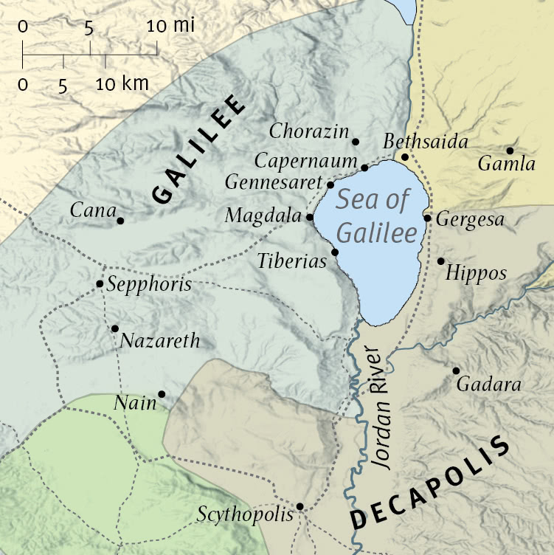
Sea of Galilee
13 miles long
7½ miles wide
680 ft below sea level
Mount Hermon (9200) feet
Cold gusts mix with warm breezes of Mediterranean and warm air hovering over Galilee

Slide 4
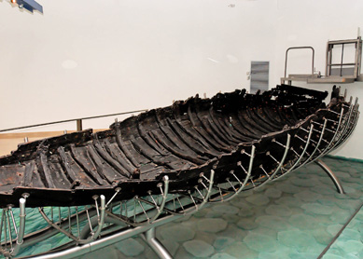
Fishing boat, found at Ginosar, 1986
(2000 years old – between 40 BC – AD 50)
(27 feet long by 7.5-feet wide)
(Cedar, pine, jujube, willow, and oak)

Slide 5
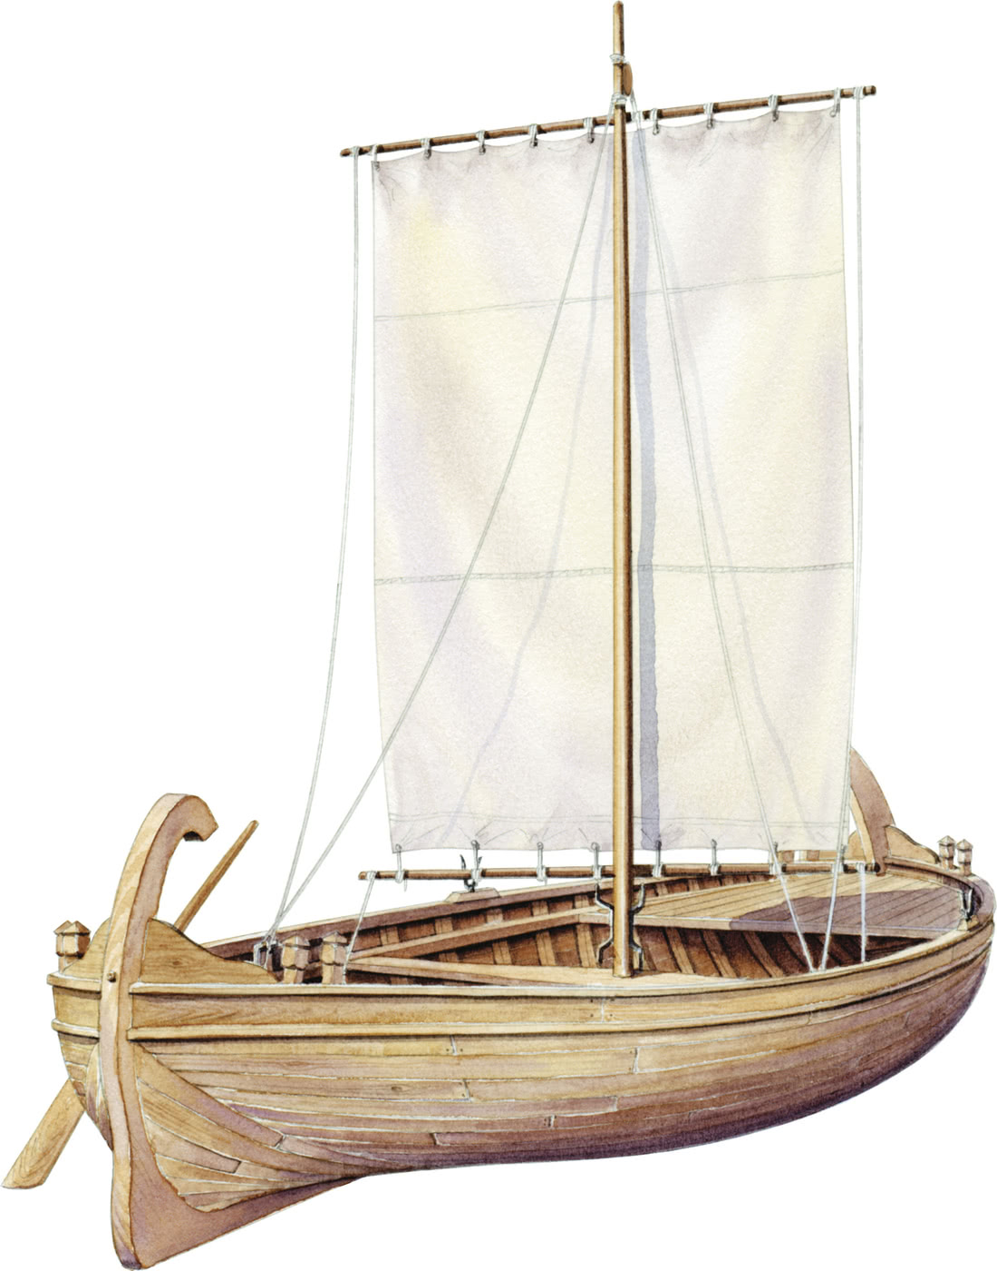
Reproduction
ESV, 1851

Slide 6
Mk.4:38
Language of panic – some shout one thing, some another. “Perishing”
1. Lord’s peaceful sleep illustrates perfect trust and absence of fear.
2. “He” = emphatic (very distinct from the terrified crew).
3. Mark: ‘Do you not care…?’
Panic / fear can destroy our faith, or it can deploy our faith (1 Pt.5:7)

Slide 8
I. Everybody talks about the weather, but . . .

Slide 9
Jesus, like Jonah, is awakened by a frightened crew
Jonah could pray, but could not stop a storm
Contrast Jesus. Mt.12⁴¹ The men of Nineveh will rise up in the judgment with this generation and condemn it, because they repented at the preaching of Jonah; and indeed a greater than Jonah is here.

Slide 10
Why do disciples wake Jesus?
Ask Him to pray (as Jonah)?
…or worry with them?

Slide 11
Jesus rebuked disciples
How does Lord’s almighty power affect us?
Does fear rule our life?
Does fear crush our faith?
To follow Jesus does not always guarantee smooth sailing or sunny skies.

Slide 12
Jesus rebuked disciples
“Isn’t it natural to be afraid in storm at sea?”
Herod, James, Peter – Acts 12 ... 1 Pt.5:7
Ac.5:41, attitude: So they departed from the presence of the council, rejoicing that they were counted worthy to suffer shame for His name.
Ac.5:42, actions: And daily in the temple, and in every house, they did not cease teaching and preaching Jesus as the Christ.
Ro.10:17, trust comes from Lord’s word → Mk.4:35

Slide 13
Acts 27: Lord did not calm the storm for Paul (as for men of little faith, Mk.4)
Lord can save us from trouble or in trouble: 2 Co.4¹, who comforts us in all our tribula-tion, that we may be able to comfort those who are in any trouble, with the comfort with which we ourselves are comforted by God
God can save us from death or in death, Ac.12 – James / Peter

Slide 14
I. Everybody talks about the weather but . . .
II. Everybody knows that trouble comes to those who deserve it (?)

Slide 15
Jesus, not His disciples, called for this crossing
Disciples were not doing wrong…storm was not their fault
Storms (hard times) don’t always imply disobedience
“No waters can swallow the ship, where lies, the Master of ocean and earth and skies.”
When disciples were with Jesus, they were in safest place on earth.
Faithful child of God can hope in life or death

Slide 16
I. Everybody talks about the weather but . . .
II. Everybody knows: trouble comes to the deserving (?)
III. Everybody knows that Jesus was just a man (?)

Slide 17
Disciples see His humanity
He is tired, sleepy
Disciples see His deity
Almighty power over nature
Why come to Jesus (a carpenter) for help? Bale water?
Jonah, a man, was saved by a miracle; Jesus saved others by a miracle.
What mere man could do what Jesus did?

Slide 18
Gn.1:1-3 . . . Jn.1:1-3 – more than a man
What skeptic can duplicate what Jesus did?
“If Jesus is God, how could Jews kill Him?
Highlights love of Messiah
He conquered death with resurrection
Anyone who can still a storm CANNOT be killed by wicked men...unless He allows it.

Slide 19
Fear and faith are contrary – as disciples facing a storm.
Fear and faith are consistent – as disciples fear the incredible power of Jesus.
Some fear is good . . .
Ph.2¹² Therefore, my beloved, as you have always obeyed, not as in my presence only, but now much more in my absence, work out your own salvation with fear and trembling
Hb.12²⁸ Therefore, since we are receiving a kingdom which cannot be shaken, let us have grace, by which we may serve God accep-tably with reverence and godly fear

