Slide 1
Building on the Rock

Slide 2
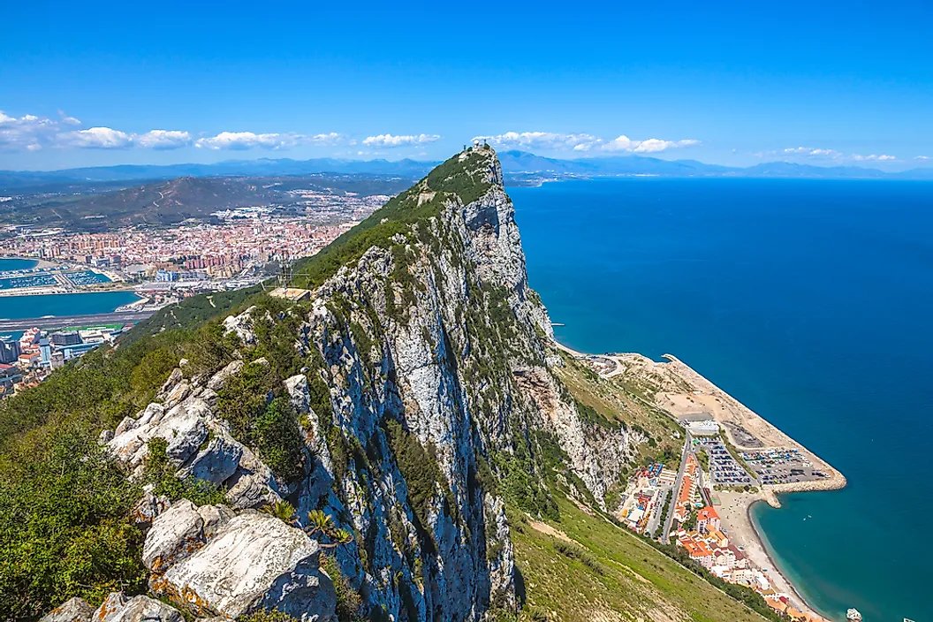
Get a piece of the rock…
General Eisenhower master-minded invasion of North Africa in Gibraltar’s tunnels.
Only spot of land in continental Europe that remained in Allied hands throughout WWII.

Slide 3
Isaiah 28
1: capture the capital…capture the country
2-4: hail storm (Assyria) is coming…
5-6: hope for remnant
7-8: erred through wine (14, Jerusalem)
9-10: mockery. “He treats us like children” (14, 22)
11: will learn lesson from foreign invaders…
12: to reject peace is to prefer war
Would not hear = reject God’s plan

Slide 4
I. Why did God write the Bible?

Slide 5
Not surprisingly . . .
1. To reveal God to man, Gn.1:1
2. To reveal man to man, Gn.1:26-27
3. To know certainty of things of God, Lk.1:3-4
4. To produce faith in our hearts, Jn.20:30-31
5. To tell us how to be saved, 1 Jn.5:13

Slide 6
Surprisingly . . . To hide the truth
Is.28¹³ For the hearts of this people have grown dull. Their ears are hard of hearing, And their eyes they have closed, Lest they should see with their eyes and hear with their ears, Lest they should understand with their hearts and turn, So that I should heal them.’
Those who don’t care enough to search for it are lost.
Gold mine…

Slide 7
“But some reject His word”
Mt.13¹⁵ For the hearts of this people have grown dull. Their ears are hard of hearing, And their eyes they have closed, Lest they should see with their eyes and hear with their ears, Lest they should understand with their hearts and turn, So that I should heal them.’
Jesus concealed truth from some…

Slide 8
Positive | Word picture | Negative
Nourish earth for food / drink | Rain (Is.55:10-11) | Flood, Gn.6
Warms body | Fire (Jer.23:29) | Burn to death, destroy property
Breaks rock in pieces | Hammer (Jer.23:29) | Jg.4:21, Jael’s hammer
Show the way | Lamp (Ps.119:105) | Expose flaws, Jn.3:19-20
Life | Aroma (2 Co.2:14-16) | Death
Protects innocent, Ep.6:17 | Sword (Hb.4:12) | Slays enemies, Mt.26:52

Slide 9
Challenge – use it or lose it
Ph.3¹⁵ Therefore let us, as many as are mature, have this mind; and if in anything you think otherwise, God will reveal even this to you. ¹⁶ Nevertheless, to the degree that we have already attained, let us walk by the same rule, let us be of the same mind.
One who loves truth will not lose it if he uses the light he has.

Slide 10
I. Why did God write the Bible?
II. False Security

Slide 11
14-15
Israel and Judah mocked prophets…
Judah’s leaders bet on fastest horse (Assyria), with another secret bet on Egypt
They trusted lies, 15
You’re in good hands with Assyria!”

Slide 12
Today
Personal security… Alarms, insurance…
National security… Dn.5
Financial security…
Eternal security… Lk.16

Slide 13
I. Why did God write the Bible?
II. False Security
III. True Security

Slide 14
^{1.} Who? Lord
1 Co.3⁹ For we are God’s fellow workers; you are God’s field, you are God’s building.
1. Process of building
2. The building itself
Ep.4¹² …for the edifying of the body of Christ

Slide 15
^{2.} Where? Zion (2:2-3)
Heb.12²² But you have come to Mount Zion and to the city of the living God, the heavenly Jerusalem, to an innumerable company of angels, ²³ to the general assembly and church of the firstborn who are registered in heaven, to God the Judge of all, to the spirits of just men made perfect, ²⁴ to Jesus the Mediator of the new covenant, and to the blood of sprinkling that speaks better things than that of Abel.

Slide 16
^{3.} What? Stone . . . foundation
Stone
True security against death and Hades.
1 Co.3¹¹ For no other foundation can anyone lay than that which is laid, which is Jesus Christ.
Tested Stone
… in all points tempted as we are, yet without sin, Hb.4:15.

Slide 17
^{3.} What? Stone . . . foundation
Precious Stone
Flawless
1 Pt.2²² Who committed no sin, Nor was deceit found in His mouth.
Corner Stone
1 Co.10¹¹ upon Whom the ends of the ages have come.
Cornerstone brought two walls together
Corner: where both parts (ages) meet…

Slide 18
^{4.} Why?
Is.28¹⁶ Whoever believes will not be in haste
Haste implies panic, insecurity
God’s people can build their lives on His promises

Slide 19
^{5.} When? (2:2-3)
Stone remains intact.
To reject Christ is to destroy ourselves.
Lk.20¹⁷ ‘…stone that the builders rejected has become the cornerstone’
Rejected Stone that make building unique
Establish the church but leave Christ out!?
“Rejected” – to reject after testing
How do people reject Christ? Jn.12:48 –
– ¹reject ²Me ¹receive not ²My words –
We may refuse His word, but cannot escape his judgment. Lk.20:18

Slide 20
^{5.} When? (2:2-3)
Rom.9³² For they stumbled at that stumbling stone. ³³ …I am laying in Zion a stone of stumbling, and a rock of offense; and whoever believes in him will not be put to shame.
Israel sought salvation in their own covenants (Assyria / Egypt). They did not trust God
When Jesus came, history repeated: Jn.11:49-50, covenant with death (Lord’s death): rejected Him, destroyed ‘selves.
Jews rejected Jesus; Father received Him, Mt.3:16f.

Slide 21
^{5.} When? (2:2-3)
Ep.2²⁰ …built on the foundation of the apostles and prophets, Jesus Christ Himself being the chief cornerstone, ²¹ in whom the whole building, being fitted together, grows into a holy temple in the Lord, ²² in whom you also are being built together for a dwelling place of God in the Spirit.
Foundation: apostles / prophets
Chief cornerstone: brought two walls together
Temple: place of worship.
Temple of Diana: one column remains.

Slide 22
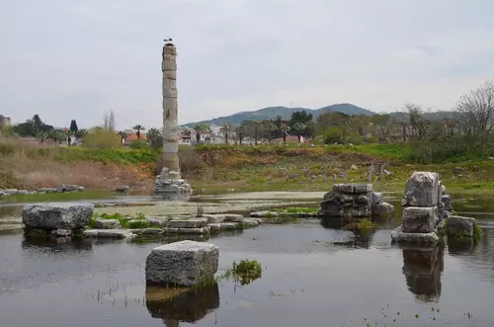

Slide 23
^{5.} When? (2:2-3)
2 Tim.2¹⁹ Nevertheless the solid foundation of God stands, having this seal: “The Lord knows those who are His,” and, “Let everyone who names the name of Christ depart from iniquity…”
Seal: inscription to show ownership; often a short motto
Leaning Tower of Pisa
Pisa: “marshy land”

Slide 24
^{5.} When? (2:2-3)
1 Pt.2⁴ “Coming to Him as to a living stone, rejected indeed by men, but chosen by God and precious … ⁶ Behold, I lay in Zion A chief cornerstone, elect, precious, And he who believes on Him will by no means be put to shame.” ⁵ you also, as living stones, are being built up a spiritual house…

Slide 25
^{5.} When? (2:2-3)
Living stone. OT: house of dead stones
You also as living stones. “Peter”
Chief cornerstone:
First stone laid
Everything else must square to it
Each stone is fitted into Him
Elect. Chosen, selected (by God)
Precious. Flawless. Costly.
Nero
OT: house of dead stones. NT: living

