Slide 1
A Tale of Two Deserters

Slide 2
I. Paul and Demas

Slide 3
Summary
Col.4¹⁴ Luke the beloved physician and Demas greet you. [Mark, v.10]
Phm.²⁴ Mark, Aristarchus, Demas, Luke, my fellow laborers.
2 Tim.4⁹ Be diligent to come to me quickly; ¹⁰ for Demas has forsaken me, having loved this present world, and has departed for Thessalonica.

Slide 4
Demas, the had been . . .
1. good example (Col.4:14)
2. helpful, zealous worker with Paul, (Phm.24)
3. incredibly blessed – Paul’s companion
4. trusted by Paul
‘Forsaken me’ is blunt, unexpected
‘Having loved this present world’ (causal)
Contrast v.8 – ‘those who have loved His appearing’

Slide 5
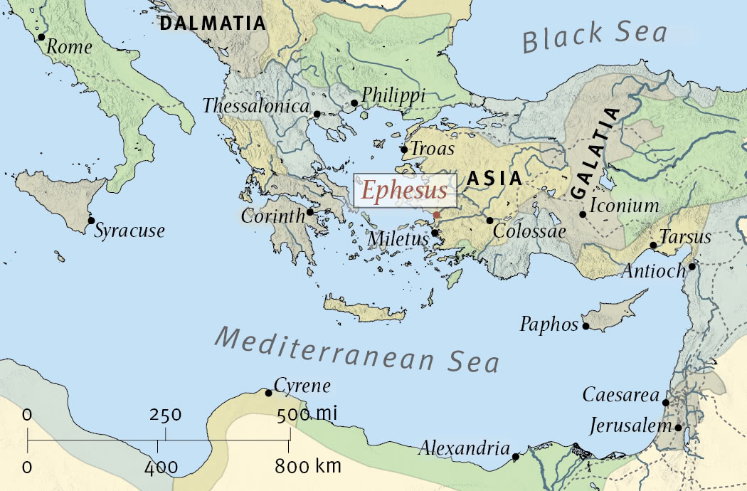
Why Thessalonica?
e

Slide 6
Demas’ fall recalls warning passages
Mt.13²² cares of this world…
Jn.12²⁵ he who loves his life will lose it, and he who hates his life in this world will keep it for eternal life
Ro.12² do not be conformed to this world…
1 Jn.2¹⁵ Do not love the world or the things in the world. If anyone loves the world, the love of the Father is not in him. …
Ja.4⁴ You adulterous people! Do you not know that friendship with the world is enmity with God? (ESV)

Slide 7
Demas failed when danger threatened?
Demas disappointed . . .
Paul. 2 Tim.4:6-8.
Other Christians.
Timothy was coming, 2 Tim.4:9.
Luke was there, v.11.
Mark was coming, 11.
Eubulus et al. were there, 21.

Slide 8
It’s not enough to begin well…
He who endures to the end will be saved – Mt.10:22.
Jesus set the example, Jn.13:1… He loved them to the end.
Hb.3⁶ Christ as a Son over His own house, whose house we are if we hold fast the confidence and the rejoicing of the hope firm to the end… ¹⁴ For we have become partakers of Christ if we hold the beginning of our confidence steadfast to the end.

Slide 9
What happened to Demas?
Worried by persecution? Rome was unsafe
Worldly desires? Lk.8:13
Worthless priorities?
Christians: strangers on earth, at home in heaven
The crown of all hope is the city of God
Wounded when others receive praise?
Weary of travel / expectations? 2 Co.11

Slide 10
Why was his fall so unnecessary?
1. A companion of Paul would see miracles that proved the genuineness of Christ…
2. Paul’s example should motivate anyone to do his best. Paul did not merely talk it…
3. Faithfulness to Lord brings eternal blessings
4. Timothy is coming to the perilous place that Demas left . . . v.9
Demas: indirect warning to Timothy
What will we do in persecution?

Slide 11
I. Paul and Demas
II. Paul and John Mark

Slide 12
History
First journey: Acts 12:25 . . . 13:2-5 . . . 13
Second journey: Acts 15:36-41
Barnabas wanted to take John Mark
Paul would not let a deserter go with him
Paul and Barnabas went separate ways
. . . But this is not the end

Slide 13
John Mark had healthy associations
His mother, Ac.12:12
Peter’s ‘biographer’ (?) and son, 1 Pt.5:13
Col.4:10, reconciled with Paul
Phm.24, one of Paul’s ‘fellow laborers’
1. He worked with Paul / Barnabas, Ac.13
2. His desertion soured Paul, Ac.15
3. He changed…he is useful, 2 Tim.4:11
God can restore failures . . . Saul of Tarsus
Abraham / Moses / Elijah / David / Peter / John Mark…

Slide 14
Influences on John Mark
Paul – rejection. Wake up call. Taught perseverance, deprivation, suffering for gospel
Barnabas – reassurance; second chance
Peter – relationship (Ac.12:12; 1 Pt.5:13)
Paul – reconciliation, restoration, 2 Tim. 4:11, ‘he is useful to me’

Slide 15
John Mark would . . .
preach truth
continue to stand for truth
not run from truth
run to Paul in his last days, despite dangers
Mark not only contrasts with Demas, but with the old Mark

Slide 16
Demas serves as a warning . . .
To Timothy
To John Mark
To us
Demas might forsake Paul, but Christ never would

Slide 17
All have failed in some ways…
Issue: how we handle it.
Some let it cripple them…
“If you find yourself loving any pleasure better than your prayers, any book better than the Bible, any house better than the house of God, any table better than the Lord’s table, any person better than Christ, any indulgence better than the hope of heaven—take alarm” – Tho. Guthrie

Slide 18
2 Tim.4:16-18
Christians were accused of . . .
Atheism
Cannibalism
Hatred of human race
Disloyal to Caesar
Renounced pleasures of sin

