Slide 1
September 9-10-11, 2022

Slide 2
Friday – I Believe in Hope
Saturday – Hope When Life Disappoints
Sun Bible class – Hope for Overcoming Sin
Sunday A.M. – It’s Hard to be Lost: Our Hope of Heaven
Sunday night – New Hope in Evangelism
“We have this as a sure and steadfast anchor of the soul”

Slide 3
New Hope in Evangelism
Go! Into the 21st Century

Slide 4
You can be a digital missionary!
STEP ONE: Recognize God doesn’t want everyone to be a missionary.

Slide 5
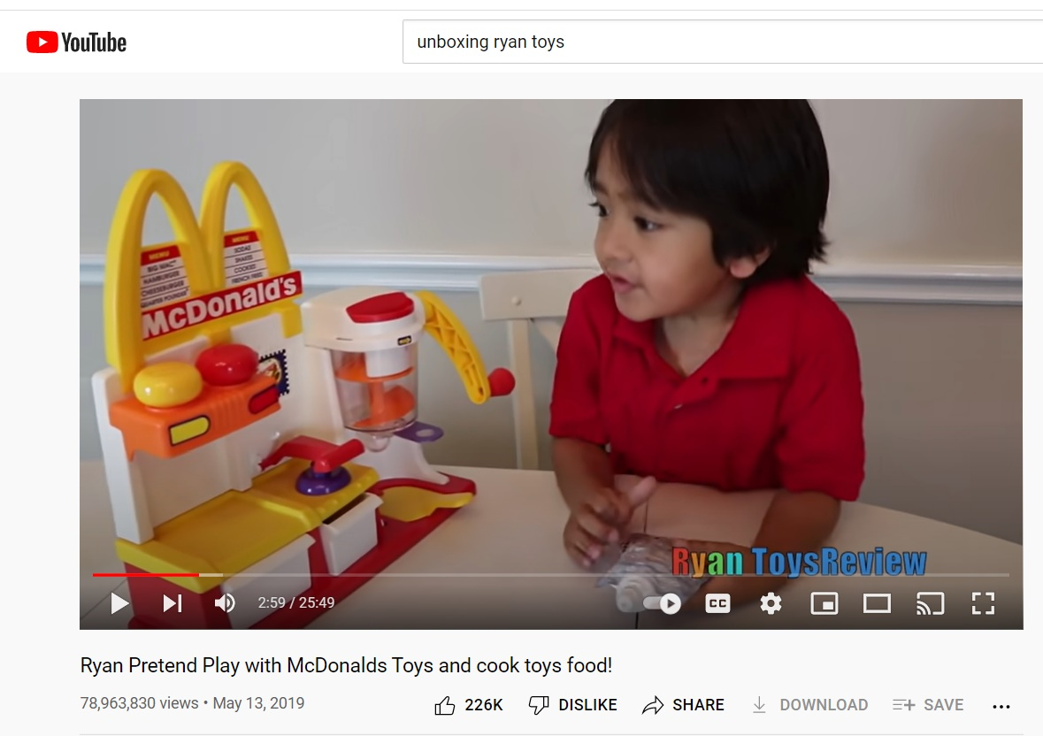

Slide 6
Social media usage
In 2008 10% of Americans had a social media account. Now 79% do.
88% of 18 to 29 year-olds have a social media account.
78% of 30 to 49 year-olds have a social media account.
69% of 50 to 64 year-olds are on social media, and even 40% of people over 65 have a social media account!
74% of people use Facebook every day. 72% use YouTube every day. 63% are on Instagram every day.

Slide 7
You can be a digital missionary!
STEP ONE: Recognize God doesn’t want everyone to be a missionary but you can be an influence for the Kingdom. STEP TWO: Think like a missionary.

Slide 8
You can be a digital missionary!
STEP ONE: Recognize God doesn’t want everyone to be a missionary but you can be an influence for the Kingdom. STEP TWO: Think like a missionary. STEP THREE: Post strategically.

Slide 9
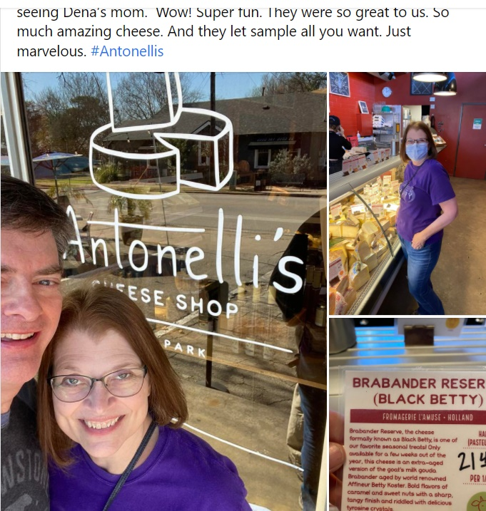
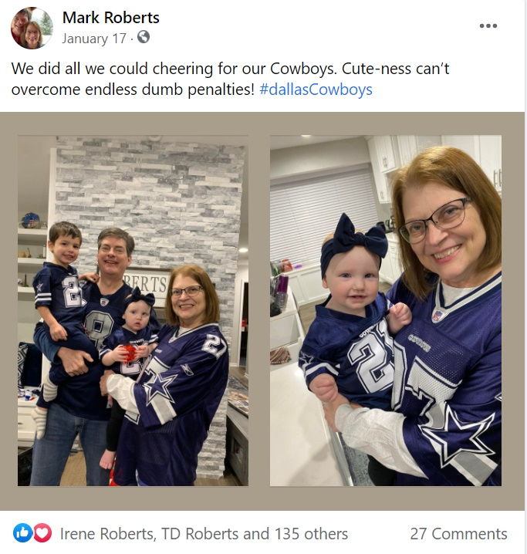
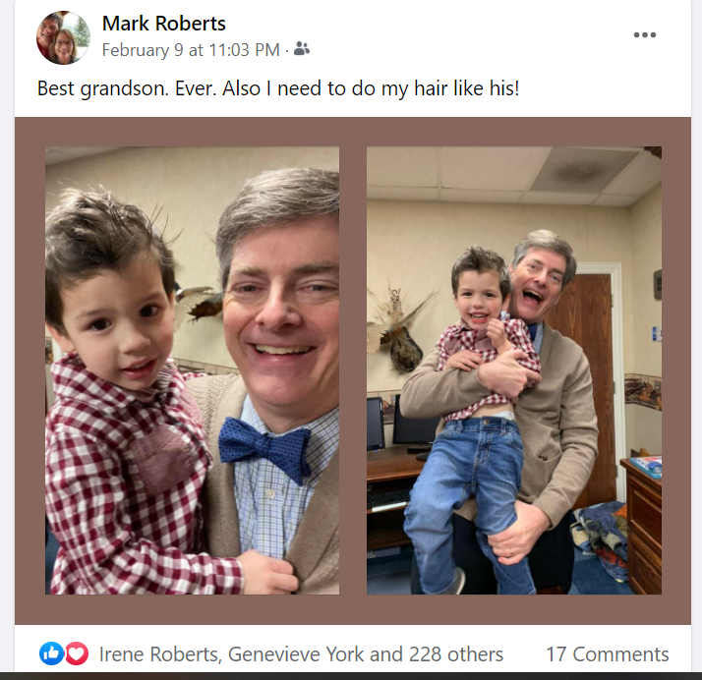

Slide 10
You can be a digital missionary!
STEP ONE: Recognize God doesn’t want everyone to be a missionary but you can be an influence for the Kingdom. STEP TWO: Think like a missionary. STEP THREE: Post strategically.

Slide 11
POST STRATEGICALLY
Nothing on my social can contradict my mission.
What can I post that will show I am a Christ-follower?
What can I post that will help people be more interested in being a Christ-follower?
How can I be a positive influence in a negative world?

Slide 12
You can be a digital missionary!
STEP ONE: Recognize God doesn’t want everyone to be a missionary but you can be an influence for the Kingdom. STEP TWO: Think like a missionary. STEP THREE: Post strategically.

Slide 13
Shorter is better.
Be genuine, be yourself.
Don’t judge or push people away.
Take arguments offline.
Get a picture.
Post a podcast.
Say something about class, sermon – link!
Get positive about church.
Talk daily Bible reading
Ask “how can I pray for you?”

Slide 14
You can be a digital missionary!
STEP ONE: Recognize God doesn’t want everyone to be a missionary but you can be an influence for the Kingdom. STEP TWO: Think like a missionary. STEP THREE: Post strategically.

Slide 15
New Hope in Evangelism
Go! Into the 21st Century

