Slide 1
Marks of Maturity

Slide 2
A child’s greatest desire…
“Big boy”
BMOC
Big Wheel”
“You are only young once, but you can stay immature indefinitely”
1 Co.3:1-9
After working with the Corinthians for years, Paul still has to talk to them like babies…

Slide 3
NT speaks fervently about spiritual maturity
1 Co.14²⁰ Brethren, do not be children in understanding; however, in malice be babes, but in understanding be mature
Col.1²²…(Christ reconciled…) to present you holy, and blameless, and above reproach in His sight... ²⁸ Him we preach, warning every man and teaching every man in all wisdom, that we may present every man perfect in Christ Jesus

Slide 4
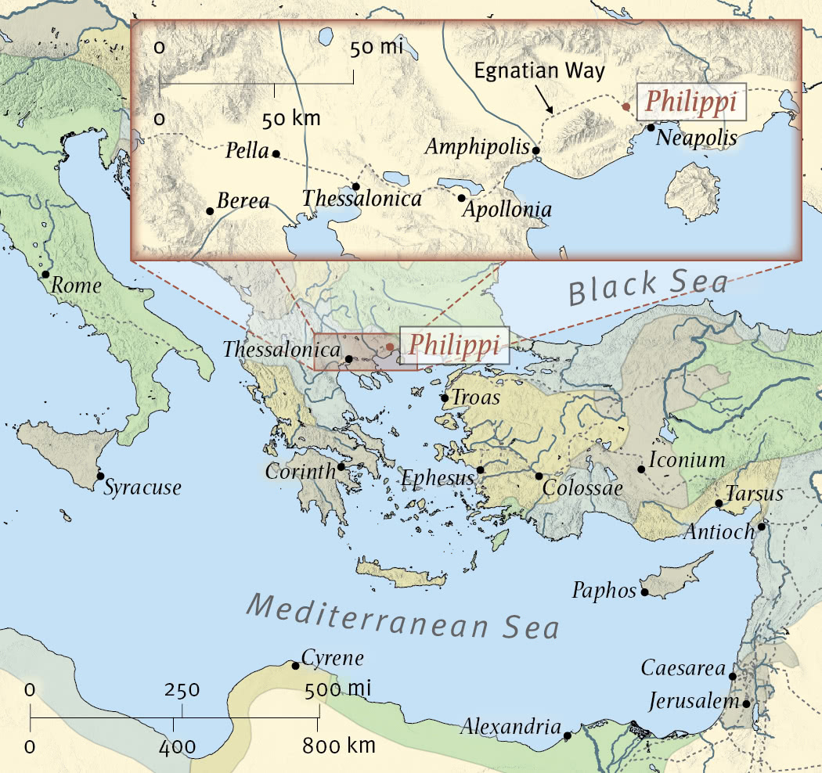
Immaturity at “Corinth” makes us appreciate mature Christians

Slide 5
The mature. . . (Philippians)
I. Abound in Whatever They Do, 1:9-11

Slide 6
9: love … more and more abound
Never satisfied with present level of growth
Ro.13:10, love is the fulfillment of the law
Gal.6:10, do good to all, especially to those who are of the household of faith
The mature don’t look for excuses to lose, but for ways to win

Slide 7
9: knowledge
Do we care about spiritual growth?
9: discernment
Insight, judgment
This is application of truth to life – Lightfoot
Prov.23:12
Commit to Bible . . .
Reading
Study
Teaching
Obedience

Slide 8
10-11: results
Approve things that are excellent (superior to, best)
Sincere: without hidden motives or pretense, pure. Sin▪cere –
Sine cera – without wax
Tested by sunlight. Ep.5:13
We need discernment in what we see . . . what we hear . . . what we believe

Slide 9
10-11: results
Approve things that are excellent
Sincere
Without offense: blameless; clear conscience
Do not stumble
Do not cause others to stumble
Filled with fruit of righteousness: make full, 22

Slide 10
The mature. . . (Philippians)
I. Abound in Whatever They Do, 1:9-11
II. They Have a Goal, 1:12-14, 20-21

Slide 11
Ph.1:12-14 … 20-21 … 2:1-5 – Willing to suffer imprisonment for gospel
Acts 16, how the church began – Ph.4:22
Ph.1:15-18, willing to endure mistreatment by envious brothers
What goal could be worth such a cost?
20: magnify [honor, exalt] Christ
From Saul the assassin to Paul the apostle
21: mimic Christ. Gal.2:20
2:1-5: mine the mind of Christ (one mind)

Slide 12
Some have no spiritual goal; never reach spiritual maturity
“For to me to live is money”; to die is what?
“For to me . . . possessions”; to die is what?
“For to me . . . fame”; to die is what?

Slide 13
Some have minimal goals; do as little as possible…still saved?
“The best use of your life is to invest it in something that will outlast it” – Henry James
Do we really want to be like Jesus?
1. Lk.4:1-13, He resisted temptation. Do we?
2. Lk.4:15ff, He taught people. Do we?
3. Lk.6:12, He prayed often / fervently. Do we?
“If you don’t know where you’re going, any road will take you there”

Slide 14
The mature. . . (Philippians)
I. Abound in Whatever They Do, 1:9-11
II. They Have a Goal, 1:12-24, 20-21
III. They Are God-Sufficient, 2:12-13

Slide 15
Determined to obey God whether Paul was there or not
Not just obedience: fear and trembling
Based on . . .
1. What God has done for us in Christ
2. Wholesome dread of displeasing God
Ph.4:13
Though Philippians is a personal letter of thanks, it contains 72 references to Godhead

Slide 16
The mature. . . (Philippians)
I. Abound in Whatever They Do, 1:9-11
II. They Have a Goal, 1:12-24, 20-21
III. They Are God-Sufficient, 2:12-13
IV. They Are Concerned About Others, 2:14-18

Slide 17
Ph.2:14-18
Set a good example before the world
Ph.2:19-24
Timothy had great care for brothers in Christ
Ph.2:25-30
Epaphroditus risked life for Paul and brothers in Philippi

Slide 18
The mature. . . (Philippians)
I. Abound in Whatever They Do, 1:9-11
II. They Have a Goal, 1:12-24, 20-21
III. They Are God-Sufficient, 2:12-13
IV. They Are Concerned About Others, 2:14-18
V. They Rejoice in the Lord, 3:1

Slide 19
What fills you with joy?
The answer reveals our spiritual maturity
Lk.22:5-6
Many practice ‘if’ rejoicing –
rejoice if outward circumstances please them (ct. 1:12)
…or if others show them respect (ct. 2:1-4)
…or if others do their duty (ct. 4:2-3)

Slide 20
What fills you with joy?
Prodigal son had everything he ever wanted . . . Lost it
Older brother had everything . . .
May as well have lost it
Miserable in sin, jealousy, self-righteous-ness as younger brother had been

Slide 21
The mature. . . (Philippians)
I. Abound in Whatever They Do, 1:9-11
II. They Have a Goal, 1:12-24, 20-21
III. They Are God-Sufficient, 2:12-13
IV. They Are Concerned About Others, 2:14-18
V. They Rejoice in the Lord, 23:1
VI. They Never Quit, 3:12-14; 4:13

Slide 22
Paul never thought of retiring from serving God; never rested on past successes; never let discouragement defeat him
What he has gained was only a motivation to further progress
1. God can use a slave-baby to lead Israel out of Egypt…
2. …shepherd boy to slay Goliath
3. …Saul the persecutor can become an apostle
4. What about us?
Gal.6:9

Slide 23
“Maturity comes from obedience, not neces-sarily from age” – Ravenhill
“A sign of wisdom and maturity is when you come to terms with the realization that your decisions cause your rewards and conse-quences. You are responsible for your life, and your ultimate success depends on the choices you make” – Waitley

