Slide 1
Dressed To Kill

Slide 2
I. God Imposes A Standard Of Conduct Upon Us

Slide 3
If no standard . . .
Anything goes – jungle!
Everyone believes in some standard
Jer.10:23
O LORD, I know the way of man is not in himself;
It is not in man who walks to direct his own steps.

Slide 4
If no standard . . .
Anything goes – jungle!
Everyone believes in some standard
Jer.10:23
Jn.12:48
He who rejects Me, and does not receive My words, has that which judges him—the word that I have spoken will judge him in the last day.

Slide 5
I. God Imposes A Standard Of Conduct Upon Us
II. God’s Standard Does Not Specify Every Sin

Slide 6
He expects us to know…
Mt.10:16
How wise? …How harmless?
Hb.5:12-14
Maturity enlightens careful students
Ro.14:23
See how close we can get to sin?
Ro.14:13
Allowed to harm brothers in Christ?

Slide 7
I. God Imposes A Standard Of Conduct Upon Us
II. God’s Standard Does Not Specify Every Sin
III. God’s Standard Includes Principles Of Modest Dress

Slide 8
Genesis 3:7…10…21
21: excludes . . .
¹nakedness
²immodest dress
Long shirt-like (under-) garment, generally w. sleeves, reaching the knees, rarely, the ankles. Gn.37:3; 2 Sm.13:18f.; Ex.28:4

Slide 9
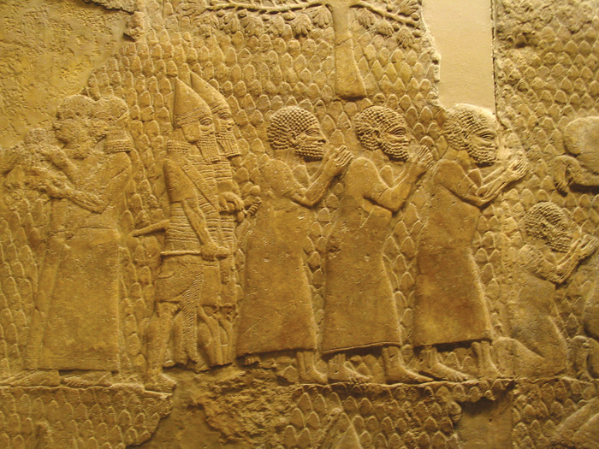
Israelite Tunics Illustrated

Slide 10
Exodus 20:26
Bans looking under priest’s garments
Canaanite worship involved sexual perversity

Slide 11
1 Timothy 2:9-10
Apparel – lit., a lowering, letting down; a garment let down. Intensive
Modest – well-arranged, seemly.
Some slit sides to expose thighs
Shamefastness – shame, modesty, the capacity to feel ashamed if you act wrongly to others; hence, respect for others and their rights

Slide 12
1 Timothy 2:9-10
Shamefastness –
► It contains an element of fear – men behave well through fear of what others may think of them if they do not. Homer: heroes must not ‘lose face’ – JACT
► It is modesty that is fast.
Bedfast; steadfast; ‘fast asleep’
► Bashfulness. Jer.6:15, be humiliated, disgraced (2 Sm.10:5) [Ph.3:19]

Slide 13
1 Timothy 2:9-10
A summary: shamefastness is . . .
1. Restraint, a modesty that keeps one from excess
2. Fear that keeps one from committing an unworthy act or base deed – Spicq
Adam and Eve cover themselves out of modesty – Josephus
Gn.41:14, 42, two changes . . .
Isa.6:2, feet / legs
Ezk.1:7

Slide 14
1 Timothy 2:9-10
Apparel
Modest
Shamefastness
Sobriety – (self-restraint)
Negative: shamefast
Positive: sobriety – rendering homage or deference to what is superior (fear of God) – Cremer
Sobriety goes with godliness (10) – a worshipper of God (cf. 2)

Slide 15
I. God Imposes A Standard Of Conduct Upon Us
II. God’s Standard Does Not Specify Every Sin
III. God’s Standard Includes Principles Of Modest Dress
IV. People Judge Us By Our Clothes

Slide 16
“Clothes make the man”
Widow, Gn.38:14, 19
Respect for God, Ex.3:5.
A mourner, 2 Sm.3: 31; Jon.3:5-7
A virgin, 2 Sm.13:18.
A harlot, Pr.7:10.
Children of caring mother, Pr.31:21…
Prisoner, Jer.52:33
Where one lives, Mt.11:8
Proper fashion, Mt.22:11-13
False piety, Mt.23:5
Godly/ ungodly char-acter, 1 T.2:9-10
Rich or poor, Ja.2:2

Slide 17
People judge us by our clothes
Annual best and worst dressed awards
Muslim woman boards plane… Man enters store w. hood, mask…
Car lot: man in old overalls, beat-up truck
Mercury Sable . . . Mercedes ML320
Tamar, Gn.38; cf. Pr.7:10.
Offensive Jesus T-shirts
Mt.22:11-13

Slide 18
“It’s all a matter of judgment”
1. Judgment often restricts and binds
*Elders’ qualifications
*Withdrawing
*Hb.5:12-14
2. Slippery slope. What is forbidden? Why?
3. Mt.18:6; Ro.14:15
“My liberty ends where other man’s nose begins.”

Slide 19
“I don’t intentionally entice people to sin”
Poison is poison, regardless of motive
1. 1 Co.9:19-23
2. Gal.2:11-13
Paul: willing to forfeit rights to save souls
Peter: by example alone carried away Jews

Slide 20
“Who is this man walking in the field to meet us?” The servant said, “It is my master.” So she took a veil and covered herself – Gn.24:65
Rebekah’s first response: cover herself
Veil: wrapper, shawl, i.e., a piece of clothing that covers the shoulders and upper body of a woman, but in context could also cover the face
Moderns uncover to impress…

