Slide 1
Living The Good Life
1 Peter 3:8-10
[1 Timothy 4:7-8; 1 John 5:12]

Slide 2
I. Looking For Life In All The Wrong Places

Slide 3
Some look for life in . . .
1. Money. Comes at a price.
2. Fame. 1 K.4:31
3. Intelligence. 1 Co.1:23
4. Talent. Jg.20:16
5. Power and Influence. Samson
6. Selfishness. Eli’s sons. Haman. Mt.16

Slide 4
I. Looking For Life In All The Wrong Places
II. Look For The Good Life In The Good Book

Slide 5
1. Learn to Love
Ultimately: God, 1 Jn.4:19
a. Brothers. 1 Jn.4:20-21.
b. Family, Ep.5:25.
c. Neighbors, Mt.22:37-39.
d. Enemies, Mt.5:43-48.
e. Word, Ps.119:97.
Jn.14:15 . . . 13:34-35

Slide 6
1. Learn to Love 2. Learn to work
Genesis 2:15 (3:17-19)
“Nothing to do…”

Slide 7
1. Learn to Love 2. Learn to work 3. Learn to examine yourself
⁵Examine yourselves as to whether you are in the faith. Test yourselves. Do you not know yourselves, that Jesus Christ is in you?—unless indeed you are disqualified – 2 Co.13

Slide 8
1. Learn to Love 2. Learn to work 3. Learn to examine yourself
¹⁴ for when Gentiles, who do not have the law, by nature do the things in the law, these, although not having the law, are a law to themselves, ¹⁵ who show the work of the law written in their hearts, their conscience also bearing witness, and between themselves their thoughts accusing or else excusing them) –Ro.2

Slide 9
1. Learn to Love 2. Learn to work 3. Learn to examine yourself
Conscience: mind acts as judge
Examines conduct
Consults law (Word)
Pronounces verdict
Protects Against . . .
Pride, Lk.18:9
Disdain
Mt.21:23…
Bitterness, Criticism
Compromise,
Shame

Slide 10
1. Learn to Love 2. Learn to work 3. Learn to examine yourself 4. Learn to accept yourself
Never be satisfied with spiritual growth – Ph.3:13-14
a. Few are good at everything.
b. Most can improve in anything.
c. Everyone can do something.
d. Don’t be caught doing nothing.
If green, you grow
If ripe, you rot

Slide 11
1. Learn to Love 2. Learn to work 3. Learn to examine yourself 4. Learn to accept yourself 5. Cultivate an interest in others
Lk.6:31
Not ‘live and let live’
Not mind their business / meddling
Not try to get something from them
Sincere, selfless love

Slide 12
1. Learn to Love 2. Learn to work 3. Learn to examine yourself 4. Learn to accept yourself 5. Cultivate an interest in others
Lk.6:31
Lk.22:24-27
Ambitious contention, 24
Acting like worldly tyrants, 25
Ignoring example of Jesus, 26-27
Jn.13:4-14

Slide 13
1. Learn to Love 2. Learn to work 3. Learn to examine yourself 4. Learn to accept yourself 5. Cultivate an interest in others
Lk.6:31
Lk.22:24-27
Not every man for himself
Not competing with each other
Let nothing be done through selfish ambi-tion or conceit, but in lowliness of mind let each esteem others better than himself – Ph.2:3

Slide 14
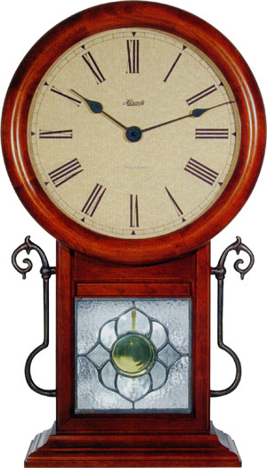
1. Learn to Love 2. Learn to work 3. Learn to examine yourself 4. Learn to accept yourself 5. Cultivate an interest in others 6. Live one day at a time
“Therefore do not worry about tomorrow, for tomorrow will worry about its own things. Sufficient for the day is its own trouble – Mt.6:34
31,536,000!

