Slide 1
Dorcas, The Disciple
Acts 9:36-42

Slide 2
I. Dorcas

Slide 3
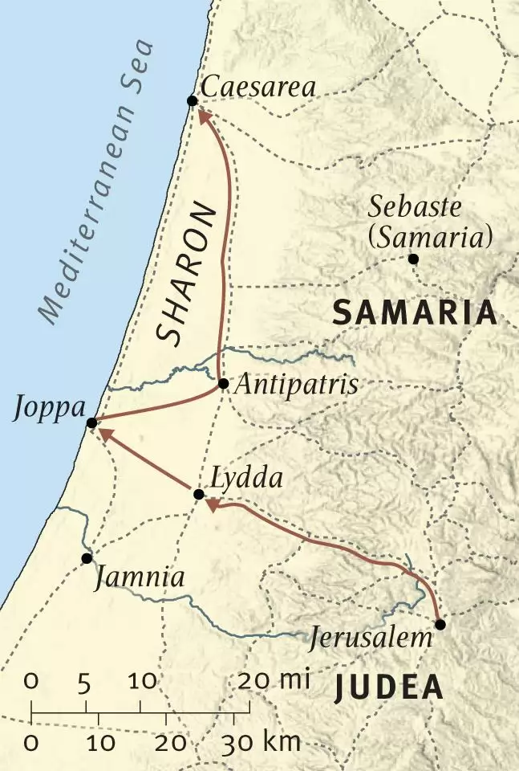

Slide 4
One disciple singled out (36)
Not an elder . . . not notable teacher
Not a man . . . A woman
Her influence not due to high office
Due to godly life, generous service
Good company:
Rahab
Mary
Hannah
Phoebe
Mary
Priscilla

Slide 5
FULL disciple (36)
Not full of herself . . . (pride)
Full of good works. Pr.31
Full of charity. Mt.20
Who do we prefer to get credit?
Do good deed, let no one know?
Constant (“she continually did” -NASB)
But be doers of the word, and not hearers only, deceiving yourselves – Ja.1:22

Slide 6
Sick disciple (37)
No complaints
The good suffer too
Martyrs’ song
God carefully watches over (is greatly concerned about) their death
Precious in the sight of the LORD is the death of His saints – Ps.116:15

Slide 7
Peter (38)
Two men
Come w/o delay
*Ac.9:35
*2 K.4
Faith, 1 Co.15
“Come to us” (1 Sm.28)

Slide 8
Her legacy / epitaph (39)
Others may not know our deeds…
Ph.2:3-4
Her resurrection (40)
Recalls Mk.5:41, “Talitha qum”

Slide 9
Her legacy / epitaph (39)
Others may not know our deeds…
Ph.2:3-4
Her resurrection (40)
Recalls Mk.5:41, “Tabitha qum”
A present (41 . . . 39)
O! to see their joy . . .
What if she had been . . .
Trouble-maker?
Secret disciple?
Indifferent?
Gossip?

Slide 10
Purpose of miracles (42)
Even her death led many to believe
Peter’s journey (43)
Poised to embark on strange journey
Joppa: house of physical death
Caesarea: house of spiritual death
Joppa: Jewish Christians
Caesarea: Gentile conversions

Slide 11
I. Dorcas
II. Death

Slide 12
Her eulogy: full of good works, charity
Giver.
Faithful until death.
→Never retired.
→Alone? Not alone.
Her example:
Full of good works, charity

Slide 13
Her eulogy: full of good works, charity
Giver.
Faithful until death.
Works follow her. Rv.14:13
What will follow me?
Her example:
Full of good works, charity

Slide 14
I. Dorcas
II. Death
III. Demotion

Slide 15
Her body (37): no glory (1 Co.15:43)
Her soul: (39) joy, rest, glory
Called back to earthly life (41)
Returns to serve again
Her greatest sacrifice: recalled
Lk.16, Lazarus

Slide 16
Lessons
A beautiful life. Dorcas . . .
a. Second woman mentioned after Acts 2. Sapphira – Ac.5.
b. Tabitha (Dorcas):
1) Gazelle – a beautiful name.
2) Joppa – ‘beautiful’ city.
3) Led beautiful life.

Slide 17
Lessons
A beautiful life.
Learn from examples…to become an example. Bear good fruit.
If we are not full of good works, other things will fill that space.
Little things mean a lot.
If someone has blessed your spir-itual growth, tell her.
Death is coming soon . . .
Our influence outlives us . . .

