Slide 1
Run For Your Life! Lot’s Wife
Luke 17:32

Slide 2
I. Long Journey (Gn.19)

Slide 3
From Sodom to Zoar From Sin to Safety
Aggravated sins, 4-11. Ps.9:17
Grace, 12-23
13-14, refused
15-16, lingered
17-19, presumed
20-22, ignored
23, taken for granted
22: cannot destroy Sodom till Lot enters Zoar.
24: He destroys Sodom.

Slide 4
From Sodom to Zoar From Sin to Safety
Aggravated sins, 4-11. Ps.9:17
Grace, 12-23
Wrath, 24-26
Sin destroys nations, thus individuals

Slide 5
I. Long Journey (Gn.19)
II. Lessons From Lot’s Wife

Slide 6
1. She was righteous
Escaped destruction of Sodom
Lk.17:32, remember Lot’s wife
Jesus speaks to disciples (righteous)
26-27, days of Noah
28-30, days of Lot
31, Jerusalem (21:20)
32-33, Mrs. Lot –
Same choices:
1 Co.10
2 Pt.2
Valued material things over spiritual
Held to life; lost everything

Slide 7
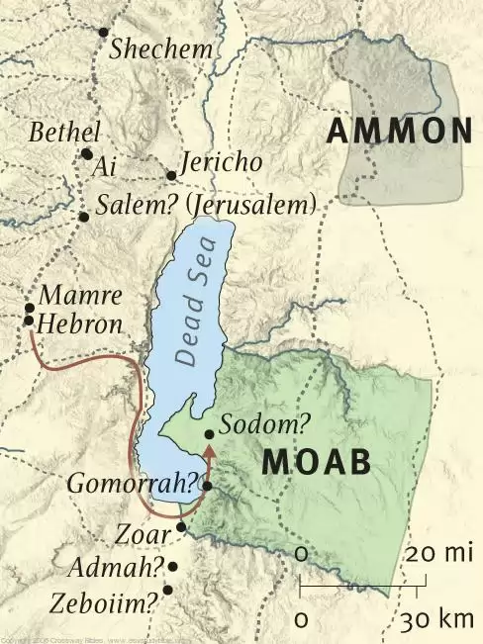
1. She was righteous 2. She was near Zoar

Slide 8
1. She was righteous 2. She was near Zoar
False love. Mt.16:24-26
Fatal love.
She looked…longed…lingered…lost.
Don’t put weight on world. 1 Co.7:29-31
So worried about lost possessions / family, she lost ALL
World meant more than God and salvation? Lk.12
“I was baptized…” Ac.26:28
Must choose Christ or . . .?

Slide 9
1. She was righteous 2. She was near Zoar
False love. Mt.16:24-26
Fatal love. 1 Co.7:29-31
Faded love. Rv.2:4-5
Family love.
Samson
David
Solomon
Gn.19:30-38

Slide 10
1. She was righteous 2. She was near Zoar 3. She enjoyed every advantage
Owned no Bible
Heard no preaching
No local church
Special knowledge of God confined to few favored families
Most lived in sin, ignorance…
Mrs. Lot had clear knowledge of God

Slide 11
1. She was righteous 2. She was near Zoar 3. She enjoyed every advantage
She died . . .
1. In best influences
2. In best company (Hb.13:2)
3. On best way (God’s way out)
4. Because of something ‘trivial’
5. Despite plain orders (17)
6. Despite clearest warnings (17): escape for your life!

Slide 12
1. She was righteous 2. She was near Zoar 3. She enjoyed every advantage
She belongs to large host . . .
Joab – David’s captain
Gehazi – Elisha’s servant
Judas – Lord’s disciple
Demas – Paul’s companion

Slide 13
1. She was righteous 2. She was near Zoar 3. She enjoyed every advantage 4. God’s word is firm
His warnings imply real danger
Ro.11:22
Lk.21:34-36
2 Pt.2:9

