Slide 1
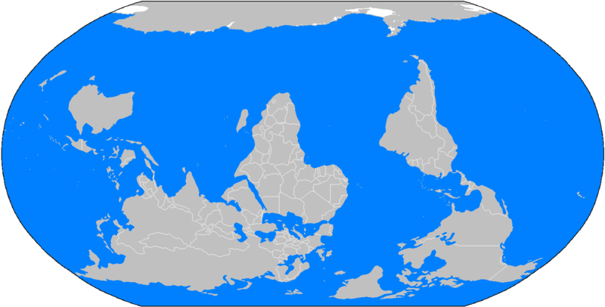
Acts 17:6
1 Kings 18:17
For us: Word settles issues
Others: it causes trouble
Three-legged stool: Reason, Revelation, Tradition
1. Reason: Is.1:18
2. Tradition: 2 Th.2:15; 3:6

Slide 2
Homosexuality

Slide 3
I. Homosexuality: What Does The Bible Say?

Slide 4
Genesis 18-19
On the way to Sodom, Gn.18:…16
Outcry, 20-21
Their sin is very grave, 20
Before chapter 19
Fact-finding mission, 18:21
Men went toward Sodom, 22

Slide 5
Abraham’s response to God’s wrath hanging over Sodom, 18:23-32
Destroy (18:23)
Righteous, too? (2 Pt.2:7-8)
Principle of justice: 18:25

Slide 6
Genesis 19, two angels
[1] “Angels” (19:1)
Men (18:1-2, 16, 22 . . .)
[2] Sodomites, 19:4-7
“Know” (19:5, 8; 4:1)
[3] Lot, the “judge” (19:9)
[1] “Men” rescue him (19:10)

Slide 7
N.T. Commentary # 1: 2 Pt.2:6-9 (Actual history)
Reduce to ashes, 6
Guilty verdict, 6 (consign to destruction)
Warning example for godless, 6
Righteous Lot, 7 (Gn.18:23); distressed
Extreme immorality; filthy / sensual conduct of unprincipled men [NASB], 7
Tormented in soul, 8 (harass)
Lawless, without regard to law, 8
Unrighteous, unjust, sinful, 9

Slide 8
N.T. Commentary # 2: Jude 7 (Actual history)
Sexual immorality
Strange flesh
Set forth as example
“Indulge in illicit sexual relations, debauchery”
Engage in unnatural sexual intercourse . . . Gn.19:8-9

Slide 9
N.T. Commentary # 3: Ro.1:18-32 (Actual history)
God’s wrath revealed against all – (18)
Not idolatry alone
“Nature” (25-26) based on creation (20)
Consensual, 27
Filled with all unrighteousness (29-32)
Practice, approve such things, 32
¹Ungodliness
²Unrighteousess

Slide 10
N.T. Commentary # 4: 1 Co.6:9-11 (Actual history)
God’s list of unrighteous people includes:
Homosexuals
Sodomites
“Paul’s strictures against same-sex activity cannot be satisfactorily explained on the basis of alleged temple prostitution” (BDAG)

Slide 11
I. Homosexuality: What Does The Bible Say?
II. Homosexuality: What Do Men Say?

Slide 12
1. “The sin of Gn.19 was rape, not homosexuality”
Ignores Gn.18: their sin already existed before the attempted rape
Ro.1:27, condemns consensual homosexuality, not merely rape

Slide 13
2. “Sins of Sodom (Ezk.16) do not mention homosexuality”
Ezk.16:50-52, abomination includes sexual transgressions
“Most of the Hebrew words translated ‘abomination’ have the meaning of ‘impure,’ ‘filthy,’ and ‘unclean’ – that which is foul-smelling and objectionable to a holy God” (Nel., 7)

Slide 14
2. “Sins of Sodom (Ezk.16) do not mention homosexuality”
Ezk.16:50-52, abomination includes sexual transgressions
Lv.18:22 (3, 24-30)
Lv.20:13 (23)
Illustration: Gn.6:5, 12 Mt.24
2 Pt.2 & Jd.7 confirm Genesis record

Slide 15
3. “Strange flesh (Jd.7) refers to angels, Gn.18-19”
Ignores Gn.18:20 –outcry; grave sin
Ignores 2 Pt.2:8 –‘day by day’ sins
Sodomites sought ‘men’: Gn.19:5,10

Slide 16
4. “Homosexuals are born, not made”
Biological predispositions do not authorize sinful behavior
Ro.1, not natural, therefore not born
1 Co.6:11, you were
“As opp. to what is monstrous, abnormal, perverse…that which is contrary to nature’s laws, against nature, Ro.i. 26 (Th., 660).

Slide 17
5. “We cannot define ‘man’ and ‘woman’”
Can we define “human”?
May we marry an animal?
May we marry a tree?
May we marry a child?

Slide 18
Bible condemns all sexual immorality
Immoral assumes moral
Includes:
Premarital
Extramarital
Homosexual
Bestial
Incest
Condemned:
Ep.5:3,5
Mt.19:9
1 Co.5:1
Hb.13:4
Jude 7
Sin
Judgment

