Slide 1
The Lion And The Lamb
Isaiah 11:1-10

Slide 2
Typical comments on Isaiah 11
“Since we don’t see this happening now, it must refer to a future millennial kingdom on earth”
“Describes conditions on earth in the coming kingdom age after Christ returns to earth” – Morris

Slide 3
Isa.11:1 – figurative language
Branch (1)? . . . Lion eats straw (7)?
Hb.1:1, variety includes figurative language
If all is literal . . .
Isa.2:1-4, mountain
Isa.40:3-5, no mountains
Isa.11:7, lion
Isa.35:9, no lions

Slide 4
Isa.11:1 – figurative language Isa.11:9 – kingdom
My holy mountain
Isa.2:1-3, as Dan.2:35, 44
“Kingdom age” is now–Acts 2
Gospel spread (Isa.11:9)–Col.1

Slide 5
Isa.11:1 – figurative language Isa.11:9 – kingdom Isa.11:10 – NT explanation
Paul quotes Isa.11:10
Ro.15 context: God accepts Gentiles
When? As Paul writes Romans
This age; not future millennium
And again, Isaiah says: “There shall be a root of Jesse; And He who shall rise to reign over the Gentiles, In Him the Gentiles shall hope” – Ro.15:12 [Mt.12:21]

Slide 6
I. Crowning Of The King, 1

Slide 7
Descendant of David
Ezk.34:23-25, Prince David
Priest and King
Zec.6:12-13, who?
No Levite king
No Judah priest
Hb.7: Jesus, after Melchizedek,
Priest – King

Slide 8
I. Crowning Of The King, 1
II. Character Of The King, 2-5

Slide 9
Revelation, Righteousness, Reckoning
2: Spirit (divine revelation). Jn.12:49
3: delight (righteousness). Mt.3:15
4: strike earth (Judge). Jn.5:22

Slide 10
I. Crowning Of The King, 1
II. Character Of The King, 2-5
III. Citizens Of The King, 6-9

Slide 11
Once brutal, 6-9
Now tame, submissive.
2 Pt.2:12, some reverted
Isa.11 refers to change of character when a person becomes a Christian.

Slide 12
1. Jews and Samaritans
John 4:9…
Luke 9:51-56
Ac.8:1-18
Before-After pictures of James and John
Before-After pictures of Samaritans

Slide 13
1. Jews and Samaritans 2. Jews and Gentiles, Ep.2
11-13: Gentiles’ past, present
14: Christ, our peace; no wall

Slide 14
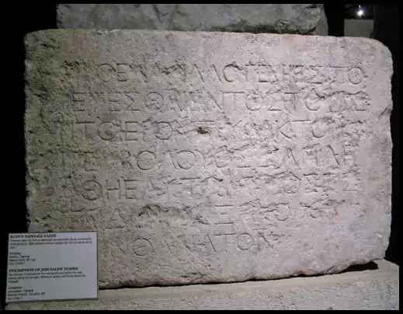
Jerusalem Temple: warning sign to Gentiles

Slide 15
1. Jews and Samaritans 2. Jews and Gentiles, Ep.2
11-13: Gentiles’ past, present
14: Christ, our peace; no wall
15: one new man (peace)
Is Christ our peace?
Did Prince of peace fail?
“It’s not that Christ has brought one up to level of the other, but that He has produced a greater, as if one should melt down one statue of silver and another of lead, and the two together should come out gold” - Chrysostom

Slide 16
1. Jews and Samaritans 2. Jews and Gentiles, Ep.2
11-13: Gentiles’ past, present
14: Christ, our peace; no wall
15: one new man (peace)
16: what, who, where, how of peace
What? Reconcile
Who? Both
Where? In one body (4:4)
How? Cross (Jn.12:32-33)

Slide 17
1. Jews and Samaritans 2. Jews and Gentiles, Ep.2
11-13: Gentiles’ past, present
14: Christ, our peace; no wall
15: one new man (peace)
16: what, who, where, how of peace
17: He preached peace
18: Jew and Greek access Father
19: fellow-citizens, one family (3:15)

Slide 18
1. Jews and Samaritans 2. Jews and Gentiles, Ep.2 3. No distinctions, Gal.3:26-29
In Christ: not distinctions of race, class, nationality, social status.
Laws do not change the heart; gospel does.
1. Mt.5:9, peacemakers radiate peace
2. Ep.2:17, Christians reproduce peace
3. Ph.4:7, in Christ, we receive peace

