Slide 1
God Is Great, God Is Good
Isaiah 40

Slide 2
Isaiah: Bible in miniature
Sixty-six chapters
2. Two parts: 39 + 27 chapters
3. Theme of 1-39: condemnation
4. Theme of 40-66: consolation
And behold, there was a man in Jerusalem whose name was Simeon, and this man was just and devout, waiting for the Consolation of Israel . . . – Luke 2:25

Slide 3
Isaiah 40:1-2
My people…your God (Ex.19:5-6)
Judgment for one nation…consolation for whole world
Her warfare is ended. Ro.8:37
Her iniquity is pardoned.
Double: fold over / in half; each matches; exact correspondence between sin and payment
Word of doom
39:5-7
Word of Comfort
to the heart, 40:1

Slide 4
I. Preparation For Coming Of Lord, 3-11

Slide 5
Is.40:3, preparation
30 day journey through desert from Babylon to Judea
The highway
Remove hills
Fill valleys
Straighten curves
Clear obstacles
John:
one man road crew
LORD, God (deity)
Mk.1

Slide 6
Is.40:3, preparation
OT: “A voice cries:
‘In the wilderness prepare the way of the LORD . . .’”
Emphasis on where to prepare
NT: “The voice of one crying in the wilderness . . .”
Emphasis on where the voice cries

Slide 7
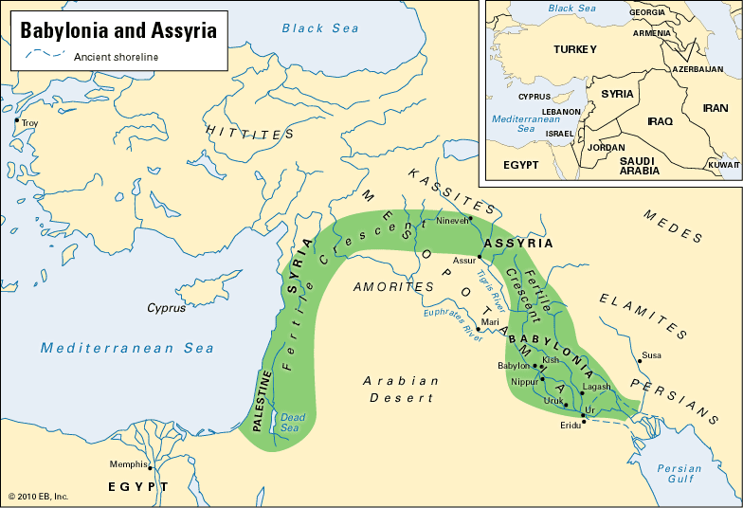
From Babylon To Judea
900 m.
500 m.

Slide 8
Is.40:4, problems
Building a road is much similar to the way God prepares hearts
Babylon (Cyrus) . . . Sin (Christ):
Expensive (Jn.14:6)
Presents variety of problems, challenges (Hb.5:8)
Requires expert engineer (Is.9:6)

Slide 9
Is.40:5, people
His glory will be revealed to prepared hearts, without regard to nationality
“All flesh”
Jesus – apostles
Jn.16:12-14;
Ac.2:39;
Ac.10
John

Slide 10
Is.40:6-11, proclamation
Frailty of man, 6-8: All flesh is grass: Mt.6:30
Don’t worry about opponents.
Permanence of God, His word, 8
“I, even I, am He who comforts you.
Who are you that you should be afraid
Of a man who will die…” – Is.51:12

Slide 11
Is.40:6-11, proclamation
Frailty of man, 6-8 (grass)
Don’t worry about opponents.
Permanence of God, His word, 8
Certainty of His message, 9a.
1 Pt.1:22-25
Subject of message, 9b-11: Behold your God!
Do I help people to behold God?

Slide 12
Is.40:6-11, proclamation
Behold your God!
Strong hand, to reward His own, 10
He comes as loving Shepherd, 11
Abel: slain shepherd
Jacob: working shepherd
Joseph: persecuted/exalted shepherd
Moses: called-out-from-Egypt shepherd
David: shepherd king

Slide 13
Is.40:6-11, proclamation
Behold your God!
Shows special care for lambs – youngest, weakest
Cradles them in His bosom, close to His heart

Slide 14
I. Preparation For Coming Of Lord, 1-11
II. Pertinent Lessons For People of Lord

Slide 15
1. Refuge, Isaiah 39:6-40:1
No refuge from God–only in God
Is.28:15 [16] 17. Hb.6:18
Comfort: God’s forgiveness, 2 (52:7; Ro.10:15; Ac.10)
Almighty arms that sustain the universe also gather lambs, 11

Slide 16
1. Refuge, Isaiah 39:6-40:1 2. God’s word never dies, 40:6-8
“Remember the Alamo!”
Written on perishable material
Copied for hundreds of years
Did not diminish style, accuracy
More MSS than any ten pieces of classical literature combined
Diocletian; Voltaire

Slide 17
1. Refuge, Isaiah 39:6-40:1 2. God’s word never dies, 40:6-8 3. Focus on God, not self, 40:9
Our faith must come from Scripture, not ourselves or other people

Slide 18
1. Refuge, Isaiah 39:6-40:1 2. God’s word never dies, 40:6-8 3. Focus on God, not self, 40:9 4. Jesus, our Shepherd, 40:11
Not power alone, but also love to save
Good Shepherd, Jn.10:11, sacrifices His life for flock
Great Shepherd, Hb.13:20: triumphs over every enemy
Chief Shepherd, 1 Pt.5:4: comes for His sheep

