Slide 1
Only One Church: How To Identify It?

Slide 2
The main things are the plain things
“There is one body and one Spirit, just as you were called in one hope of your call-ing; one Lord, one faith, one baptism; one God and Father of all, who is above all, and through all, and in you all” –Ep.4:4-7
“And He put all things under His feet, and gave Him to be head over all things to the church, which is His body, the fullness of Him who fills all in all” –Ep.1:22-23

Slide 3
I. We Can Read Of Church(es) In N.T.

Slide 4
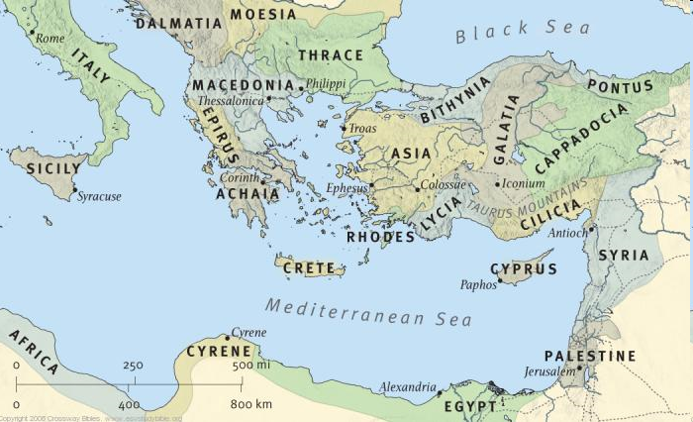
Phil.1:1
(4:15)
Local churches
Ro.16:16
Mt.16:18 “My church” (all the saved)

Slide 5
The Lord’s church in Jerusalem, Acts 2 – JEWS
The “church” in Jerusalem
(Ac.5:11, 14; 8:1)
This church was not a denomination
Standard: Word, 14; 22; 29, 33; 40, 41
Basis: Jesus’ life, death, resurrection, 22-24, 32. Exalted, 33-36
Conditions: repent, be baptized 38
Results: added saved together, 41, 47
Didn’t add to church w/o saving them
Didn’t save w/o adding to church

Slide 6
The Lord’s church in Samaria, Acts 8 – SAMARITANS
The “church” in Samaria
(as Jerusalem)
United; no denomination here either
Standard: Word, 4; 6; 14
Basis: Jesus, 5. Exalted, 12
Conditions: belief, baptism, 12
Results: church in Samaria, Ac.9:31

Slide 7
The Lord’s church in Corinth, Ac.18 – GREEKS
The “church” at Corinth
(as Jerusalem)
No denomination here either
Standard: Word, 4-5, 11
Basis: Jesus, 5. Exalted, 1 Co.1:12-13
Conditions: belief, baptism, 8
Result: church in Corinth, 1 Co.1:1-2
If we do what they did, we will be what they were
Do we still have the Word? …exalted Lord? …conditions? Why not same result? (Ac.2:39)

Slide 8
I. We Can Read Of Church(es) In N.T.
II. We Cannot Read Of ‘Denominations’ In N.T.

Slide 9
Denominational Practices: change with the times
“It is most likely that in the Apostolic age when there was but ‘one Lord, one faith, and one baptism,’ and no differing denom-inations existed, the baptism of a convert by that very act constituted him a member of the church, and at once endowed him with all the rights and privileges of full membership. In that sense, ‘baptism was the door into the church.’ Now, it is different...” – Hiscox, Manual for Baptist Churches, p. 22

Slide 10
Lord’s church at Jerusalem
R. Catholic Church
Methodist Church
What makes them denominational?
They joined: “now it is different”
They follow something besides NT
Church in Jerusalem
Lord’s church is not a denomination though separate from other groups
Presbyterian Church
Baptist Church

Slide 11
I. We Can Read Of Church(es) In N.T.
II. We Cannot Read Of ‘Denominations’ In N.T.
III. How To Identify The Lord’s Church?

Slide 12
1. Establishment: seed Lk.8:…11
300 satanic enemies
300 gospel preachers
Sow tares
Preach gospel
One crop
One product

Slide 13
1. Establishment: seed Lk.8:…11
300 denom. preachers
300 gospel preachers
Sow creeds
Preach gospel
300 denominations
One product

Slide 14
2. Doctrine: gospel Ac.2:42 (Mk.16:15-16)
“It is not enough, therefore, simply to throw out the name of Church, but judgment must be used to ascertain which is the true Church, and what is the nature of its unity… Our adversar-ies, therefore, if they would persuade us that they are the true Church must, first of all, show that the true doctrine of God is among them… since Paul declares (Eph.2:20) that the Church is ‘built upon the foundation of the Apostles and Prophets,’ it necessarily follows that any church not resting on this foundation must immediately fall” – Calvin, Schaff’s History…VIII, 454

Slide 15
3. Organization: congregation
“Paul and Timothy, servants of Jesus Christ, To all the saints in Christ Jesus who are in Philippi, with the bishops and deacons” –Phil.1:1 (4:15)
No larger organization found in NT
Do denominations look like this?

Slide 16
4. Worship: spiritual Ac.2:42
“Speaking to one another in psalms and hymns and spiritual songs, singing and making melody in your heart to the Lord” – Ep.5:19
“The custom of organ accompaniment did not become general until the eighteenth century” –Schaff-Herzog VIII, 258

Slide 17
5. Work
Jerusalem, Ac.2
Evangelism, 47
Edification, 42
Benevolence, 44f.
Antioch, Ac.11
Evangelism, 24
Edification, 23, 26
Benevolence, 27ff

Slide 18
6. Terminology: oracles of God
Universal church, but not “Catholics”
Baptism, but not “Baptist” church
Methods, but not “Methodist” Church
Bishops, but not “Episcopalians”
Elders, but not “Presbyterians”
Pentecost, but not “Pentecostals”
Holiness, but not “Holiness” Church
Last days, but not “Latter Day Saints”
Ac.11:26

Slide 19
Illustrated
Ac.11:21
Ac.20:7-8
1 Tim.3
1 Tim.4:15
Carl
Henry
Urma
Ralph
Carla
Harry
Is it a church “of” Christ?
They follow only the Bible . . . Is it a denomination?
Individually: *Christians* (Acts 11:26)
Collectively: *church* (Acts 11:26)

Slide 20
New Testament
Pharisees
Sadducees
Essenes
Philosophers
Judaizers

Slide 21
New Testament
Roman Catholicism
Lutheran
Anglican
Baptist
Methodist

Slide 22
Jn.17:20-21
Bitter division gave the world the right to disbelieve the Gospel – Schaeffer
The division between Rome and evangelicals was great, but it “seems almost trifling compared to the abyss which stands between us and many ministers of our own Church” – Machen

