Slide 1
What Does Faith Mean?
Habakkuk

Slide 2
Habakkuk Timeline
626 B.C.?
606 B.C.
597 B.C.
586 B.C.
Habakkuk
Babylon Dn.1
Babylon Ezk.1
Babylon Jer.
Hated iniquity; cried for judgment (1:2-4)
Hated injustice
Challenged God’s remedy for sin (1:12-2:1)

Slide 3
I. The Mess (Habakkuk’s complaint)

Slide 4
Sin everywhere…
People out of control; wicked surround righteous (1:3-4)
Even worse, God doesn’t care (1:2)

Slide 5
I. The Mess (Habakkuk’s complaint)
II. The Message (God’s comeback)

Slide 6
God is doing something
Armies of Babylon are on the move
Defeat Assyria, 612 BC
Defeat Egypt, 605 BC
Next . . . ?
Babylon’s assault, Hab.1:5-11
Cure worse than the disease
Habakkuk’s astonishment, Hab.1:12-2:1
How can God fellowship ungodly?

Slide 7
Babylon punishes Judah . . .
Politically
Physically (death; exile)
Socially
Economically (ch.3)
Spiritually (1:16-17)
Judah worships idols too.
Babylon is not worse than Judah.

Slide 8
I. The Mess (Habakkuk’s complaint)
II. The Message (God’s comeback)
III. The Meaning (God’s clarification, 2:4)

Slide 9
How can caring God use cruel Babylon to destroy chosen people?
Not because Babylon is righteous
Babylon is powerful: a temporary instru-ment of God’s judgment
Book of Judges
Assyria (Is.10)

Slide 10
Five Woes Against Babylon (Hab.2:6-19)
*God is great, 2:4*
1. Woe for a greedy nation, 6-8
2. Woe for misplaced trust, 9-11
3. Woe for violence and injustice, 12-13
*God is vindicated, 2:14*
4. Woe for shameful mistreatment, 15-17
5. Woe for idolatry, 18-19
*God is awesome, 2:20*

Slide 11
Habakkuk’s education (2:4)
⁴Behold the proud, His soul is not upright in him; But the just shall live by his faith.
⁵Indeed, because he transgresses by wine, He is a proud man, And he does not stay at home. Because he enlarges his desire as hell, And he is like death, and cannot be satisfied, He gathers to himself all nations And heaps up for himself all peoples.
1. ‘Un-faith’…faith…‘unfaith’
2. Not: begins w. faith, or part-time faith

Slide 12
Faith in Habakkuk 1. Faith does not disapprove God’s work
Pastime of Children of Israel, Ex.14:12
9/11 – Why did God let this happen????
If God must immediately destroy evil, He must rid world of people.
Blaming God makes you evil.
Should He start with you?

Slide 13
Faith in Habakkuk 1. Faith does not disapprove God’s work 2. Faith does not doubt God’s ways
Egypt insolated Israel from Canaan’s influence
Pharaoh’s oppression: deliverance should generate thanksgiving . . . and FAITH
W/o Babylonian exile: no Daniel . . .
Is.55:8-9
Habakkuk had to change, not God

Slide 14
Faith in Habakkuk 1. Faith does not disapprove God’s work 2. Faith does not doubt God’s ways 3. Faith does not deny God’s wisdom
“God, you don’t know what you are doing!”
Jonah – spare Nineveh!?
Peter – not spare Christ!? (Mt.16:22)
What should we do? Ro.11:33-36
Faith must be nurtured. Ro.3:8

Slide 15
Faith in Habakkuk 1. Faith does not disapprove God’s work 2. Faith does not doubt God’s ways 3. Faith does not deny God’s wisdom 4. Faith does not disobey God’s word
His judgment against Judah did not nullify His promises to Abraham
Israel’s sins posed greater threat than Babylon’s soldiers
Exile produced a faithful remnant
TRUST ME! (2:4)

Slide 16
NT Fulfillment
1. Ro.1:17, the just (righteousness of God): 36x in Romans.
Gentiles! 1:13, 16
2. Ga.3:11, shall live (not just physical deliverance, but spiritual. V.12; 2:19
Live – saved, but not by Law, v.12; 2:19
3. Hb.10:38, by faith
New army would soon march (AD 66-70)
Their sins pose greater threat than Rome

Slide 17
Prophet’s change of heart (Hab.3:16-19)
Though my 401-k goes under…banks crash…social security collapses… insurance company folds…business fails …can’t find a job…food is scarce… our enemies are planning an attack . . .
Lord still sits on His throne. I rejoice.

Slide 18
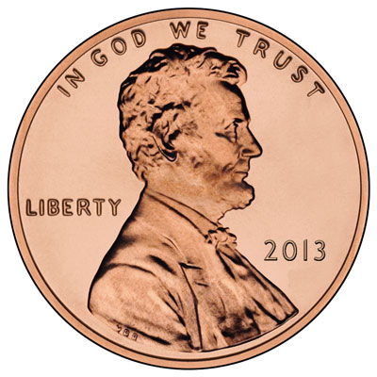
Faith
Abraham, Gn.22 (Ro.4)
Israel, Ex.14
Sailors, Mk.6
Peter, Ac.12
Paul, 2 Tim.4

