Slide 1
‘In The Wilderness’

Slide 2
Numbers = In the wilderness
Nu.1: the combatants.
This chapter is . . .
long
repetitive
lists (dates, draft totals)
Nu.2: the camp.
Easy part; not at war

Slide 3
I. The Certainty

Slide 4
Real people, places, things
A fraud would not go to so much trouble
46, soldiers: 603,550 – suggests national total of two million or more
46, multitude of fighters (not counting women, children, old)
Would uninspired Jewish author kill off so many because of unbelief?

Slide 5
I. The Certainty II. The Camp, Numbers 1

Slide 6
When God speaks . . .
Lord spoke to Moses, 1:1
Thirteen months after exodus, 1:1 (Ex.40:17)
Lord did not . . .
let him direct own steps, Je.10:23. Ac.16
make suggestions

Slide 7
Every person is important, 1:2
Lk.19:33, colt
Jn.6:8, boy
Jn.19:38-42, tomb
1 Co.12, members

Slide 8
What happened to Reuben? 1:20
Reuben lost right of firstborn, 1:20; 1 Chr.5:1-2
Nu.32:23 . . . Ro.6:23

Slide 9
Joseph: double portion, 1:32-35
Loyal in horrific circumstances; now receives greater reward
Elevated from lowest position…
Our present joy in serving Christ can’t compare to heaven.…

Slide 10
Great numbers, meager results, 1:46
Few entered Promised Land.
We cannot trust numbers (2 Sm. 24).
‘Playing church’ in wilderness will not get us to Promised Land. 1 Co.10; Hb.3-4.

Slide 11
No trespassing, 1:51-53
Levites don’t fight; they do bless.
‘Outsider’ includes Jew of another tribe. Ex.19:11-13.
Mt.5:23-26, bad blood.
Protected others from drawing near unprepared. Hb.13:17.

Slide 12
They obey, 1:54
2:2, rally round the flag.
Safe if they remove...
envy. Nu.16
work for common good. 1 Co.3: 1-3; 11
Reverence blesses, rebellion judges

Slide 13
Judah: the blessing, 1:26-27
Largest tribe, 1:27 (74,600 men)
First place, 2:3-7 (Gn.34; 44)
Gn3
Gn.49:8-10
2 Sm.7. . .Lk.1. . .
Rv.5:5

Slide 14
Orderly camp / marching, 2:1-31
2:…9, 16, 24, 31
10:1-10, trumpets signal orders.
Not God of confusion in . . .
Congregation, 1 Co.14:40; 14:8
Conduct, Col.2:5
10:11-28
Left Egypt as mob; now, organized nation

Slide 15
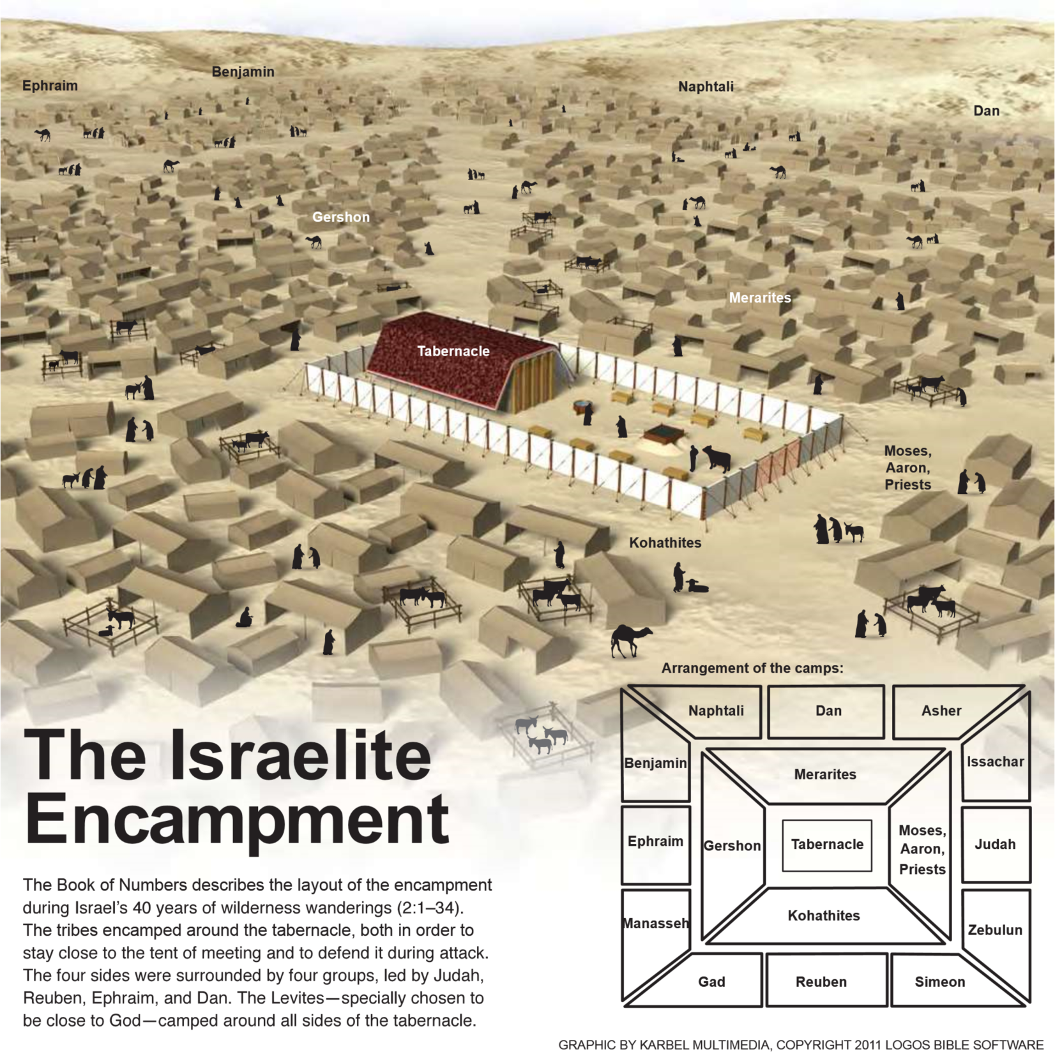

Slide 16
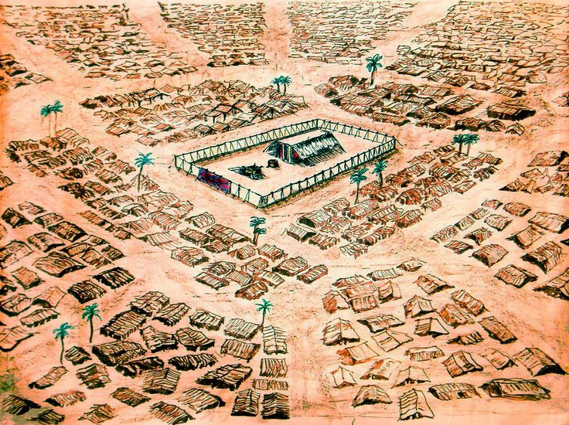

Slide 17
I. The Certainty II. The Camp, Numbers 1 III. The Center, 2:1-31 . . .

Slide 18
Ark of covenant, 2:1-31
God in their midst (2:17). Dt.20:1
OT promise: Ex.6:7; 2 Co. 6:16.
Immanuel, Mt.1:23. Jn.1:14.
1 Co.10:4 Rv.21:1-3.
God is their Leader, 17; ch.10.
Follow those in the lead. 1 Co.11:1
He became Man and walked here that we may become like Him and walk there

Slide 19
Levites, 3:2
Nadab, Abihu – a reminder
Everyone in his place –
Gershon, 3:23, 25
Kohath, 3:29, 31
Merari, 3:35-36
Moses and priests, 3:38
Levites, 22,000 (3:39)
1 Chronicles 13

Slide 20
Numbers 10:11-28

Slide 21
Application
We also are God’s people in transi-tion (Gal.6:16) – left sin, not yet in heaven.
What happened to Israel can happen to us, Hb.3. (Mt.7:13-14)
We invite others to journey with us, Nu.10:29.
Do not get on wrong side of God, Nu.10:35-36. Ro.11:22.

