Slide 1
Wavering In The Wilderness
Numbers 13-14

Slide 2
I. Location

Slide 3
Reached Promised Land, turned away
12:16 . . . 13:1
LORD spoke (usual formula) (13:1)
Exciting word of hope: Promised Land
God kept His promise
Wilderness of Paran (12:16)

Slide 4
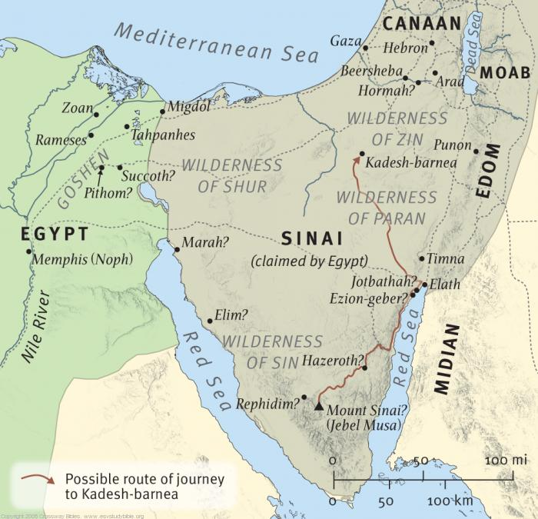
Reach their goal

Slide 5
Comparison: Nu.13:1-2; Dt.1:19-23
LORD gives order, 13:2
Moses agrees (Dt.1:22-23)
Israel’s original idea: send spies (22)
‘Moses sent them…according to the command of the LORD’ (Nu.13:3)
[‘at the mouth of JHVH’]

Slide 6
LORD gives order (13:1-2)
He knew weakness and unbelief of His people, but granted their request
He knew their fickleness
If Israel rebels. . .do it in wilderness
Blasphemy: will not believe God unless 12 spies confirm it
How to pray. Mt.6:10; 26:39
2 Co.12:2-3

Slide 7
I. Location II. Leaders

Slide 8
13:2, spies
Confirms God’s description of Land
Gift exceeds claim
13:4-16
We know two names…
*Unbelievers are out of place
*Book of life, Ex.32:32-33
*Prepared place for prepared people, 2 Pt.1:10-11

Slide 9
I. Location II. Leaders III. Land, 17-26

Slide 10
Open house (17)
Truth does not fear investigation
Land, people, cities, fruit, 40 days, 18-26
Courage, 20
Travels, 21-22

Slide 12
Open house (17)
Truth does not fear investigation
Land, people, cities, fruit, 40 days, 18-26
Courage, 20
Travels, 21-22
One cluster, 23

Slide 13
‘One cluster of grapes’ (13:23)

Slide 14
Open house (17)
Truth does not fear investigation
Land, people, cities, fruit, 40 days, 18-26
Courage, 20
Travels, 21-22
One cluster, 23
Forty days / 500 miles

Slide 15
I. Location II. Leaders III. Land IV. Lamentation, 13:27-14:4

Slide 16
Spies state facts, 27
‘However. . .’ (small print), 28-29
GIANTS! …no vacancy; fortified; Anak
‘What God said is true, BUT…’ ? ? ? ?
Ro.3:4
Caleb quieted people (30): implies violent reaction
Power of words for good or evil

Slide 17
Spies state facts, 27
‘However. . .’ (small print), 28-29
Power of words for good or evil
Caleb: ‘We are well able’ → faith (30).
View circumstances through God.
God can! Ro.16:20
Spies: ‘We are not able’ → unbelief (31).
View God through circumstances.
Can God?

Slide 18
Spies state facts, 27
‘However. . .’ (small print), 28-29
Faith admits truth (tall people, walls, etc.) . . .
but they are no match for God. Ro.8:31
Younger generation conquered Canaan… Hb.11:30

Slide 19
A bad report, 32
Exaggeration, 33 – God is liar (an inten-tional attack against faith)
Dt.19:16-19, false witnesses
Unbelief (Hb.3) –
Talked themselves out of Promised Land
God says it, but that does not settle it

Slide 20
Cause and effect (14:1)
Lying words → Unbelief
Ro.10:17; 1 Co.15:19
Unbelief → Complaining (v.2)
Back to Egypt: time dulls bad memory
“Die in wilderness” – folly of unbelief

Slide 21
Back to Egypt (14:3-4)
God: the One who brought you out of Egypt
Unbelievers turn His glorious victory into painful failure
They reject –
God’s Lessons, 3. Pharaoh was right…
God’s Land, 3. Neh.9:17; Ro.6:20-23
God’s Leaders, 3-4. Lk.10:16

