Slide 1
A Day That Changed Lives

Slide 2
I. Crucifixion Day Confusion

Slide 3
Amazing things happen (1)
1.Human judges condemn Judge of man, Mt.27:3
2. Creatures reject Creator, Mt.27:12-14
3. Giver of life, dies, Mt.27:15-23

Slide 4
Amazing things happen (2)
Nature responds
1. Sun, Mt.27:45
2. Veil, Mt.27:51
3. Earthquake, Mt.27:51
4. Tombs, Mt.27:52

Slide 5
Amazing things happen (3)
Lord reacts to His enemies –
1. Prays for their forgiveness, Lk.23:34
2. No retaliation, Lk.23:35-38
3. Complete trust in God, Lk.23:46

Slide 6
I. Crucifixion Day Confusion II. Crucifixion Day Corrections

Slide 7
Judas, Mt.27:1-5
Betrayed Jesus
If anyone knew flaw in His character…
Dying words declare Lord’s innocence
Love of money surpassed love for Christ
Sin made him hate money he coveted
He could not undo his deed
1 Tim.6:10

Slide 8
Simon of Cyrene, Mk.15:21
Cyrene: large city in North Africa (Libya); modern Tripoli; many Jews

Slide 9
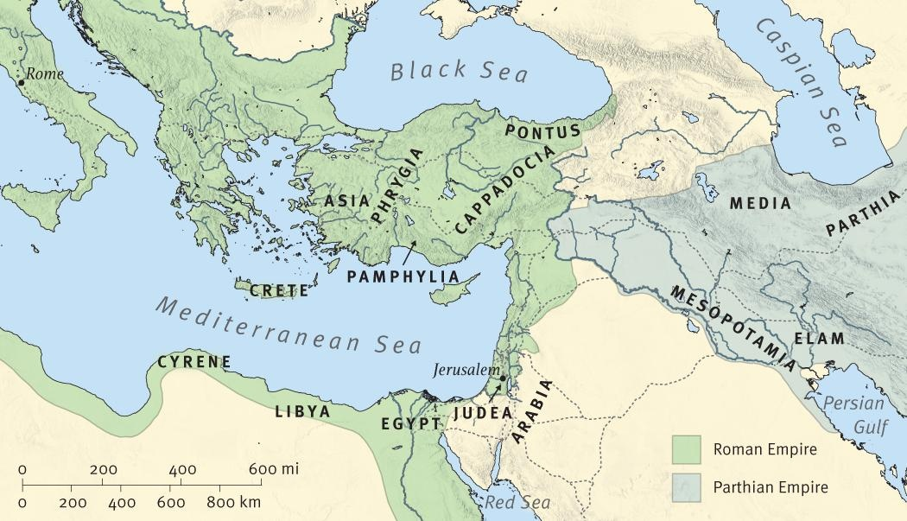
Simon of Cyrene

Slide 10
Simon of Cyrene, Mk.15:21
In Jerusalem for Passover?
Jesus struggled, Jn.19:17
Officer forced Simon to help, Mk.15:21 (Mt.5:41)
Mark implies that Simon did more than required . . .
Mt.16:24
Ro.16:13

Slide 11
Robber, Lk.23:39-43
Both robbers blasphemed, Mt.27:44
One repented, Lk.23
Mk.2:10, power on earth to forgive; Ac.2, great commission
What victim ever promised another victim salvation in Paradise?
Greatest display of mercy . . .
PARDON
PARADISE

Slide 12
Roman Centurion, Lk.23:47
His job: crucify three men
Mk.15:39
Became increasingly impressed with middle-man
How many times had he . . .
Heard one pray for tormentors (34)?
Heard one pray as Jesus did (46)?
Seen such wonders? Jn.12:32

Slide 13
Roman Centurion, Lk.23:47 (Mk.15:39)
His conclusions
Righteous, 47
A son of God, Mk.15:39
Demons confess it, Mk.1:24
Common people know it, Mk.12:37
Religious officials can’t see it
Executioner finds Him without fault

Slide 14
Curious Spectators, Lk.23:48
Of spectators in public games
Days before: Hosanna!
This morning: Crucify Him!
This evening: Beat their breasts…
‘Came to see a show; left with feelings of woe’
God’s sign language convicted their conscience. Lk.18:13 . . . Ac.2:37

Slide 15
Supreme Court Judges, Jn.19:38-42
Joseph, 38. Mt.27:57; Is.53:9
Secret disciple; feared Jews, Jn.19:38
Identified himself with Jesus
Nicodemus, 39-40
100 lbs.: blend of myrrh and aloes for burial
Peter’s boasting fell short
Secret disciples summoned courage
Defiled during Feast
Cross of Christ overcame
Might of money
Pressure of popularity
Power of position

Slide 16
Jesus’ brothers, Ac.1:13-14
Unbelievers, Jn.7:4-5
Believers, 1 Co.9:5; 15:7

Slide 17
Conclusion (1)
1. Amazing restraint of writers.
John 20:25
Writers focus on His death for our salvation

Slide 18
Conclusion (2)
In entire scene, Jesus is in control –
Not Jews
Not Romans
Not crowds
Just as true today

Slide 19
Conclusion (3)
God took worst thing that man could do to His Son and transformed it into best thing He could do for us
How does it affect us?
Forgiveness is our business
Live to give. 2 Co.9:7
Attitude of gratitude. Psalm 100

