Slide 1
Why Are So Many Lost?

Slide 2
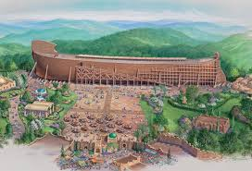
“Do you really believe so many are lost?”
Mt.7:13-14, many vs few
Mt.22:14, many called; few chosen
Lk.13:23-30, not about numbers
1 Pt.3:20, when few was eight
Just your little group?
Lord’s church

Slide 3
I. People Are Not Lost Because…

Slide 4
1. God does not love them
Jn.3:16, world . . . whosoever . . .
But we see Jesus, who was made a little lower than the angels, for the suffering of death crowned with glory and honor, that He, by the grace of God, might taste death for everyone – Hb.2:9

Slide 5
1. God does not love them 2. They cannot understand Bible
Ep.3:3-5
NKJV: 7th grade level
First principles understood on first hearing
Acts 2
Acts 8
Acts 16

Slide 6
1. God does not love them 2. They cannot understand Bible 3. They cannot overcome sin
³For we have spent enough of our past lifetime in doing the will of the Gentiles—when we walked in lewdness, lusts, drunkenness, revelries, drinking parties, and abominable idolatries.
⁴In regard to these, they think it strange that you do not run with them in the same flood of dissipation, speaking evil of you – 1 Pt.4:3-4

Slide 7
1. God does not love them 2. They cannot understand Bible 3. They cannot overcome sin 4. Bible or believers say it the wrong way
for all have sinned and fall short of the glory of God – Ro.3:23
For the wages of sin is death... – Ro 6:23

Slide 8
I. People Are Not Lost Because…
II. People Are Lost Because…

Slide 9
1. They do not love God
Jn.14:15, command
1 Jn.2:15-17, choice
Possessions, Mt.6:24 (Gn.29:30f)
A hate
B love
B’ loyal
A’ despise

Slide 10
1. They do not love God
Jn.14:15, command
1 Jn.2:15-17, choice
Possessions, Mt.6:24 (Gn.29:30f)
Parents, Mt.10:37 (22:37)
Practice, Lk.11:42
Praise, Jn.12:42-43

Slide 11
1. They do not love God 2. They do not study His Word
Mt.22:23-29
I’m religious; nothing else matters
I’m satisfied as I am
I’m a good moral person
I wouldn’t swap my feeling for a stack of Bibles
Acts 17:11

Slide 12
1. They do not love God 2. They do not study His Word 3. They are preoccupied with pleasures of sin
Lk.8:14
Two dangers:
1. Sinful pleasures. Ro.1:32
Those who applaud sin, ridicule repentance

Slide 13
1. They do not love God 2. They do not study His Word 3. They are preoccupied with pleasures of sin
Lk.8:14
Two dangers:
1. Sinful pleasures. Ro.1:32
2. Scriptural pleasures. 2 Tim.3:4
Mt.7:13-14, narrow, restricted, strait

Slide 14
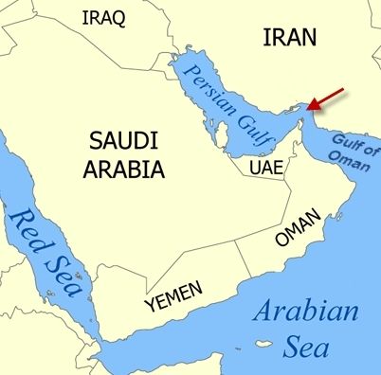
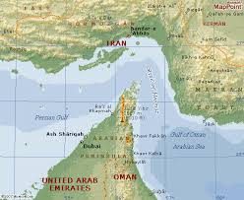
Strait of Hormuz

Slide 15
Results of choices
When we choose a road, we choose its destination (Mt.7:13-14)
If we work for sin, we receive its wages (Ro.6:23)
To sow seed is to reap its harvest (Gal.6:7-8)

