Slide 1
Moses’ Worst Enemy In The Wilderness
Numbers 20

Slide 2
After Korah’s rebellion . . .
God chose Aaron…again, Nu.17.
No more complaining, 5, 10.
We have less reason to complain…
10, Hb.9:4, once for all…
13, finally understand need for priest.
Support for priests and Levites, Nu.18
Value of priests seen in offerings, Nu.19

Slide 3
When Moses became his own worst enemy (Nu.20)
1. Accurate picture – no touch-up.
2. Agonizing passage – will mention it again and again.
3. Alarming possibility – ‘there but for the grace of God go I.’

Slide 4
I. A Sorry Sight

Slide 5
History repeats
Wilderness of Zin (1). [Spies, 13:21]
Kadesh: on border (16).

Slide 6
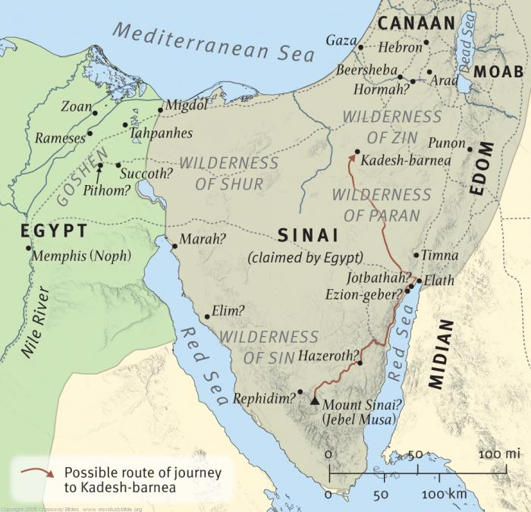

Slide 7
History repeats
Wilderness of Zin (1). [Spies, 13:21]
Kadesh: on border (16).
Miriam (NT: Maria, Mary)
Saved Moses’ life, Ex.2
Secured nurse, Ex.2
Sang praise to God, Ex.15

Slide 8
History repeats
No water (2). [Ex.17]
They react as before. Bad habits…
An undeniable concern
An unruly crowd
An unholy conduct

Slide 9
History repeats
Overstatement (3): usual for Israel
Wish they were dead?
STATEMENT:
Capital punishment is better than following Moses
SITUATION:
Death sentence; no use for deferred gratification

Slide 10
History repeats
Always someone else’s fault (4): they blame their benefactors
“Why have YOU brought us…?”
Nu.13-14 – blame only themselves; got their wish.
Nu.16 – still don’t get it.
‘This wilderness’ . . . WHY?

Slide 11
History repeats
This evil place (5): courtesy of ten spies and people’s unbelief (Nu.14)
Opportunity to show God’s goodness . . . again (6)
Nothing unusual: whiners complain (7)
We don’t expect Moses to vent his pent-up anger (Nu.12:3)

Slide 12
God said (7-8) | Moses did (9-11)
1. Take rod | 9, did as commanded
2. Gather congregation | 10, did so
3. Speak to rock x x | 10, spoke to people; struck rock
PROPOSED RESULTS | ACTUAL RESULTS
1. Yield water | 11, water came out
2. You will bring water | 11, abundantly
3. Give drink | 11, they drank

Slide 13
Moses’ sin (10-13)
Moses mentions his and Aaron’s role (cf. v.8) but not God’s
God said:
You did not believe Me (12): (Moses no better than others, 14:11!)
You did not hallow Me. Ps.106:32-33
Water of Meribah (contention; arguing)

Slide 14
I. A Sorry Sight II. A Sad Sin
Moses (greatest prophet) fell
1 Co.10:…12 – Moses too?
What can we learn from Moses’ sin?

Slide 15
1. All his past work / sacrifice cannot undo his sin
Like others, he can be forgiven, but consequences remain
David

Slide 16
2. It was right to strike the rock last time (Ex.17)
“God had ordered it, so striking the rock is Scriptural.”
We must obey God – Dt.4:2.
Those who change His commands elevate themselves above God
We lack wisdom to know why God commands what He does

Slide 17
2. It was right to strike the rock last time (Ex.17)
We act in faith, not assumption
IF Ex.17 pictures Jesus, the Rock, 1 Co.10:4 . . .
He is struck [sacrificed?] to give us Water of Life (Jn.4) . . .
The Rock is struck only once.
Nu.12:11, strikes Rock again (after He has been struck / sacrificed)
Is.53:4; Zec.13:7; Mt.26:31; Hb.9:26

Slide 18
2. It was right to strike the rock last time (Ex.17)
A humble, contrite heart does what(ever) God says because He says it. PERIOD!
“They had IM in OT; so can we.”
Issue: what does Lord tell us? (Hb.1:1-2; Mt.17:5)
Where does our covenant authorize it?

Slide 19
3. Difficult circumstances (1-10): “people drove me to it”??
After 40 years with Israelites, Moses had PTSD? (Ps.106:32)
“The devil made me do it!”

Slide 20
4. Moses, victim of tongue abuse, unleashes his tongue in anger
Nothing good EVER comes from it.
If anyone among you thinks he is religious, and does not bridle his tongue but deceives his own heart, this one’s religion is useless – James 1:27

Slide 21
5. Moses fell in his strong points
Num.12:3
1 Co.10:12 . . . Pr.16:18
Samson…strongest man
David…man after God’s own heart
Solomon…wisest man
Peter…willing to die for Christ

Slide 22
6. Striking the rock worked
Water came out
Mt.5:45
God still blesses unjust with water…
Spiritual blessings are in Christ, Ep.1:3.

Slide 23
I. A Sorry Sight II. A Sad Sin III. A Sudden Stop

Slide 24
Aaron’s death (22-29)
22: thirty-eight years of movement without progress
23-26: rebellion: will not enter Canaan
25, recalls Gn.25:8; 2 Sm.12:23
27-29, every leader is expendable
God lives on
Moses knows his time is coming, too
So is ours

Slide 25
Aaron’s death teaches:
1. Leaders are not perfect.
2. Leaders’ faults are on display.
3. Momentary lapses can produce serious consequences.
A few seconds destroyed forty years of work

Slide 26
Aaron’s death teaches:
1. Leaders are not perfect.
2. Leaders’ faults are on display.
3. Momentary lapses can produce serious consequences.
4. Failure need not be the last word with our merciful God.

Slide 27
Numbers 20: saddest chapter?
1. Miriam dies at beginning; Aaron at end; Moses fails in middle.
God is greater than death and failure. Romans 8.

Slide 28
Numbers 20: saddest chapter?
1. Miriam dies at beginning; Aaron at end; Moses fails in middle.
2. Moses’ sin was not presumptuous, but he could not enter Canaan.
3. Moses’ day came – Mt.17.
* Moses did not rebel or complain…
* He kept leading, teaching, preparing next generation…though he had no hope of going in with them.

