Slide 1
A Bronze Thing In The Wilderness
Numbers 21

Slide 2
Feet from Canaan’s border, Nu.21:4
Forced to take long way around
Discouraged.

Slide 3
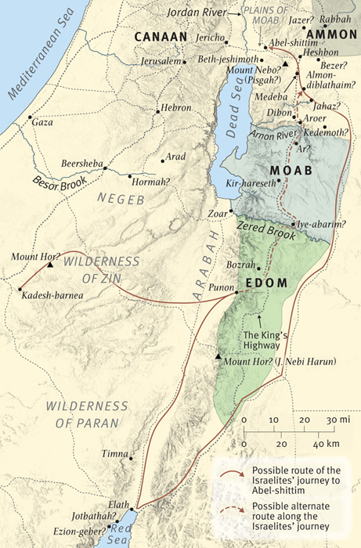
Delayed by road block / detour (away from King’s Highway)
Delayed by road block / detour (away from King’s Highway)
Nu.20:14-21; Dt.2:1-3…8
Going toward Red Sea. . .in 40th year
Dt.2:1-3…8
Going toward Red Sea . . . In 40th year!

Slide 4
Feet from Canaan’s border, Nu.21:4
Forced to take long way around
Discouraged. Must remember –
They are on the right way.
God is with them.
There is no other way to Canaan.
It is worth it.
When tired and discouraged, you are more at risk. Sin makes it worse

Slide 5
Final grumbling, Nu.21:5
Spoke against God and Moses, (5)
No bread or water – exaggeration
Despise God’s provisions
Worthless: miserable, ‘good for nothing’
God sent fiery snakes; many died (6)
‘We sinned’; ‘take them away!’ (7)
Moses prayed for the people

Slide 6
First aid for snake bite, Nu.21:8-9
1. Make fiery (bronze) serpent
2. Set it on pole
3. Whoever looks will live
So What?

Slide 7
I. An Instrument To Save, Nu.21

Slide 8
The Usual Objections
1. “A piece of bronze cannot save; Lord does”
Rabbis: God, not the snake, saved
Confuses Savior with His own means
FALSE CHOICE
“Lord saves, not faith”??
“Blood saves, not faith”??
HE SAVES ONLY THOSE WHO LOOK

Slide 9
The Usual Objections
1. “A piece of bronze cannot save; Lord does”
2. “No first aid book would recommend it”
First aid book cannot explain, under-stand, or produce a miracle of healing
First aid book cannot save from sin
God’s way worked

Slide 10
The Usual Objections
1. “A piece of bronze cannot save; Lord does”
2. “No first aid book would recommend it”
3. “Not only illogical, but foolish”
Of course; that’s why it’s a test of faith
If it appeals to our senses, it would not be a test
1 Co.1:18, 21, 23

Slide 11
The Usual Objections
1 Corinthians 1:
¹⁸For the message of the cross is foolishness to those who are perishing, but to us who are being saved it is the power of God ²¹For since, in the wisdom of God, the world through wisdom did not know God, it pleased God through the foolishness of the message preached to save those who believe ²³but we preach Christ crucified, to the Jews a stumbling block and to the Greeks foolishness

Slide 12
Truth vs Error
Ex.12; 2 K.5; Jn.9; Ac.2, etc.
False prophet advises Israelite dying of snake bite –
“Just believe; you can look later”
“Looking nullifies God’s grace”
“Chariot may run over you on way”
“Hypocrites around the pole”
“Snakes are still here; it’s hopeless”

Slide 13
Truth vs Error
If there is one thing a sinner must do, someone can pose a problem to hinder it
If there is nothing a sinner must do, all are saved unconditionally (universalism)
Both make nonsense of the snake and of God’s requirements

Slide 14
I. An Instrument To Save, Nu.21 II. An Idol To Shatter, 2 K.18:4

Slide 15
Fallen men make idols of almost every good thing: 2 K.18
‘Covetousness’ (Col.3:5) may include–
BEAUTY…BRAWN…BODY…BOOKS
Catholicism: idolize cross, burial cloth…
Better off if they were destroyed
2 K.18:4, this ‘bronze thing’ –
High antiquity
Undoubted authenticity
Work of Moses himself
Once had miraculous powers . . .
DESTROY IT!

Slide 16
Fallen men make idols of almost every good thing: 2 K.18
‘Such was the venom of the Israelitish idolatry, that the brazen serpent stung worse than the fiery’
Some idolize good things –
Church building (Jn.4; Hb.10; Ac.19:9; 20:8; Ja.2)
NT MSS
Education
Possessions

Slide 17
I. An Instrument To Save, Nu.21 II. An Idol To Shatter, 2 K.18:4 III. An Illustration To Symbolize, Jn.3

Slide 18
John 3:14
As . . . So: type-antitype parallel
Bronze serpent on pole (type)
Crucified Savior on cross (antitype – ‘corresponding likeness’)

Slide 19
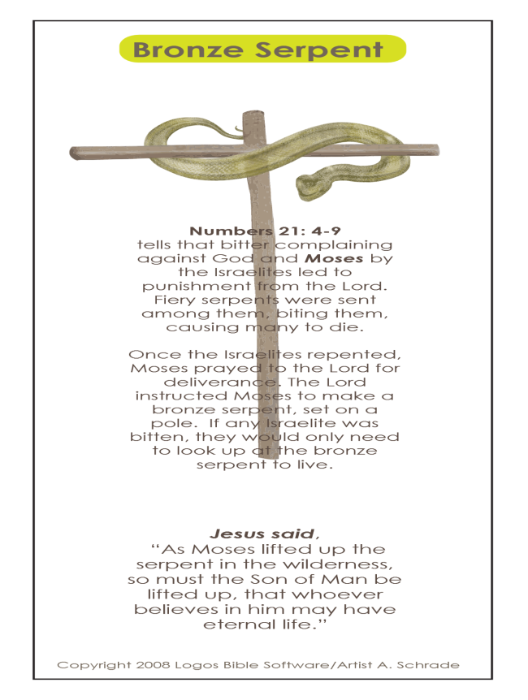
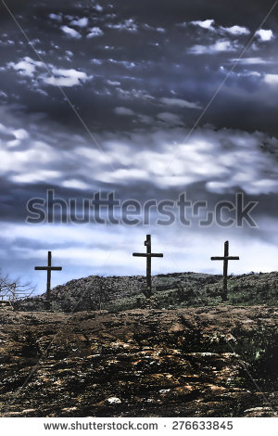
John 3:14
corresponding likeness
TYPE
ANTITYPE

Slide 20
John 3:14
As . . . So: type-antitype parallel
Bronze serpent on pole (type)
Crucified Savior on cross (antitype – ‘corresponding likeness’)
Must (as 3:7; 4:4): necessary
Lifted up (cross, 12:32)

Slide 21
John 3:14
Jesus to Nicodemus:
“You expect to see the Messiah raised on glorious throne, breaking the Roman yoke from Jewish nation and leading them on to conquer their enemies . . . Brace yourself for a shock . . .”

Slide 22
Bronze serpent must go through fire
For to this you were called, because Christ also suffered for you, leaving you an example, so that you might follow in his steps – 1 Pt.2:21
Beloved, do not think it strange concerning the fiery trial which is to try you, as though some strange thing happened to you; ¹³ but rejoice to the extent that you partake of Christ’s sufferings, that when His glory is revealed, you may also be glad with exceeding joy – 1 Pt.4:12-13

Slide 23
John 3:15
Whoever believes
No mere mental act would save from bite . . . or from sin
Jew sits under tree believing . . .
Lord’s parallel destroys ‘faith alone’ (vv.3, 5, 36)
36:
Unconditional?
Unchangeable?
believes
has eternal life
not obey
shall not see life

Slide 24
John 3:16
God so loved
World (Jn.12:32)
Gave only Son (cf. 14)
Whoever believes (cf. 15)
Should not perish…everlasting life

Slide 25
Why compare deadly snake to Jesus, not satan (Gn.3; Rv.12)? (1/3)
1. Snakes killed sinful Jews; sin kills sinful world. Ro.3:23; 6:23
2. God provided remedy. Is.52:13; 2 Co.11:2-3
3. Good news had to spread. Mk.16
4. Remedy visibly displayed: lifted up on pole / cross

Slide 26
Why compare deadly snake to Jesus, not satan (Gn.3; Rv.12)? (2/3)
5. Cure resembled disease.
Bitten by snake; healed by its likeness
By man came death; by Man, life, Ro.5; 8:3
6. Bronze snake: no venom; Jesus, no spot or blemish, 1 Pt.1:18-19
7. Israelite cured by looking; sinner, by faith
8. Stumbling-blocks to human reason, but not to faith. 1 Co.1:18

Slide 27
Why compare deadly snake to Jesus, not satan (Gn.3; Rv.12)? (3/3)
9. Both were effective: cured / saved
10. Only one serpent; one Savior, Ep.4:5
11. Both were only way to be saved, Jn.14:6
12. God did not remove snakes (v.7); Jesus did not remove satan (Gn.3:4; Rv.12:9).
We live in world of snakes, but also in the grace of God.

