Slide 1
Buyer’s Remorse In The Wilderness
Numbers 22-24

Slide 2
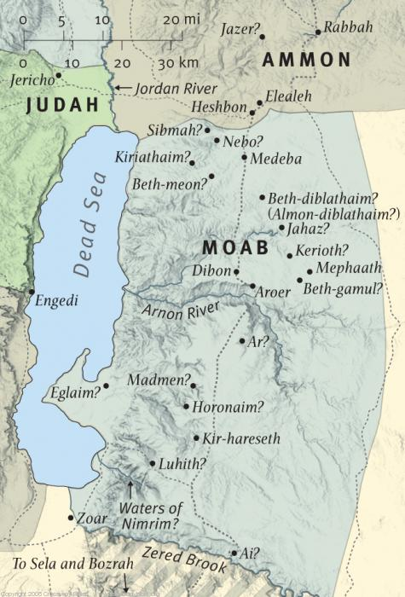

Slide 3
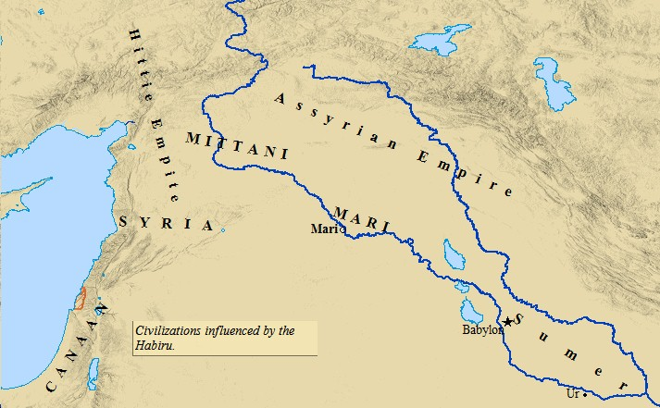

Slide 5
I Real Issue: Power Of God

Slide 6
The Usual treatment of Nu.22
1. “Who was Balaam?”
2. “How could a donkey talk?”
Real issue: God’s destruction of Egypt terrified surrounding nations
Ex.15:14-16
Balak’s fear is reason we know Balaam

Slide 7
The Usual treatment of Nu.22
Israel’s faith in God surpassed heathen superstition
Text does not call Balaam prophet
Soothsayer: Nu.23:23; Josh.13:22
The contest:
2 Pt.2:16, ‘prophet’ – what he became
God’s promises
Gn.12
Balaam’s magic
Dt.23:4-5

Slide 8
I Real Issue: Power Of God II No One Can Change God’s Word

Slide 9
No reverse
Greatest prophet / sorcerer in world cannot reverse God’s blessings.
Gn.12. Ga.3; 6:7-8
Greatest prophet / sorcerer in world cannot reverse God’s curses.
Ga.1:6-9; Ep.5:6

Slide 10
I Real Issue: Power Of God II No One Can Change God’s Word III Prayers Can Make Hypocrites

Slide 11
Nu.23:10
Hypocritical to pray for safety, then flirt with danger
Balaam: determined to get as close as he could to the reward…
Nu.22:12: ‘do not go’ – (love)
Nu.22:20: ‘go’ – free will (35) – (test)
God does not force obedience. 21-22
Jesus to Judas: warning / free will.

Slide 12
Mt.6:13
Self: Mt.5:27-30
Others: Mt.18:6-10
6: worst form of capital punishment
7: “no one can avoid offenses”
8-9: cause another to fall, we fall
10: “brother’s keeper”? (12-14)

Slide 13
1 Jn.5:14
Do not push toward goal with eyes blinded to God’s will
Job prevents attendance
Marriage to infidel
Live in spiritually deserted place
God’s mercy shines in every broken plan
Balaam: “Thy will be changed!”

Slide 14
I Real Issue: Power Of God II No One Can Change God’s Word III Prayers Can Make Hypocrites IV Some Not As Strong As They Think

Slide 15
Balaam thought he could flirt with temptation and win
Lot . . . Peter
Devil works overtime to tempt us
Lie for boss
Drink with clients
Dance without lust
Run with wrong crowd

Slide 16
I Real Issue: Power Of God II No One Can Change God’s Word III Prayers Can Make Hypocrites IV Some Not As Strong As They Think V Some Love Money More Than Soul

Slide 17
Angry Balak sent Balaam home without pay
Balaam would not be denied
Could not curse Israel
Could trade prophet’s robe for consultant’s garb
Balak’s friendship more dangerous to Israel than prophet’s curse
Friends may harm us more than enemies

Slide 18
Balaam loved wages
2 Pt.2:15 – modern Balaams
Jude 11 –
Rv.2:14 – compromisers are stumbling-blocks (ct. v.13)
Non-prophet for-profit enterprise
Balaams are always a non-profit venture

