Slide 1
Do We Really Need The Bible?

Slide 2
The downhill slide
John Shelby Spong
People had already abandoned Bible
Churches more concerned for number and feelings than Scripture
“Some of the dire predictions you brethren made a few years ago that I was confident would never come to pass, alas, I must say I see them present in so many places”

Slide 3
We Do Not Need The Bible If . . .
I. Bible Is Not True

Slide 4
Fulfilled prophecy
Tyre
Nineveh
Babylon
Messiah

Slide 5
Fulfilled prophecy Archaeology

Slide 6
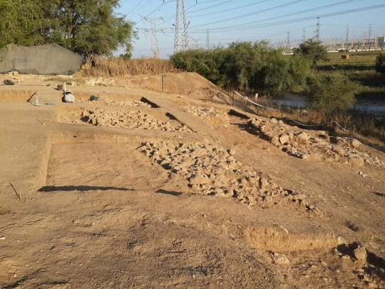
Gates of Gath
…then he arose at midnight, took hold of the doors of the gate of the city and the two gateposts, pulled them up, bar and all, put them on his shoulders, and carried them to the top of the hill that faces Hebron – Jg.16:3

Slide 7
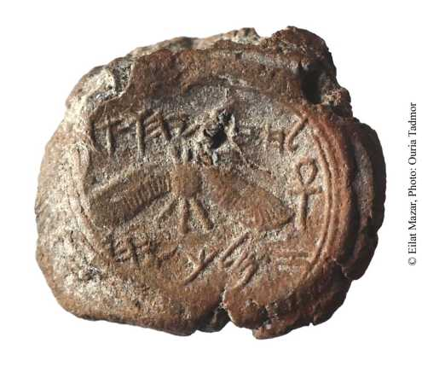
Hezekiah seal
"לחזקיהו [בן] אחז מלך יהדה"
"Belonging to Hezekiah [son of] Ahaz king of Judah"

Slide 8
Fulfilled prophecy Archaeology
"It may be stated categorically that no archaeo-logical discovery has ever controverted a Biblical reference. Scores of archaeological findings have been made which confirm in clear outline or in exact detail historical statements in the Bible. And by the same token, proper evaluation of Biblical descriptions has often led to amazing discoveries. They form tesserae in the vast mosaic of the Bible's almost incredibly correct historical memory" – Nelson Gleuck, Rivers in the Desert, p.31.

Slide 9
Fulfilled prophecy Archaeology Resurrection of Christ
“The force of human testimony depends on three things: first, the honesty of the witnesses; second, their competency; and third, their number” – McGarvey

Slide 10
We Do Not Need The Bible If . . .
I. Bible Is Not True
II. God Lets Us Believe Anything We Want

Slide 11
Who can believe it?
PCA?
Jim Jones?
Jn.17?
1 Co.1?
“It does not make much difference what denomination you belong to. I do not think God is so concerned with that. He is just concerned w. His children that are in those denominations . . . So if any of you wonder what I am, I am still the same. I am a Pentecostal Nazarene Baptist Lutheran Methodist Presbyterian. I could belong to all of them because I belong to Christ” – Wm. Branham, A Prophet Brings His Message, p.13-14).
One person, conflicting doctrines?

Slide 12
God does not give us multiple choices
Gen.2-3, in obedience
Gn.4:1-7, in worship [Hb.11:4; Ro.10:17]
There is a way that seems right to a man, But its end is the way of death – Pr.14:12
Whoever transgresses and does not abide in the doctrine of Christ does not have God. He who abides in the doctrine of Christ has both the Father and the Son – 2 Jn.9

Slide 13
We Do Not Need The Bible If . . .
I. Bible Is Not True
II. God Lets Us Believe Anything We Want
III. We Are Saved By Direct Operation of Holy Spirit

Slide 14
John Smith
Awaited mysterious call of H.S. to save him.
Believed he was totally depraved.
Emotions finally subsided; was this the call?
Preaching – urged sinners to repent, believe gospel. Got confused . . .
If elect did not believe, saved?
If non-elect did believe, saved?
“Brethren, something is wrong – I am in the dark – we are all in the dark; but how to lead you to the light, or to find the way myself, before God, I know not.”

Slide 15
“But Holy Spirit saved Cornelius Before Baptism”
Cornelius did not know it, Ac.11:14
Peter did not know it, Ac.11:15; 15
Spirit did not know it, Ro.8:2
Lord did not know it, Lk.8:15
Luke did not know it, Ac.2:38
Why command water baptism…?
Ac.10: 47-48, in name of Jesus Christ
Ac.2:38, for forgiveness of sins

Slide 16
If Holy Spirit Baptism saves without gospel, why are there unbelievers?
Why Mk.16:15?

Slide 17
If Holy Spirit Baptism saves without gospel, why are there unbelievers?
Apostles | Apostles | H.S. baptism | Cornelius | Cornelius
Ac.1:8 | Ac.2:1-11, 32 | X | Ac.11:15-18 | Ac.10:44-48
Purpose: witnesses | Effect: water baptism | X | Purpose: Gentiles can be saved | Effect: water baptism
Ac.10: water baptism is point of contention: last step in salvation
Ep.4:5, one baptism; 1 Pt.3, it is water

Slide 18
We Do Not Need The Bible If . . .
I. Bible Is Not True
II. God Lets Us Believe Anything We Want
III. God Lets Us Believe Anything We Want
IV. Once Saved, Cannot Be Lost

Slide 19
We have free will, before and after conversion
No one learned impossibility of apostasy from Scripture
1) First advocate: Gn.3:4
2) First followers: Gn.3:6-19

Slide 20
Galatians 5:4
‘of persons…to be severed from, separated from, discharged from, loosed from, any one; to terminate all intercourse with one’ –Th.
You have become estranged from Christ, you who attempt to be justified by law; you have fallen from grace – Ga.5:4
to no longer experience a state or condition—‘to be outside of, to experience no longer’ …‘you no longer experienced (God’s) grace’ Ga 5:4 – L-N

Slide 21
2 Peter 2, three declarations
Pardon | Passion | Punishment
Bought, 1 | Deny, 1 | Destruction, 1,3
Forsake, 15 | Sensual, 2,7 | Judgment, 3
Escaped, 20 | Covet, 3,14 | Punish., 12-14
Known, 21 | Flesh, 10 | Perish, 20-21
 | Adultery, 14 | Worse jdgt., 20f.
 | Astray, 15
 | Again, 21
 | Turn from, 21

Slide 22
We Do Not Need The Bible If . . .
I. Bible Is Not True
II. God Lets Us Believe Anything We Want
III. God Lets Us Believe Anything We Want
IV. Once Saved, Cannot Be Lost
V. We Do Not Obey It

Slide 23
Nothing profits from non-use
¹ Moreover, brethren, I declare to you the gospel which I preached to you, which also you received and in which you stand, ² by which also you are saved, if you hold fast that word which I preached to you—unless you believed in vain – 1 Cor.15:1-2

