Slide 1
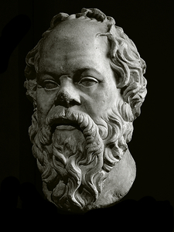
No man has the right to be an amateur in the matter of physical training.
It is a shame for a man to grow old without seeing the beauty and strength of which his body is capable.
-Socrates
469-399 BC

Slide 2
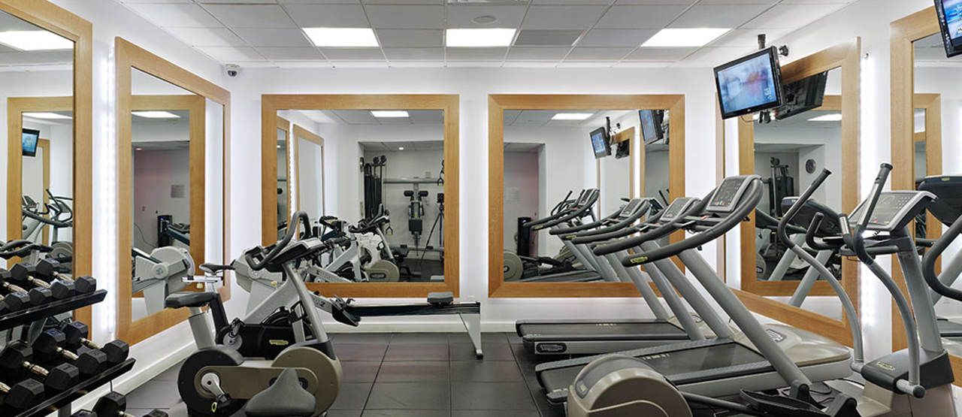
Our Body
1st Corinthians 6:13

Slide 3
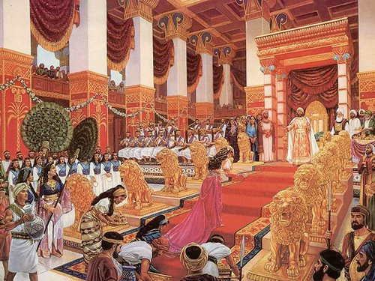
The Importance Of The Body
1st Corinthians 6:19
Our body is the temple of God
Care should be taken so that temple is not destroyed or defiled
But when it comes to serving God, our bodies are secondary to the soul
2nd Corinthians 4:8-18
Which do we give more attention to?

Slide 4
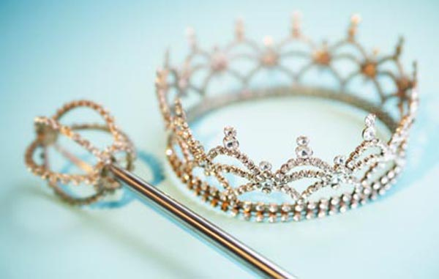
Focus on Beauty
Proverbs 31:30; Judges 14:1-3, 15:2
What did the “worthy woman” look like?
The quest for beauty is a futile effort
The standards are unreachable
You will not prevent its passing
There is no real joy or benefit in it
How much emphasis should we place on it ourselves, or onto others?

Slide 5
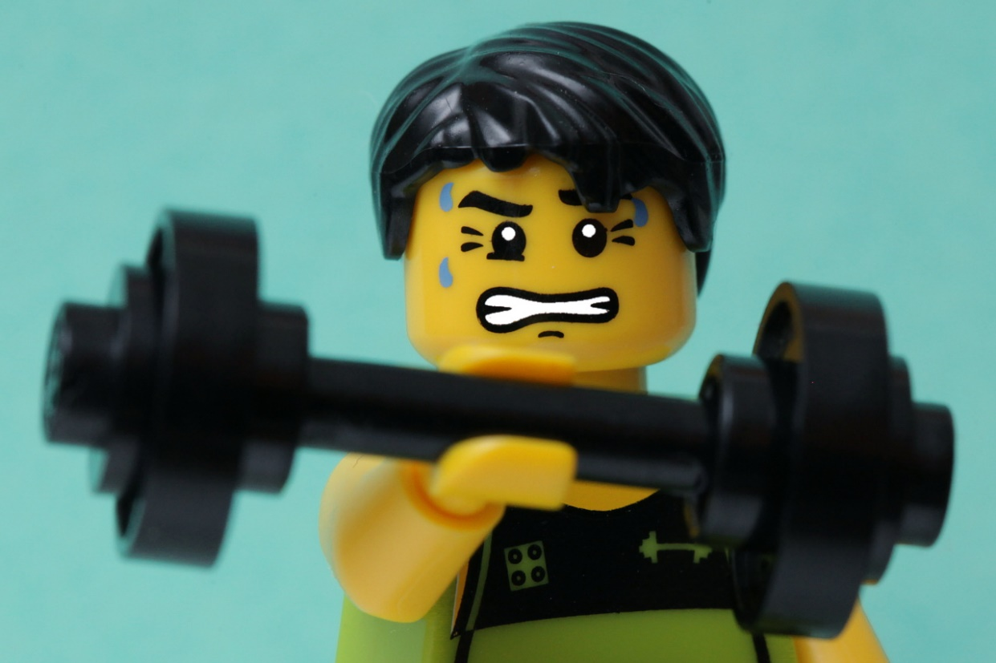
Focus on Strength
Proverbs 20:29; Jeremiah 9:23-24
Our physical strength:
Is a temporary thing
Is a source of pride and arrogance
Is useless in the fight against the devil – Eph. 6:10
Is outweighed by a more important training – 1st Tim. 4:7-8

Slide 6
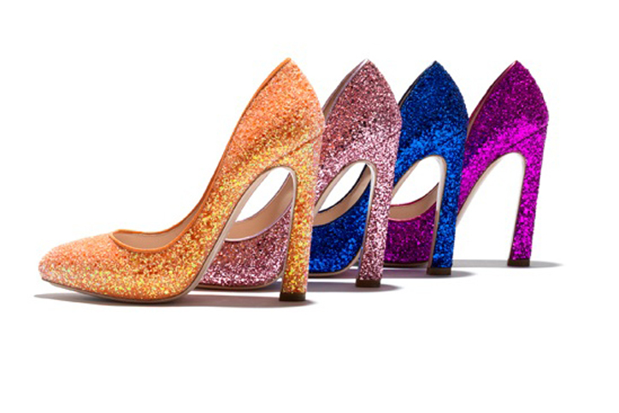
Focus on Appearance
1st Samuel 16:7; 1st Peter 3:1-4
The desire to be desirable is a very strong emotion
God doesn’t value us by our outward appearance
What time and money are wasted on updating the body at the expense of the soul!
Matthew 6:24-25

Slide 7
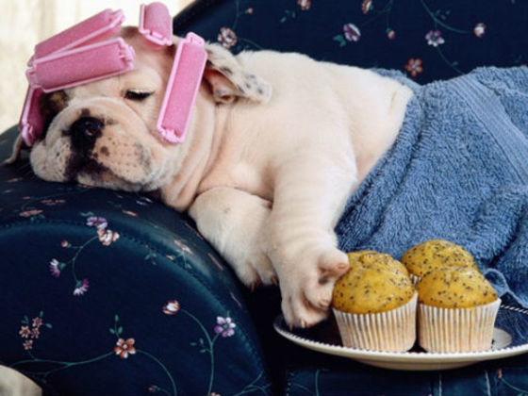
Either Or?

Slide 8
First and Second
Matthew 6:33 – “But seek first the kingdom of God and his righteousness, and all these things will be added to you.”

