Slide 1
Our Money
Luke 12:15

Slide 2
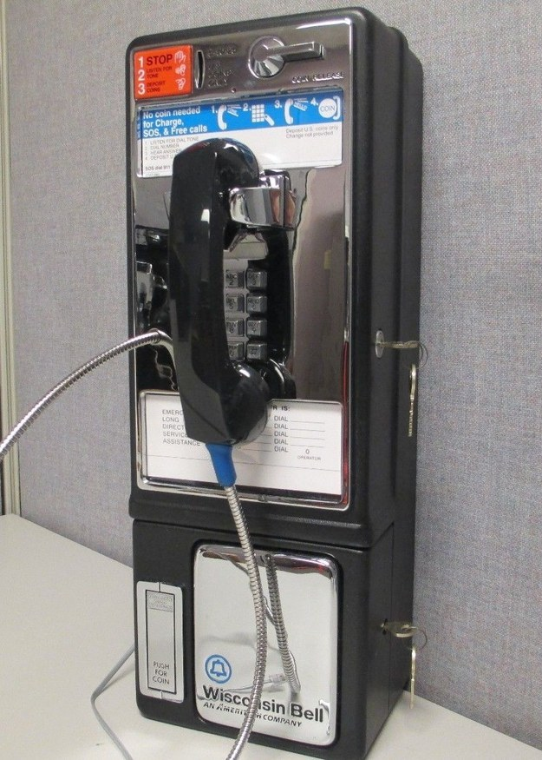
A 21st Century Problem
It’s hard to not think about money!
From the time we wake up to the time we sleep, most of our day revolves around money
Shopping
Your Wages
Gambling
Investments
Gifts
Taxes

Slide 3
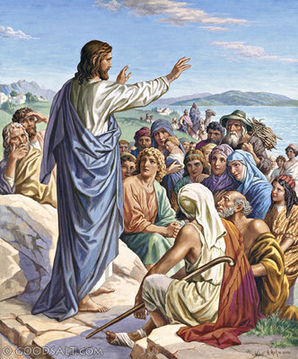
Life Is About More Than Money
Luke 12:13-15
This man’s question showed what mattered most to him
Shouldn’t we spend our time on the things that matter most?
What if you were never going to make more money, have a better car, or get any new clothes?
Philippians 4:11-12

Slide 4
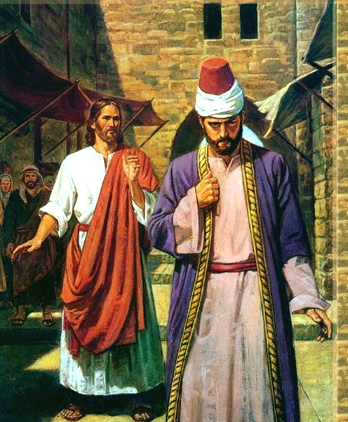
Learn To Part With It
Matthew 19:16-25
Our attitude toward money has moral implications
We store up treasure in heaven by giving it away here on earth
Our service with money is always mutually exclusive – we either spend on ourselves or use it for others
Galatians 2:10, Deuteronomy 15:7-11

Slide 5
Leave Without It
Luke 12:16-21
When we wake up in the morning, what motivates us?
The fool is one who is focused on himself
There will be a day when all of our financial accomplishments mean nothing
1st Timothy 6:3-11

Slide 6
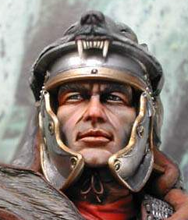
Biblical Principles For Money
Acts 10:3-4 “About the ninth hour of the day he saw clearly in a vision an angel… And he said to him, "Your prayers and your alms have ascended as a memorial before God.
Share it
Save it
Spend it
1st Corinthians 16:2 “On the first day of every week, each of you is to put something aside and store it up, as he may prosper, so that there will be no collecting when I come.”
Ecclesiastes 5:18 “Behold, what I have seen to be good and fitting is to eat and drink and find enjoyment in all the toil with which one toils under the sun the few days of his life that God has given him, for this is his lot.”

