Slide 1
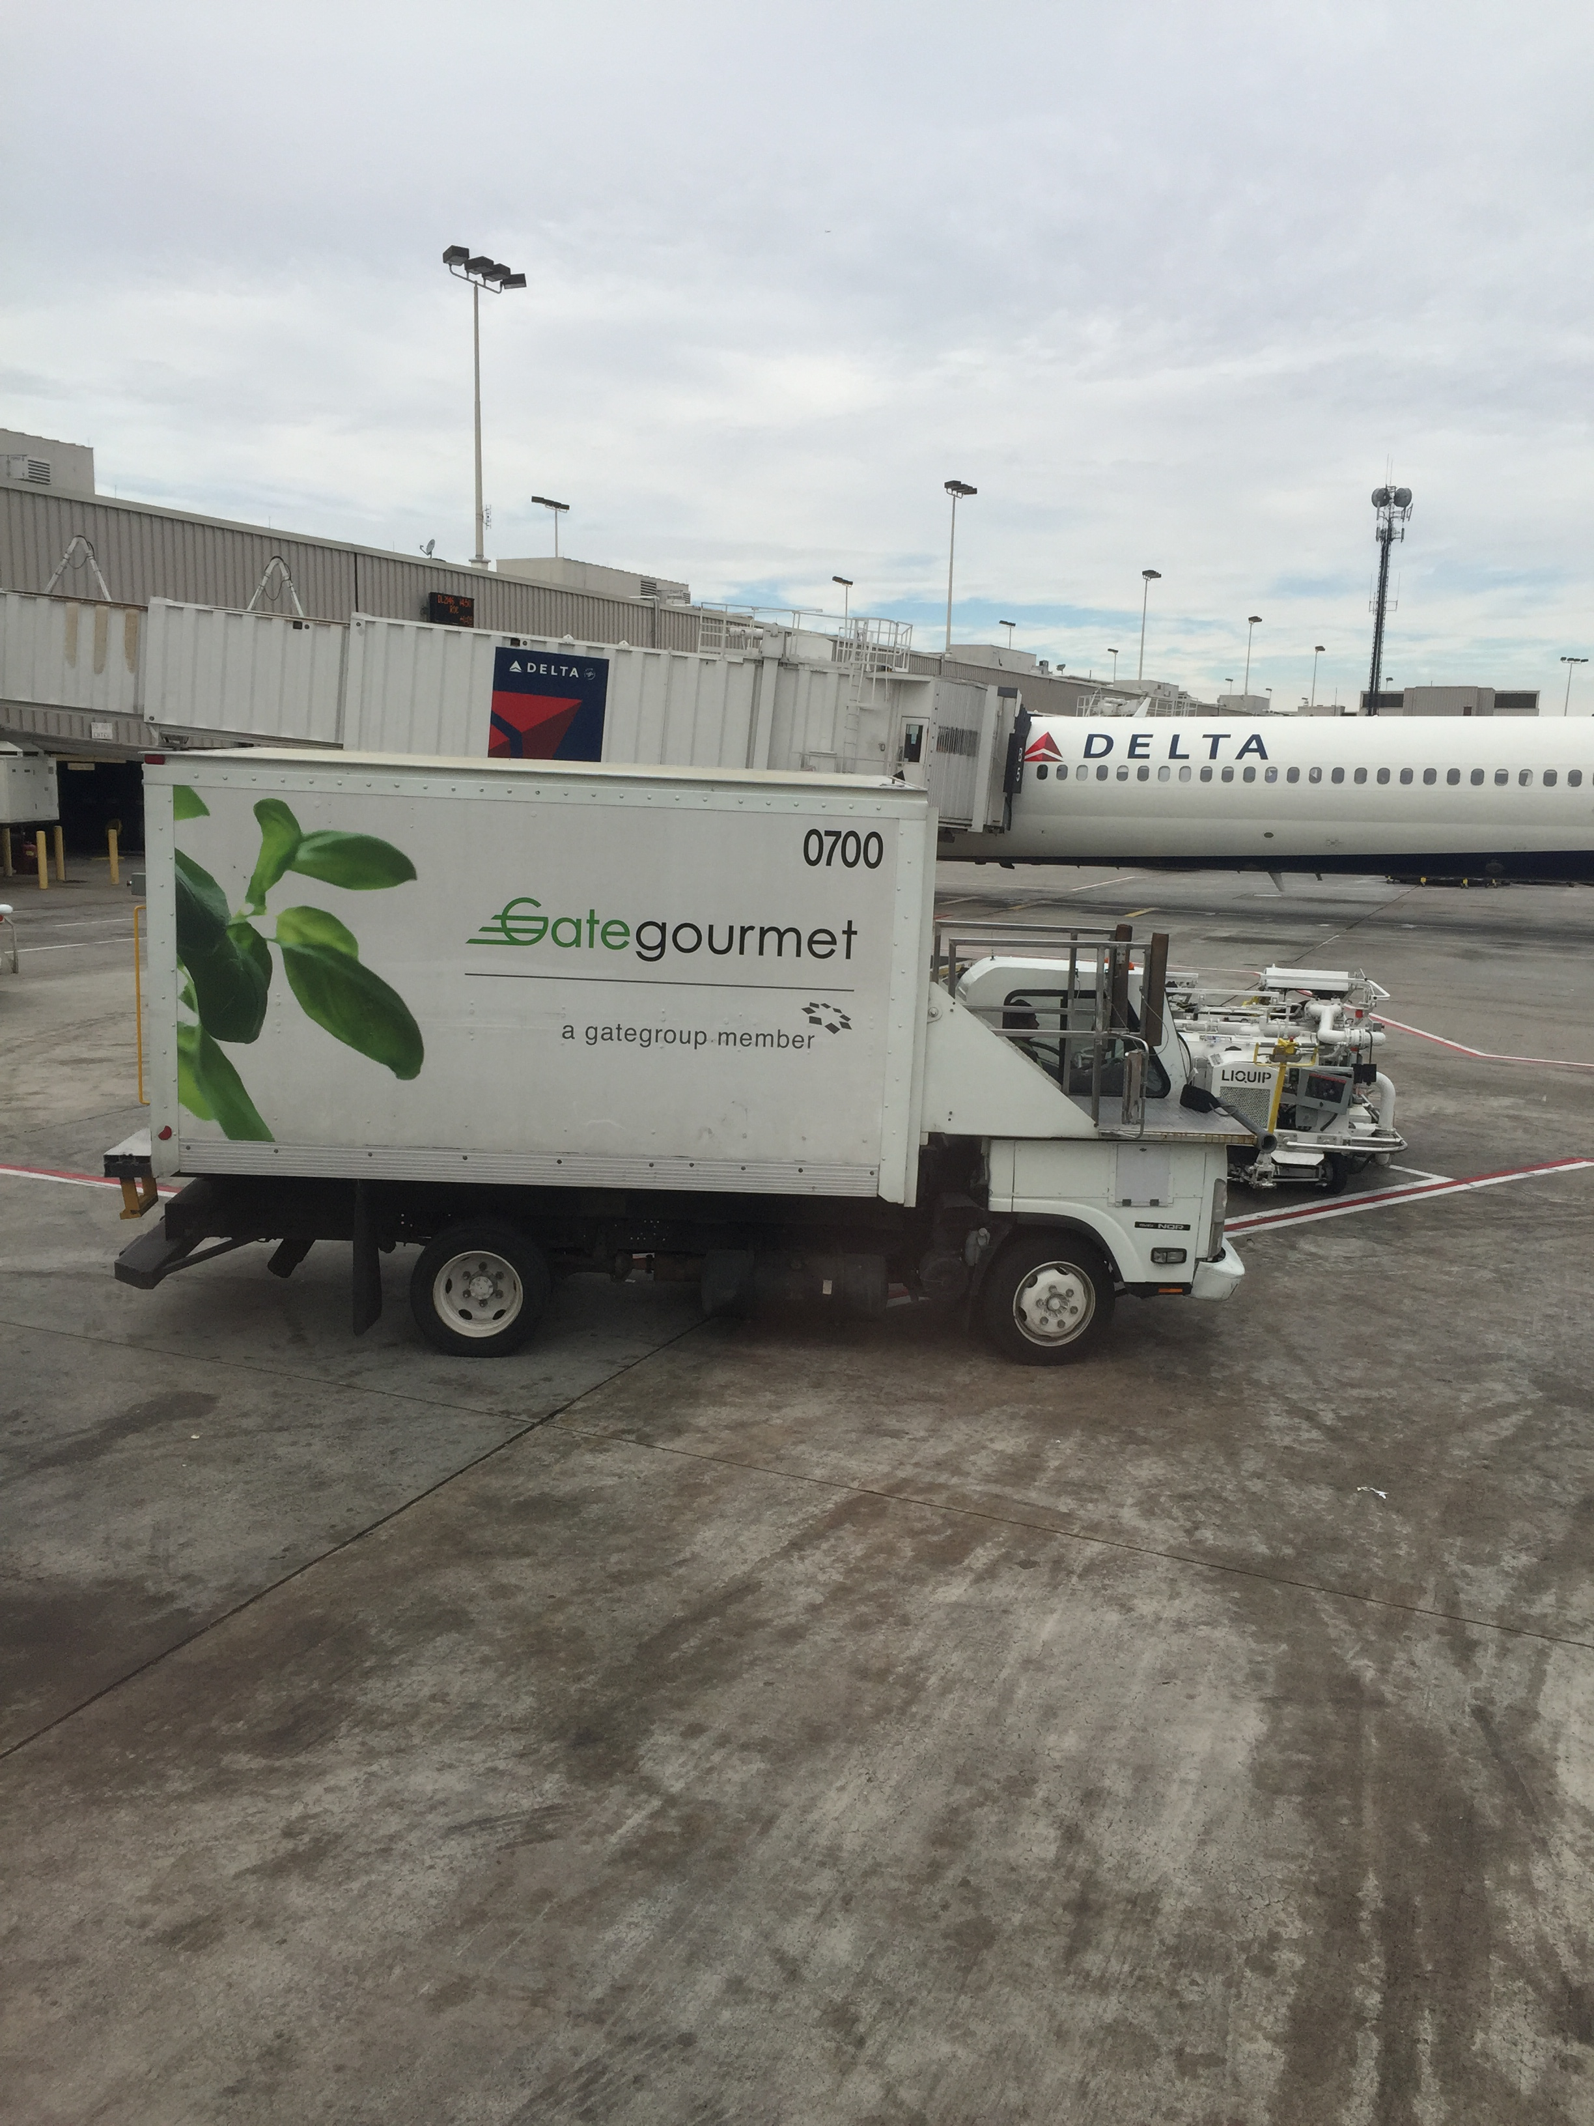

Slide 2
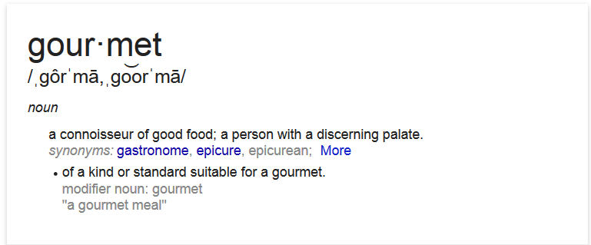

Slide 3
False Advertising
1st Peter 4:10-11

Slide 4
Speaking As God Speaks
Scripture isn’t just a collection of words, it is inspired by God
2nd Timothy 3:16-17; Matthew 22:43; 2nd Peter 1:21
Being the words of God, they carry a special weight to their importance and meaning
John 6:63; Luke 21:33
We need to understand and respect God’s designation for things – it’s the only thing that matters

Slide 5
Christian
The term Christian was applied to the early disciples of Jesus
Acts 11:26; Acts 26:28; 1st Peter 4:16
Over time the term has come to signify anyone with any association to Jesus
Applying the word Christian to ourselves doesn’t mean we actually follow Jesus!
John 15:1-10

Slide 6
Church
The word church comes from the Greek word ekklēsia, signifying an independent, special congregation
Acts 19:39; Matthew 16:18
Christ is head of His church – Ephesians 1:20-23
Christ is the savior of His church – Ephesians 5:23
The church submits to Christ
Revelation 3:14-15; Revelation 3:1-2; Revelation 2:20-23

Slide 7
Saved
Salvation is the term used to describe the state of a person who has been forgiven by God through Jesus
Luke 3:5-6; Acts 4:12; Hebrews 5:9
God is the author of salvation, and the only one who can designate someone as forgiven or saved
We can think we are saved, be told we are saved, look like we are saved, want to be saved, but unless God saves us, it doesn’t matter
Matthew 7:21-23

Slide 8
Baptized
Baptism is a word that has come to mean many different things
a ceremonial immersion in water, or application of water, as an initiatory rite or sacrament of the Christian church.
The word itself means to immerse
Acts 8:36-39
The purpose has always been associated with the remission of sins
Acts 2:38; Mark 16:16; 1st Peter 3:21

