Slide 1
Our Creation and Use Of Media

Slide 2
Your Digital Footprint

Slide 3
Matthew 12:36-37
“I tell you, on the day of judgment people will give account for every careless word they speak, for by your words you will be justified, and by your words you will be condemned."

Slide 4
Everything You Say Is Seen
Luke 12:1-3
What we say and do online is a revelation of who we really are
God will record and remember even our very thoughts
Sites may be anonymous, but God knows who we are
Would you want your hidden thoughts to be made public?

Slide 5


Our Reason For Sharing?
What’s the reason for so much content creation?
Matthew 6:1-2
Social media is often used as a tool to grow and gauge our own value
Christians should value the approval of God, rather than the approval of men
What percentage of our created content mentions anything related to God?

Slide 6

Sharing Our Image
Galatians 2:20
When the world sees us, they should see the image of Jesus Christ
Images of us that don’t reflect His values or character bring shame to the name of Jesus
1st Peter 3:3-4

Slide 7
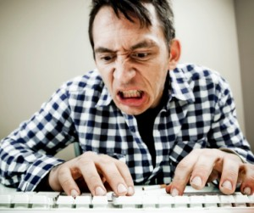
Sharing Our Thoughts
Ephesians 4:29
It is easier to say things we shouldn’t when we are behind a keyboard
Anger, impurity, gossip, pride, etc. should NEVER come from us
As a general rule, you shouldn’t share something that you wouldn’t want to type up here

Slide 8
Matthew 7:19
“… Every tree that does not bear good fruit is cut down and thrown into the fire.”

Slide 9





Deuteronomy 6:6-9

Slide 10
Psalm 119:33
“Teach me, O LORD, the way of your statutes; and I will keep it to the end.”

Slide 11
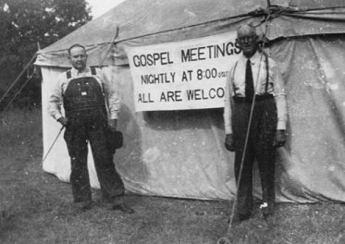
Media For Instruction
Proverbs 9:9; Ephesians 4:11-16
Instruction is the means by which we grow up into the image of Christ
Individuals are equipped by God to accomplish His task
We now have access to the collective wisdom of every minister!
What more can we do to provide the content people need to be saved?

Slide 12
Psalm 119:15
“I will meditate on your precepts and fix my eyes on your ways.”

Slide 13
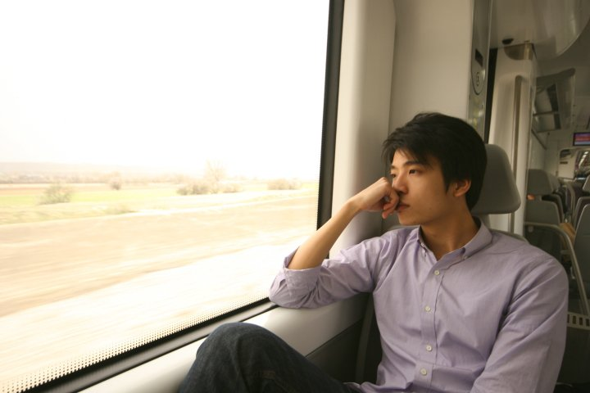
Reflecting On The Truth
Joshua 1:8; Psalm 1:2; 19:14
Meditation - hâgâh – To murmur
Instruction will only take hold in our lives if we apply it to us
Time must be set aside to think
Prayer is a good segue to times of quietness and reflection

Slide 14
Psalm 119:172
“My tongue will sing of your word, for all your commandments are right.”

Slide 15
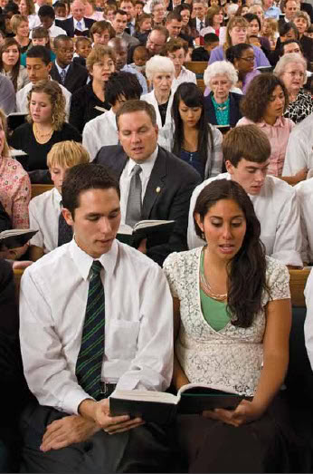
Music and Media
Colossians 3:16; Revelation 14:3
God gave us music as a tool to praise Him and instruction each other
Most of us have experienced the power of music and song
Singings are good opportunities to share that encouragement
What music are we searching for and sharing with our children?

Slide 16
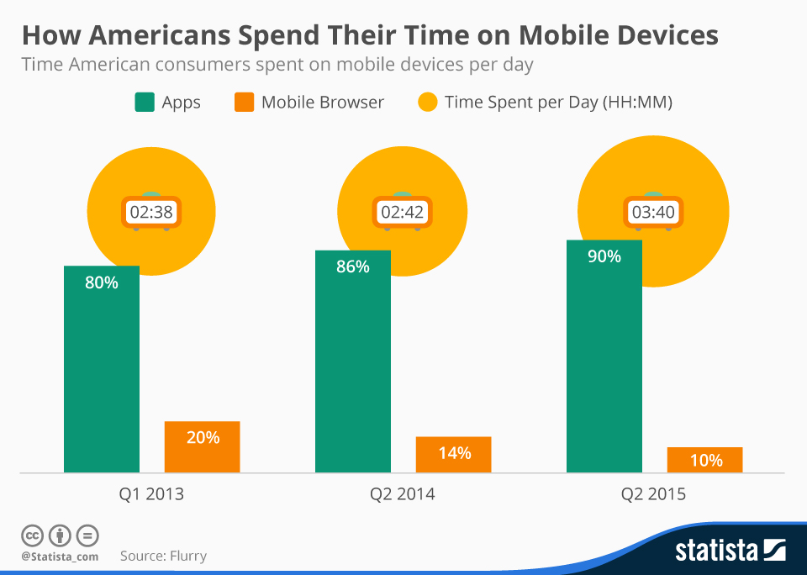

Slide 17
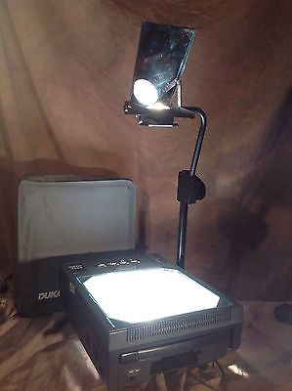
The Church and Modern Media
Churches are often slow to adapt to changes in communication
What media options are out there for a Christian who wants to grow?
It takes effort to create content for public consumption
To what lengths will we go to save the souls of others?
Luke 16:8

