Slide 1
Staying In The Wilderness
Numbers 32

Slide 2
Different goals . . .
Some want to leave wilderness for Egypt
Some prefer to die in wilderness
Some want to stay in wilderness (ch.32)

Slide 3
I. Desire of 2½ Tribes

Slide 4
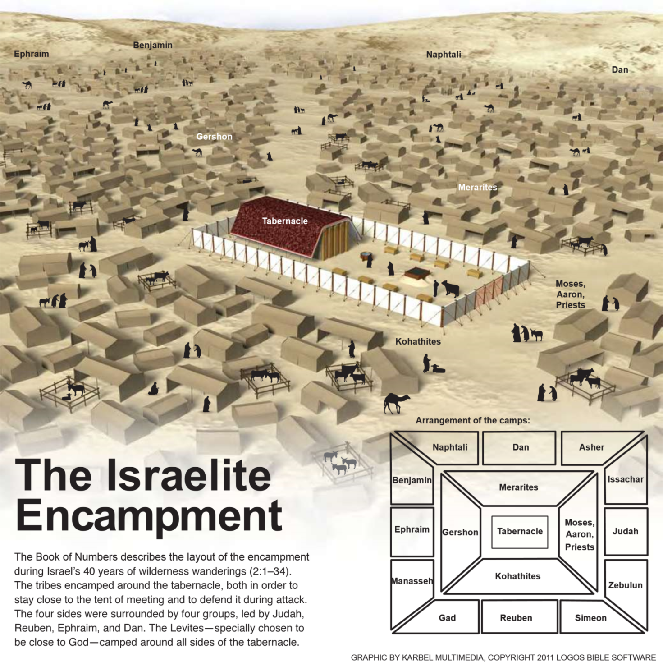
Reuben & Gad camped together

Slide 5
Reuben & Gad camped together
1-5: land proverbial for large cattle
6: could sound as if two tribes want to stay East of Jordan and immediately enjoy fruits of victory
7-15: with this in mind, Moses warns
16-19: the promise
20-30: conditions

Slide 6
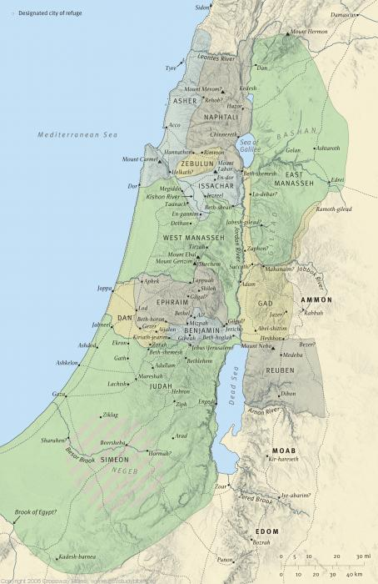

Slide 7
I. Desire of 2½ Tribes II. Distraction of 2½ Tribes

Slide 8
Riches can distract from God’s best blessings, 1-5
Former slaves / sons of slaves; now possess herds / flocks, fine land
Increased riches cause problems
Cattle not worth danger to soul (Lot)
God’s greatest blessings include Canaan; they settle for Transjordan

Slide 9
Riches can distract from God’s best blessings, 1-5
Effects of settling for less than best:
Diminish God’s promise to Abraham
Distance from brethren / worship
Divide from united kingdom. Jg.5
Draw invaders

Slide 10
It is wrong to act without consideration for others, 6-7
Two kinds of willing workers. Ph.2:1-3
We cannot expect brethren to do our work for us. Ph.2:12
To share in the inheritance, we must engage in the conflict

Slide 11
It is wrong to discourage brethren, 7
‘Discourage’ is opposite of ‘courage’
Contagious disease: shows up in . . .
Dt.20:8
words
attitudes
actions
Bad attitude within is more dangerous than bad enemy without

Slide 12
It is spiritual suicide to follow God ‘in part’, 11-12
“Not wholly follow LORD” – leaves us under carnal influence
“Who will follow Jesus?”
“I will follow if it doesn’t cost time, effort, comfort…”

Slide 13
Learn from history, 13-15
God uses history to warn His people…
“I don’t know much about history, and I wouldn’t give a nickel for all the history in the world. It means nothing to me. History is more or less bunk” – H. Ford

Slide 14
Be swift to hear… 13-15
Who regrets getting control of emotions before speaking?
¹⁹ So then, my beloved brethren, let every man be swift to hear, slow to speak, slow to wrath; ²⁰ for the wrath of man does not produce the righteousness of God – James 1

Slide 15
Sin brings unintended consequences, 14-15, 23
Anger of Lord, 14
Fierce (burning): very intense anger…
So angry that the face becomes hot and flushed skin. 1 Sm.28:18

Slide 16
Sin brings unintended consequences, 14-15, 23
Anger of Lord, 14
Destroy congregation, 15. (1 Co.10; Hb.3; Ps.90)
Personal punishment, 23 (Ga.6:7-8)
No lawyer can save us
No bribe can free us

Slide 17
I. Desire of 2½ Tribes II. Distraction of 2½ Tribes III. Danger of 2½ Tribes: Sin Will Find You Out, 23

Slide 18
Most ignore the warning; some try to disprove it
Helpless hopes
Cloak: Gn.44:16. 1 Pt.2:16.
Clock: Ex.17 . . . 1 Sm.15
Crowd: Nu.14 / 16
Compass: Jonah
Counsel: Mt.15:14; 23:2, 15

Slide 19
Analysis: Be sure…your sin …will find you out
Cause of problem: ‘your sin’ (27:3).
Certainty of punishment: ‘be sure’
Conclusion of pursuit: ‘find you out’
‘Catch up with you’
‘The appropriate punishment for that sin will be meted out’
Ps.139
2 Co.5:10

Slide 20
Your sin…
Knows your address, Gn.4:7
Knows your name, Ex.32:32-33
Remembers what you did, Nu.31:8
Cannot be shaken, Am.5:18-20
Illustrated: Mark 5, could not hide
Sin is a boomerang. Ro.6:23

Slide 21
Conclusion:
Earlier in life, sin found Saul (Ac.9)
At end of life, Paul hopes to be found in Him at His coming (Ph.3:8-9)
⁸Yet indeed I also count all things loss for the excellence of the knowledge of Christ Jesus my Lord, for whom I have suffered the loss of all things, and count them as rubbish, that I may gain Christ ⁹and be found in Him, not having my own righteousness, which is from the law, but that which is through faith in Christ, the righteousness which is from God by faith

