Slide 1
Cities of Refuge In And Out Of The Wilderness
Numbers 35

Slide 2
Looking ahead: the land
Numbers 35
48 Levitical cities, 1-8
6 Cities of Refuge, 6-8

Slide 3
Looking back: the law
Joshua 20
Refugee states case to elders, 1-4
Elders guarantee safety till trial, 5a
If acquitted, cannot leave city of refuge till death of high priest, 5b-6
Clear distinction between murder and manslaughter, 7-9

Slide 4
I. Refuge

Slide 5
Cities of refuge: asylum, haven
State or condition of protection and safety (common in ancient world)
Christ of refuge – Hb.6:18 → Nu.35
Two immutable things –
We fled for refuge (Nu.35:11)
Hold fast to hope (Hb.4:14)
Oath, Ps.110:4
Promise, Hb.6:14
Tech. term: appeal to ruler who can help

Slide 6
Cities of refuge & Christ (Hb.6:18)
Within easy reach (Ps.46:1). Hb.4:16

Slide 7
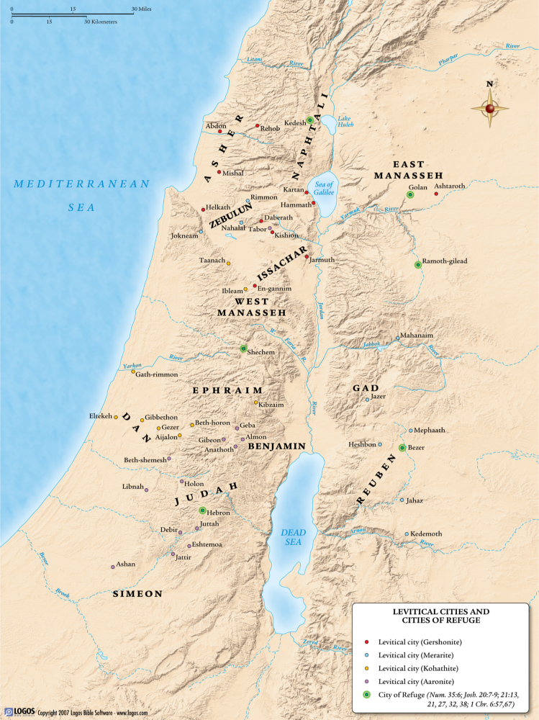

Slide 8
Cities of refuge & Christ (Hb.6:18)
Within easy reach
Good roads led to cities, Dt.19:3
Prepare: build up. Keep in good repair.
Divide into three parts. Interstate.
Flee
No struggle through deserts…
Useless if unreachable, hard to find
Is.35:8 [40:3] ‘open country thorough-fare…relatively wide and maintained’ - Swanson
Mt.3:9; Jn.14:6; Hb.10:19-20

Slide 9
Cities of refuge & Christ (Hb.6:18)
Within easy reach
Good roads led to cities, Dt.19:3 (Is.35:8; Jn.14:6; Hb.10:19-20)
Open to all (Nu.35:15). Hb.2:9; Ac.10:34-35

Slide 10
Cities of refuge & Christ (Hb.6:18)
Within easy reach
Good roads led to cities, Dt.19:3 (Is.35:8; Jn.14:6; Hb.10:19-20)
Open to all. Hb.2:9; Ac.10:34-35
Open always. Hb.7:23-24

Slide 11
Cities of refuge & Christ (Hb.6:18)
Within easy reach
Good roads led to cities, Dt.19:3 (Is.35:8; Jn.14:6; Hb.10:19-20)
Open to all. Hb.2:9; Ac.10:34-35
Open always. Hb.7:23-24
Place where refugees lived. Hb.10:38

Slide 12
Cities of refuge & Christ (Hb.6:18)
Within easy reach
Good roads led to cities, Dt.19:3 (Is.35:8; Jn.14:6; Hb.10:19-20)
Open to all. Hb.2:9; Ac.10:34-35
Open always. Hb.7:23-24
Place where refugees lived. Hb.10:38
Exclusive; no other refuge. 1 K.2. Ac.4:11-12

Slide 13
Cities of refuge & Christ (Hb.6:18)
Within easy reach
Good roads led to cities, Dt.19:3 (Is.35:8; Jn.14:6; Hb.10:19-20)
Open to all. Hb.2:9; Ac.10:34-35
Open always. Hb.7:23-24
Place where refugees lived. Hb.10:38
Exclusive; no other alternative. 1 K.2. Ac.4:11-12
Cities protect those who stay within borders. Outside: death awaits. Hb.6:18-20. 2 Jn.9

Slide 14
Cities of refuge & Christ (Hb.6:18)
Within easy reach
Good roads led to cities, Dt.19:3 (Is.35:8; Jn.14:6; Hb.10:19-20)
Open to all. Hb.2:9; Ac.10:34-35
Open always. Hb.7:23-24
Place where refugees lived. Hb.10:38
Exclusive; no other alternative. 1 K.2. Ac.4:11-12
Cities protected only those who stay within borders. Hb.6:18-20
Freedom comes w. death of HP. Hb.7:25

Slide 15
Cities of refuge & Christ (Hb.6:18)
Within easy reach
Good roads led to cities, Dt.19:3 (Is.35:8; Jn.14:6; Hb.10:19-20)
Open to all. Hb.2:9; Ac.10:34-35
Open always. Hb.7:23-24
Place where refugees lived. Hb.10:38
Exclusive; no other alternative. 1 K.2. Ac.4:11-12
Cities protected only those who stay within borders. Hb.6:18-20
Freedom comes w. death of HP. Hb.7:25
No refuge for murderer. Nu.35:11-34

Slide 16
Cities of refuge & Christ (Hb.6:18)
Within easy reach
Good roads led to cities, Dt.19:3 (Is.35:8; Jn.14:6; Hb.10:19-20)
Open to all. Hb.2:9; Ac.10:34-35
Open always. Hb.7:23-24
Place where refugees lived. Hb.10:38
Exclusive; no other alternative. 1 K.2. Ac.4:11-12
Cities protected only those who stay within borders. Hb.6:18-20
Freedom comes w. death of HP. Hb.7:25
No refuge for murderer. Nu.35:11-34
No payment / bribe, Nu.35:31-33. Ro.5:15

Slide 17
Cities of refuge & Christ (Hb.6:18)
Differences
Cities of refuge helped only the innocent, Nu.35:15.
The guilty come to Jesus for refuge, Hb.5:8-9
Cities of refuge saved from physical death
Jesus saves from spiritual / eternal death, Hb.5:9

Slide 18
I. Refuge II. Revenger

Slide 19
Kinsman revenger: avenger of bloodshed
Killing the murderer of one’s relative cleared away the crime. 1 K.16:11
Scene: two men fight; one grabs ax . . .
Considerations:
1. Weapon.
2. Waiting (lying in wait–premeditated).
3. Wish (motive).

Slide 20
I. Refuge II. Revenger III. Redeemer

Slide 21
Kinsman redeemer:
Make a claim for a person or thing (reclaim him / it, redeem)
Bondage: Ex.21:4; Hb.2:15
Property: Lv.25:23-28
Kin:
Hb.2:9, 11-13
a. Rich enough (v.10)
b. Willing (v.14)
2. Male relative for childless widow, Ru.2:12; 3:12

Slide 22
The scene
Two men chop trees; ax head flies off, kills one…an accident
Avenger of blood from dead man’s family will track him down to kill him… thinking he is a murderer.
Manslayer flees to city of refuge
Jesus: our refuge (Kinsman Redeemer)

Slide 23
The scene
Ancient wars waged to acquire laborers
Slave merchants followed armies
Generous souls could intervene, redeem them for a price (Spicq, 2.427)
Jesus, Rv.5:9; Mt.18:27
Released from bondage to sin, Mk.10:45
No refuge from Him; only in Him
1 Chr.20:1-3, no ugly break

Slide 24
Conclusion:
Slave market: world
1 Jn.5:19
Slave master: satan
2 Tim.2:25-26
Slave state: sin
1 Pt.1:18
Redeemer: Christ
1 Pt.1:19
Price: blood
1 Pt.1:19

