Slide 1
A New Jezebel And Her Pawn
Mark 6

Slide 2
Herod the Great had many wives
Son: Herod Philip (private citizen of Rome) married niece – Herodias.
Their daughter – Salome.
Son: Herod Antipas visited half-brother, Philip – eloped with Herodias.

Slide 3
Mark 6:
14-16: tetrarch (Mt.14:1) king (14:9)
Ruled AD 4 to AD 39
Hears of Jesus; thinks He is John
Jn.10:41
17: Prison (Machaerus – Josephus); NE corner of Dead Sea
Fortress, palace, prison

Slide 4
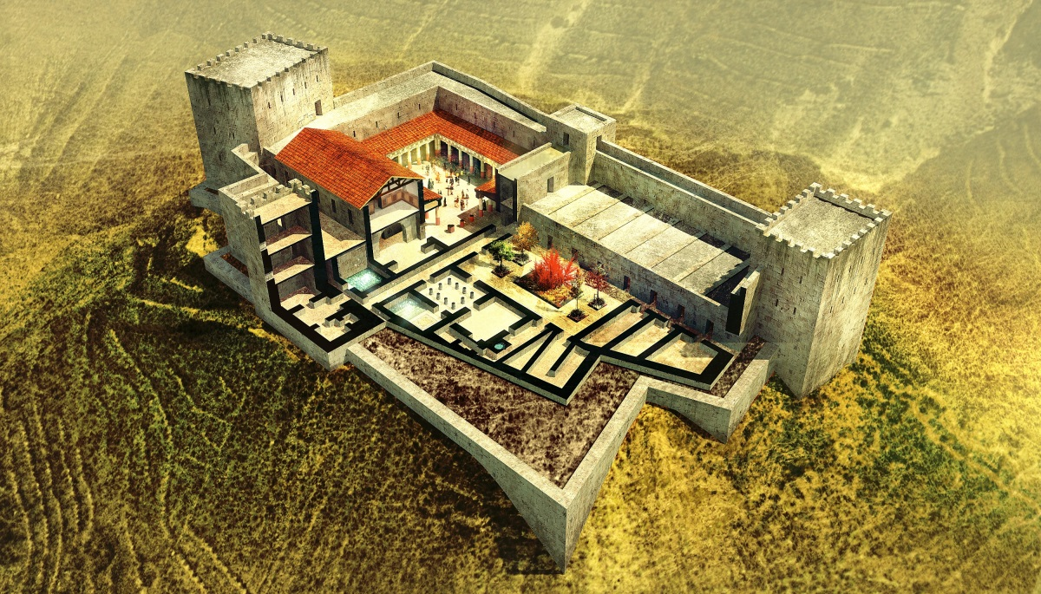
Machaerus

Slide 5
Mark 6:
14-16: tetrarch (Mt.14:1, 9)
Ruled AD 4 to AD 39
Hears of Jesus; thinks He is John
Jn.10:41
17: Prison (Machaerus – Josephus); NE corner of Dead Sea
Fortress, palace, prison
18: Legally married; lawfully bound to another = adultery

Slide 6
I. Herodias – stubborn hatred

Slide 7
1. Immoral (left husband for Herod), 17

Slide 8
1. Immoral (left husband for Herod), 17 2. Hated word of God, 18
‘My God wants me to be happy.’
‘Nobody tells me what to do.’

Slide 9
1. Immoral (left husband for Herod), 17 2. Hated word of God, 18 3. Hated John, 19
Holds grudge against him
She sins; hates preacher

Slide 10
1. Immoral (left husband for Herod), 17 2. Hated word of God, 18 3. Hated John, 19 4. Miserable mother –
Her example: MDR; cruelty; secularism
Her enmity: waited for opportunity to murder
Her enticement:
daughter’s dance designed to kill

Slide 11
I. Herodias – Stubborn hatred
II. Salome – Sinful youth

Slide 12
1. Immoral; lewd; seductive, 22
Such dances usually performed by professional dancer or prostitutes

Slide 13
1. Immoral; lewd; seductive, 22 2. Indifferent to morals (amoral), sacredness of life, truth, 22, 25
“There is no such thing as right and wrong. There’s just popular opinion.”
She pleased Herod, but displeased God

Slide 14
I. Herodias – Stubborn hatred
II. Salome – Sinful youth
III. Herod – State persecutor

Slide 15
Herod’s fear, 14-16
“John is just and holy” (20)
Haunted; afraid of dead man
“I” beheaded (16)
Herod, a Sadducee

Slide 16
Herod’s fear, 14-16 Herod’s frailty, 17
“For the sake of Herodias” (20). Henpecked. Lacked courage…

Slide 17
Herod’s fear, 14-16 Herod’s frailty, 17 Herod’s fault, 17-18
Sinful; adulterous; hates message; punishes messenger.
Great opportunity lost on Herod. Ja.1:25

Slide 18
Herod’s fear, 14-16 Herod’s frailty, 17 Herod’s fault, 17-18 Herod’s frivolity, 20
Liked John’s preaching?? Ezk.33
People like a preacher until he ‘meddles’; want him in crisis
Some like preaching, but do not intend to change their way of life

Slide 19
Herod’s fear, 14-16 Herod’s frailty, 17 Herod’s fault, 17-18 Herod’s frivolity, 20 Herod’s fun, 21-26
A party is not wrong…but it can degenerate

Slide 20
Herod’s fear, 14-16 Herod’s frailty, 17 Herod’s fault, 17-18 Herod’s frivolity, 20 Herod’s fun, 21-26 Herod’s friends, 23
Danger of peer pressure
‘Many a man has made himself far worse than he is because he feared the laughter of his so-called friends’
Gelotophobia
Lk.6:21, 25; 8:53

Slide 21
Herod’s fear, 14-16 Herod’s frailty, 17 Herod’s fault, 17-18 Herod’s frivolity, 20 Herod’s fun, 21-26 Herod’s friends, 23 Herod’s folly, 26-27
Gave sinner a blank check
Herod sinned against . . .
God – adultery; murder.
Brother – stole wife.
John – prison, murder (v.26).
Conscience – scared; no change.

Slide 22
The conscience
‘speaking lies in hypocrisy, having their own conscience seared with a hot iron’ – 1 Tim.4:2
‘having faith and a good conscience, which some having rejected, concerning the faith have suffered shipwreck’ – 1 Tim.1:19

Slide 23
Herod’s conscience
Silenced John’s voice, but . . .
Facts remain
Words ring in his ears
‘John’ engraved on his memory
Cannot hide, 14-16

Slide 24
Herod’s warnings
Heard John, yet . . .
Attacked the preacher
Stifled conscience
Committed greater sin
Lk.23:8-12
No longer exceeding sorry (Mk.6:26)

Slide 25
I. Herodias – Stubborn hatred
II. Salome – Sinful youth
III. Herod – State persecutor
IV. John – Steadfast courage

Slide 26
1. Who is John?
Forerunner of Messiah
Fulfillment of OT prophecies
Last of OT prophets
Last martyr of OT
Forceful preacher
Faithful servant of God
Mt.11:11

Slide 27
Who is John?
2. What did John do?
Spoke for God. 18: ‘had been saying.’
Finished his work.
Loved God…even enemies.

Slide 28
Who was John?
2. What did John do?
3. What John could have done.
Complimented Herod / Herodias
Recanted: ‘you misunderstood me’
Apologized: ‘I rethought my view’
Fled

Slide 29
Who was John?
2. What did John do?
3. What John could have done.
4. What happened to John?
Death
One swift stroke: troubles ended
Lost head on earth; gained crown above
Life
Herodias hates him; God loves him

Slide 30
I. Herodias – Stubborn hatred
II. Salome – Sinful youth
III. Herod – State persecutor
IV. John – Steadfast courage
V. John’s Disciples – Mt.14:12

Slide 31
John always pointed disciples to Jesus (Jn.1)
John died; his disciples’ faith did not.
They went to Jesus
1. John sought answers in Jesus, Mt.11:2
2. ‘Where could I go but to the Lord?’

Slide 32
Herod’s end
Lk.13:31-33
Caligula took throne, AD 37
Herodias envied brother (Agrippa I)
Persuaded Herod to accuse her brother to Caligula
Backfired
AD 39: banished to Gaul
Caligula added Herod’s tetrarchy to Agrippa I’s domains

