Slide 1
Loving God With All Our Heart

Slide 2
I. Prominence – Why Is This The Greatest Command?

Slide 3
This love is . . .
Offered to God –Greatest Being. Gn.43:11. Jn.12
Based on Word –Greatest communi-cation. Ps.139:17. 2 K.1:13-14
Affects whole person –Greatest purpose. Mt.22:37.
Involves eternal facts –Greatest promise. 2 Pt.1:4
Produces most good –Greatest life. Jn.10:10.

Slide 4
I. Prominence – Why Is This The Greatest Command?
II. Possibilities – What Does This Command Mean?

Slide 5
Personal issue?
Within reach of some, beyond others?
►Jn.21:15-17
“If I claim it, I’m lying”?
Inability? No! Failure? Yes!
Ro.3:23
►We can become what God wants – Ep.6:10.
Not the final answer

Slide 6
Personal issue? Perfective issue?
Written to complete our spiritual growth? Mt.5:48
►1 Jn.4:20-21
►Mt.22:37, threefold emphasis
2 K.10:…31, Jehu
2 Chr.19:2-3; 20:35-37, Jehosh.
Mk.10:17-22, divided heart
True love is ‘to base one’s whole being on God’ – TDNT

Slide 7
Personal issue? Perfective issue? Purpose issue?
Summarizes goal of our life? Mt.6:33
►Lk.17:7-10.
►Ro.12:1-2.
Prayer –
Ro.12:12
Ep.6:18
1 Th.5:17
Daniel 6:10.
‘He’s always praying’

Slide 8
Personal issue? Perfective issue? Purpose issue? Pattern issue?
Describes actual emphasis of our life?
►Job 1-2 (yet 38:2-3; 42:3…)
►1 K.14:8, David (failed at times)
►Psalm 119:2…10
Saul’s sins appear small.
Excuses.
Presumptuous.
David’s sins appear huge.
Sincere repentance.
Improvement.

Slide 9
Personal issue? Perfective issue? Purpose issue? Pattern issue? Period of life issue?
Love grows with years?
►Ph.3:12-14, keeps us growing in love – not absolute perfection
►Faith: Jn.2:11 . . . 11:15
Develops (muscle)
Work in progress

Slide 10
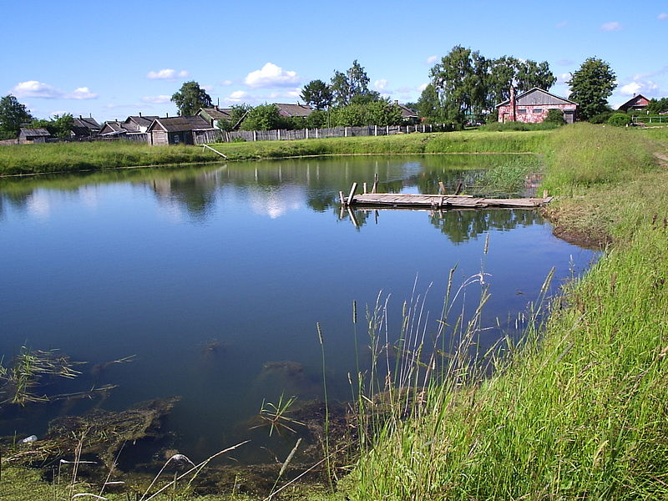
Growing with time

Slide 11
Personal issue? Perfective issue? Purpose issue? Pattern issue? Period of life issue?
Love grows with years?
►Ph.3:12-14, keeps us growing in love – not absolute perfection
►Faith: Jn.2:11 . . . 11:15
Develops (muscle)
Work in progress
►1 Thes.4:9-10; 5:23
Boy helps dad carry loads…

Slide 12
Great emphasis (5:23)
Repetition: 1 Th.3:13; 4:3-8
Completely: in every part. Mt.5
Whole: complete, intact (perfect growth of the whole)

Slide 13
Completely
Whole
Car w/o battery
Car w. every part, but very old
Mt.19:21
Ac.3:16
Therapy: only arms
Therapy on every part; only one rep.
Armor (5:8). Fortress: huge gap
Armor: all, but thin.
Fortress: 2 ft. high

Slide 14
Personal issue? Perfective issue? Purpose issue? Pattern issue? Period of life issue?
Love grows with years?
►Ph.3:12-14, keeps us growing in love – not absolute perfection
►Faith: Jn.2:11 . . . 11:15
Develops (muscle)
Work in progress
►1 Thes.4:9-10; 5:23
► 1 Jn.4:18-19

Slide 15
If you feel like Peter . . .
1. Die to sin. Ro.6:11
2. Desire to serve.
3. Determine to stay. 1 Pt.1:17
Learn God’s lessons
Became what He wants you to be
Pursue all that He wants you to do

