Slide 1
A Love Triangle

Slide 2
Shammai
Moses received 613 precepts on Sinai
365 according to days of the sun year (negative)
248 according to generations of men (positive)
Jews debated which was most important
Divided commands into greater and lesser

Slide 3
Pharisees
Used this question to ensnare Jesus
They looked for guile
‘Who committed no sin, Nor was guile found in His mouth’ –1 Pt.2:22

Slide 4
I. The Attack (Mt.22:34-36; Mk.12:28)

Slide 5
Pharisees heard He silenced Sadducees
Mixed emotions
►Glad He routed enemies (Mk.12:28)
►Grieved He won the victory
In one day He defeated elders, chief priests, Pharisees, Herod-ians, Sadducees

Slide 6
Pharisees met (Ps.2:2)
Considered new plan of attack
►Selected lawyer (22:35) ; scribe (Mk.12:28) . . . to test Him (22:18)
►Greatest command in law (22:36); first command of all (12:28)
Rabbis: many are secondary com-mands; others are of first importance
Commands of rabbis are more impor-tant than commands of Law
Contrast Ja.2:10

Slide 7
I. The Attack
The Answer (Mt.22:37-39; Mk.12:29-31)

Slide 8
‘The first’ . . . Quotes Deut.6:5
‘First’ precedes all others (rank)
Mk.12:28-29, 31, 33
‘Great’ embraces all others
‘The second’ . . . Quotes Lv.19:18
Answer is wider than the question – completes the answer
These cannot be separated
Humanism puts second one first

Slide 9
I. The Attack
II. The Answer
III. The Application (Mt.22:40; Mk.12:31b)

Slide 10
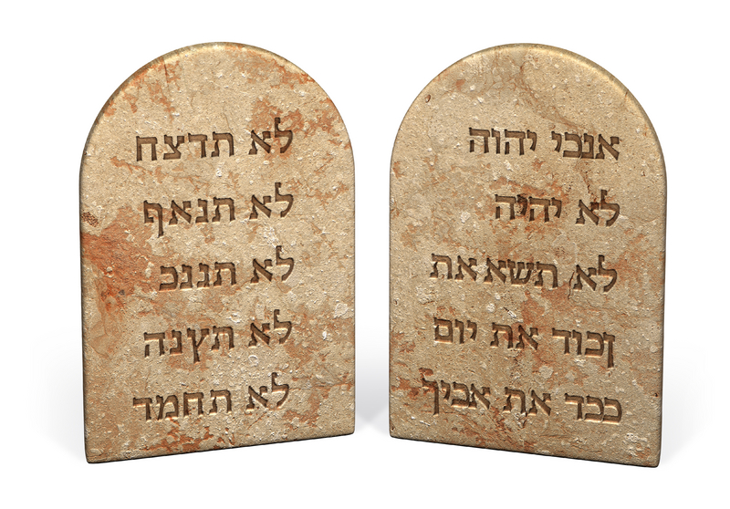
All Law / Prophets hang on these commandments, 22:40
‘Hang’ – as door on hinges
►No command is greater (Mk.12:31b)
►Ten commandments, two parts
The entire law is based on these two commandments
Love God
Love Man

Slide 11
I. The Attack
II. The Answer
III. The Application
IV. The Agreement (Mk.12:32-34)

Slide 12
A lawyer agrees with Jesus?
‘Well!’ = You are right (32a)
‘You have spoken truth’
Love is more than all whole burnt offerings and sacrifices, 32b-33
Is.40:16
Jesus responds: ‘You are not far from kingdom of God’ (34)

Slide 13
I. The Attack
II. The Answer
III. The Application
IV. The Agreement
V. The Assignment – A Love Triangle

Slide 14
Myself

Slide 15
1. Love myself
Not a command; an expectation
Forms basis of comparison for loving others – Ep.5:28-29
►God loves us, Ro.8:39; 15:30
►People confuse self-love with self-indulgence, 2 Tim.3:2-4
To elevate Self to a god to be served is self-idolatry

Slide 16
Myself
Neighbor

Slide 17
1. Love myself 2. Love neighbor
Not an emotion; a command
One way we love God: love people. 1 Jn.4:20-21
God loves our neighbors/brothers, Jn.3:16
Jesus quotes Lv.19:18

Slide 18
Leviticus 19:18
2-8 repeats, “I am the LORD…”
9-18, connects duties to neighbors
9-10, charity
11, property
12, lying
13-14, conduct
15, judgment
16, gossip
17, hatred
18, no grudge, but… love neighbor as yourself

Slide 19
Romans 13:8-10 (1/2)
8: love pays debt to law
8, 10: love fulfills law
9: love sums up law
“There is no law against things done in love. Therefore everything that is done in love is lawful.”
Where in Bible does love serve as grounds for nullifying a command?
1 Jn.5:3, what is the love of God??

Slide 20
Romans 13:8-10 (2/2)
8: love pays debt to law
8, 10: love fulfills law
9: love sums up law
“New morality” (situation ethics): “nothing is prescribed except love.”
NOT ‘love is only commandment’ BUT ‘love is greatest commandment.’
Love needs law for direction. 2 Sm.13

Slide 21
GOD
Myself
Neighbor

Slide 22
1. Love myself 2. Love others 3. Love God
Quotes Dt.6:5 – ‘with all heart…’
6: keep His commandments. 1 Jn.5:3
7: teach children to keep commands
8: bind His words to yourself (Josh.2:21)
9: review them often. 2 Pt.1:12

Slide 23
1. Love myself 2. Love others 3. Love God
Some view His commands as burdensome restrictions. 1 Jn.5:3
1 Jn.4:19
Proverb: love feels no loads
‘Jacob served seven years for Rachel, and they seemed only a few days to him because of the love he had for her’– Gn.29:20

Slide 24
The Bride eyes not her garment, but her dear Bridegroom’s face
I will not gaze at glory, but on my King of grace.
Not at the crown He giveth, but on His pierced hand,
The Lamb is all the glory, of Immanuel’s land
– The Sands Of Time

