Slide 1
Asa’s Apostasy
2 Chronicles 14-16

Slide 2
2 Chr.14:9-15:7

Slide 3
2 Chr.15:1-7
Azariah speaks to Asa
Does not applaud his victory, 2
Warns him: God will be with you IF … 2
Consequences of forsaking God, 3-6
Victories are dangerous, 7

Slide 4
I. Asa’s Rise

Slide 5
1. Devoted to God despite wicked father, 1 K.15:2-3, 12; 2 Chr.14:2
2. Deposed idols, 2 Chr.14:3-6
3. Defeated enemies, 2 Chr.14:8-15
4. Dedicated people to God, 2 Chr. 15:8-15
5. Demoted grand-mother, 2 Chr.15: 16; 1 K.15:13 (2)
6. Directed Jehoshaphat, 2 Chr.17:1
Independent piety
Corrective piety
Destructive piety
Constructive piety
Impartial piety
Parental piety

Slide 6
I. Asa’s Rise
II. Asa’s Fall

Slide 7
2 Chr.16:1-7

Slide 8
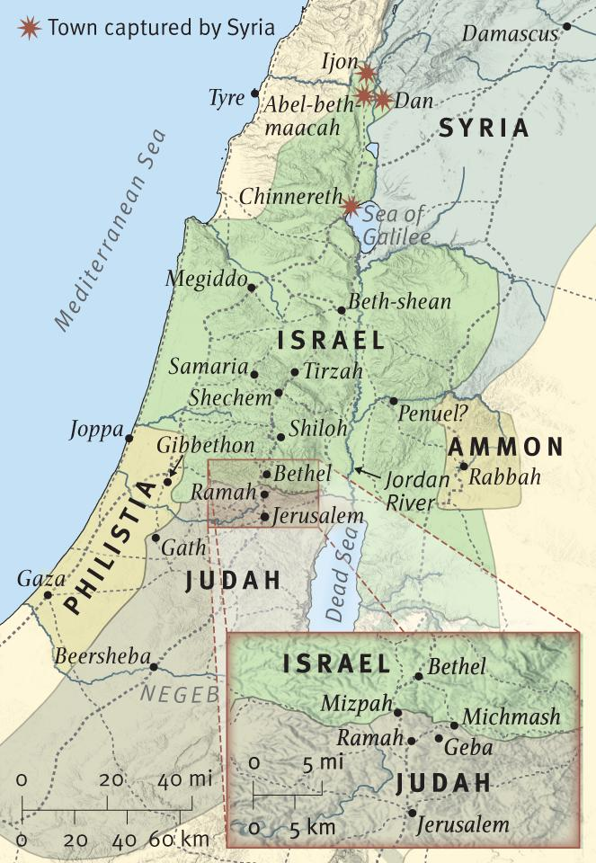
2 Chron.
16:1-7

Slide 9
1. Relied on man, 2 Chr.16:1-7
“Rent a king” worked. (1 K.15:16)
Success is not always good
1. trust: heathen king: 16:3. 1 Sm.8
2. treasury of God: bought ‘help’: 16:2-3
3. treaty: tempted Ben-Hadad: 16:3
Spoils 1-4, 6
Syria poses worse threat, 7, 9
Halted, 5

Slide 10
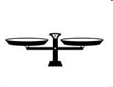
“Faith does not blind the eyes. It looks the difficulties square in the face and heaps them to one side of the balances. On the other side, it puts, simply and solely – God”
difficulties
God

Slide 11
1. Relied on man, 2 Chr.16:1-7 2. Rejected God’s warning, 7-10
7-8: is Asa infallible? …omniscient?
9: God knew his problems. 1 Pt.3:12
10: pride rejects correction
Pro.14:12 – a dead end
‘…angry…in a rage’
‘house of the stocks’

Slide 12
1. Relied on man, 2 Chr.16:1-7 2. Rejected God’s warning, 7-10
7-8: is Asa infallible? …omniscient?
9: God knew his problems. 1 Pt.3:12
10: pride rejects correction
2 Sm.12; Ga.4:13…16
Pro.14:12 – a dead end
Oppressed . . . people. 1 K.22

Slide 13
1. Relied on man 2. Rejected God’s correction 3. Requested physicians, 16:12
Passage pictures doctors negatively
Asa’s problem: doctors replaced God
2 K.1
Those who are well have no need
of a physician, but those who are sick – Mt.9:12.
Luke, the beloved physician (sends greetings) – Col.4:14.

Slide 14
Asa: 41 year reign
God blessed him abundantly
His character deteriorated as he aged
Still worshipped God, but lost his holiness. Ja.5:9
Which way are we going?
Christian
Church

Slide 15
Where will I end up?
Depends on way I am taking now.
Not enough to confess faults; must correct them. (1 Sm.24, 26)
Dangers:
Impenitence: set in our ways; unwilling to change.
Immodesty: start believing our press . . .

