Slide 1
Let your light so shine before men, that they may see your good works and glorify your Father in heaven.
Matthew 5:16

Slide 2
Let your light so shine before men, that they may see your good works and glorify your Father in heaven.
Command
1 – Within our control
2 – Will not happen without our effort
Titus 3:3-8
Heb.4:1; 4:11; 6:1

Slide 3
Let your light so shine before men, that they may see your good works and glorify your Father in heaven.
Personal
NOT Corporate
Rom.10:14
2 Cor.5:10

Slide 4
Let your light so shine before men, that they may see your good works and glorify your Father in heaven.
Not Darkness
Lk.11:34-36

Slide 5
Let your light so shine before men, that they may see your good works and glorify your Father in heaven.
Matt.17:2 – The transfiguration
2 Cor.4:6-11 – The transformation

Slide 6
Let your light so shine before men, that they may see your good works and glorify your Father in heaven.
Public
Matt.5:10-11
1 Cor.1:23
Mk.8:38

Slide 7
Let your light so shine before men, that they may see your good works and glorify your Father in heaven.
NOT Charity – Matt.6:1-4
NOT Piety – Matt.6:5-6
NOT Self Denial – Matt.6:16-18

Slide 8
Let your light so shine before men, that they may see your good works and glorify your Father in heaven.
Phil.2:12-16 – The Power of Example
2 Thes.2:14
Rom.1:16

Slide 9
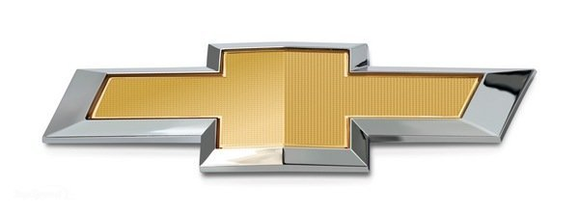
Let your light so shine before men, that they may see your good works and glorify your Father in heaven.
Gal.6:17 – Marks
Same word as Tattoo or Brand

Slide 10
Let your light so shine before men, that they may see your good works and glorify your Father in heaven.
Gal.6:17 – Marks
Same word as Tattoo or Brand
Our word: Stigma
Heb.13:13

