Slide 1
Growth Marks (Maturity)

Slide 2
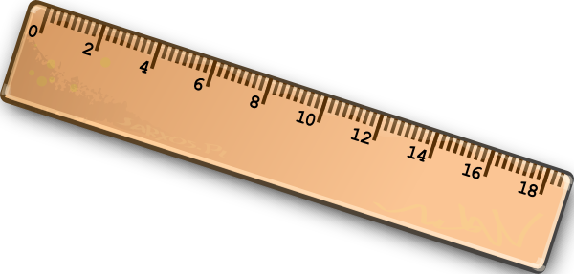
Children want to grow
‘When I get big…’
Boy wants to be a man…
When does this occur?

Slide 3
Visit congregation after five years...
Children have grown…
1 Co.3:1-3; 14:20
Acts 18, Corinth. . .Acts 19, Ephesus
Physical babies have grown
1. Are we growing and maturing?
2. How to know? – Growth marks
You are only young once, but you can stay immature indefinitely

Slide 4
I. God-Sufficient

Slide 5
DOES NOT . . .
Rely on preacher / elders to stay the course.
Need begging sermons to obey.
Need constant attention from brethren to stay faithful.
Get defensive when corrected. Ga.6:1; Hb.10:24-25.
Who propped up Paul?
Phil.1:13…16-18
Mature are conscious of faults
Ja.5:19-20

Slide 6
MATURE PEOPLE RELY ON GOD
If Bible says it, that settles it
Gn.12:1-3, Abraham: life of faith
Mt.19, RYR: life of sight
Ph.3:13, straining forward (ESV)
Exert oneself to the uttermost, stretch out, strain

Slide 7
I. God-Sufficient
II. Stands For Truth

Slide 8
Unmoved if truth . . .
Cuts family ties. Mt.10:34-37
Costs lives. Mt.21. 2 Co.12:15
Casts out of synagogues. Jn.9; 16
Purpose: not made to stumble (keep you from falling away)
Problem: put you out of synagogues (expelled – or even killed)

Slide 9
Unmoved if truth . . .
Cuts family ties. Mt.10:34-37
Costs lives. Mt.21. 2 Co.12:15
Casts out of synagogues. Jn.9; 16
Causes extra work. 2 Co.11:28

Slide 10
I. God-Sufficient
II. Stands For Truth
III. Ever-increasing Knowledge Of Scripture

Slide 11
Mt.13:52, scribes
Able to draw lessons from OT/NT
Hb.5:11-14, students
Dull of hearing (hard of hearing)
Time . . . (losing ground)
First principles
Milk . . . strong meat
Unskillful (inexperienced)
Exercised (takes work)

Slide 12
No one grows strong without good diet
2 Pt.3:18 – Ro.10:17
Baby can eat only what he is given – depends on others
Baby grows – learns what to eat, what to avoid
Practical application: daily reading schedule

Slide 13
I. God-Sufficient
II. Stands For Truth
III. Ever-increasing Knowledge Of Scripture
IV. Covets Correction

Slide 14
No excuses
Maturity comes when you stop making excuses and start making changes
“The lazy man says, ‘There is a lion outside! I shall be slain in the streets’” – Pr.22:13.

Slide 15
‘Ain’t seen nothing yet’
John 1⁵¹, Nathanael
John 6⁶², ‘Disciples’
‘Ain’t seen nothing yet’
Nathanael changed his mind; would see greater good things
‘Disciples’ rejected truth; would see greater evil consequences

Slide 16
I. God-Sufficient
II. Stands For Truth
III. Ever-increasing Knowledge Of Scripture
IV. Covets Correction
V. Genuine Concern For Others

Slide 17
SAINTS
Paul’s writes letters of concern
SINNERS
Limits liberties for benefit of others, 1 Co.9:19-23

Slide 18
I. God-Sufficient
II. Stands For Truth
III. Ever-increasing Knowledge Of Scripture
IV. Covets Correction
V. Genuine Concern For Others
VI. Perseverance

Slide 19
Jer.20:7-9
1 K.19
Ph.3:12-14
Paul would retire…when he died.
In spite of pain, persecution, losses, kept going to the end.
Always striving for maturity...like a baby

