Slide 1
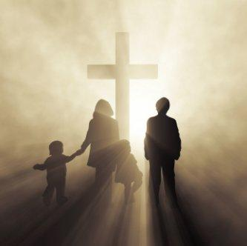
The Great Reward
Of A
Godly Home
The decline of the home.

Slide 2
The decline of the home in our culture is very evident and is the concern of many people today, because they recognize the home as the foundation of our society:
The Numbers on Moral Decline By Brent Bozell
Most American parents display an optimism about their children living in a richer, more technologically advanced world and as they grow, that they'll be healthier with a longer life expectancy. All that said, there's also a remarkable pessimism about the moral decline they are bequeathing to the next generation.
A new cultural-values survey of 2,000 American adults …reveals a strong majority, 74 percent, believes moral values in America are weaker than they were 20 years ago. Almost half, 48 percent, agree that values are much weaker than they were 20 years ago.

Slide 3
The decline of the home in our culture is very evident and is the concern of many people today, because they recognize the home as the foundation of our society:
The very fabric of the home has been assaulted by the divorce rate / living together / homosexual movement which all has undermined the God given home!
The entertainment industry is an open cesspool to violence, language, sex, and every form of ungodliness that one can imagine and then some!
The social media is a constant 24/7 exposure (people can’t lay it down) that puts parents and children alike in constant communication with many bad influences!
The home has become a powder-keg of drugs, alcohol, anger, and materialism; and we wonder why our children look for answers in all the wrong places!

Slide 4
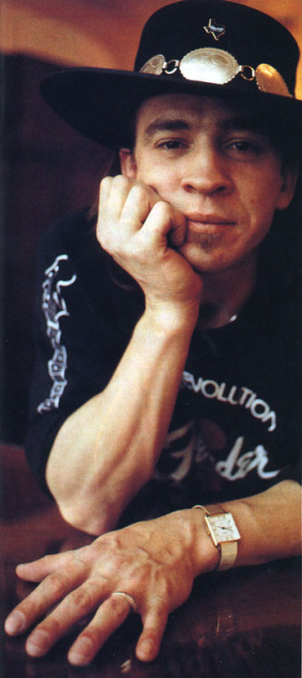
“…The thing was, that was the only thing I knew how to do. The only thing I knew how to do, was just try to get by, every day. I wasn’t really learning anything about livin’ life. There was really no information at home. ‘Cause I couldn’t…it was pretty violent at my house, I couldn’t go and ask my dad about things. I couldn’t go ask my dad about school, or about girls or about anything, ‘cause it was...it was pretty much “you’re supposed to know that stuff on your own”…or “just leave me alone.” “Is that your stuff?…get it out of the room”, you know.
So I just continued to try to find out things from the kids down the street. That wasn’t the way to really go--I didn’t know that.”
- Stevie Ray Vaughan (AA speech) January 3 1990
1954-1990

Slide 5
The decline of the home in our culture is very evident and is the concern of many people today, because they recognize the home as the foundation of our society:
The Numbers on Moral Decline By Brent Bozell
Parents also need to go beyond teaching morality to living morally. Sadly, this cultural survey shows that while Americans have a great consensus on the importance of classic virtues like truthfulness, thrift, industry and charity, they often fail to follow through.
…America needs a people who do not merely talk about public virtues, but embrace them with passion and humility. Reversing America's moral decline isn't just about the media. It's a daily fight in millions of homes and in billions of daily ethical situations. How much progress could we make by just trying harder to live the virtues so many of us profess to hold dear?

Slide 6
The Great Reward
Of A
Godly Home
The decline of the home.
The home God would have.

Slide 7
The home is created and designed by God, and He has given us the Bible to build and maintain the homes that would bring glory to Him:
THE FOUNDATION - Before a family can be what it should, the foundation of that family needs to understand their responsibility, Matthew 19:4-6.

Slide 8
Matthew 19:4-6 - And He answered and said to them, "Have you not read that He who made them at the beginning 'made them male and female,'
5 "and said, 'For this reason a man shall leave his father and mother and be joined to his wife, and the two shall become one flesh'?
6 "So then, they are no longer two but one flesh. Therefore what God has joined together, let not man separate."

Slide 9
The home is created and designed by God. He has given us the Bible to build and maintain the homes that would bring glory to Him:
THE FOUNDATION - Before a family can be what it should, the foundation of that family needs to understand their responsibility, Matthew 19:4-6.
CHILDREN A BLESSING - The children born into these families are given through God’s great blessing, and should be viewed so, Psalm 127:3-5.

Slide 10
Psalm 127:3-5 - Behold, children are a heritage from the LORD, The fruit of the womb is a reward.
4 Like arrows in the hand of a warrior, So are the children of one's youth.
5 Happy is the man who has his quiver full of them; They shall not be ashamed, But shall speak with their enemies in the gate.

Slide 11
The home is created and designed by God. He has given us the Bible to build and maintain the homes that would bring glory to Him:
THE FOUNDATION - Before a family can be what it should, the foundation of that family needs to understand their responsibility, Matthew 19:4-6.
CHILDREN A BLESSING - The children born into these families are given through God’s great blessing, and should be viewed so, Psalm 127:3-5.
PARENTS ACCOUNTABLE - The parents of these children are held accountable to teach and train God’s word to them, Deuteronomy 6:4-7.

Slide 12
Deuteronomy 6:4-7 - "Hear, O Israel: The LORD our God, the LORD is one!
5 "You shall love the LORD your God with all your heart, with all your soul, and with all your strength.
6 "And these words which I command you today shall be in your heart.
7 "You shall teach them diligently to your children, and shall talk of them when you sit in your house, when you walk by the way, when you lie down, and when you rise up.

Slide 13
The home is created and designed by God. He has given us the Bible to build and maintain the homes that would bring glory to Him:
THE FOUNDATION - Before a family can be what it should, the foundation of that family needs to understand their responsibility, Matthew 19:4-6.
CHILDREN A BLESSING - The children born into these families are given through God’s great blessing, and should be view so, Psalm 127:3-5.
PARENTS ACCOUNTABLE - The parents of these children are held accountable to teach and train God’s in word to them, Deuteronomy 6:4-7.
PARENTS DISCIPLINE - As these parents teach and train their children, it will be necessary to correct them when needed, Proverbs 13:24.

Slide 14
Proverbs 13:24 - He who spares his rod hates his son, But he who loves him disciplines him promptly.

Slide 15
The home is created and designed by God. He has given us the Bible to build and maintain the homes that would bring glory to Him:
THE FOUNDATION - Before a family can be what it should, the foundation of that family needs to understand their responsibility, Matthew 19:4-6.
CHILDREN A BLESSING - The children born into these families are given through God’s great blessing, and should be view so, Psalm 127:3-5.
PARENTS ACCOUNTABLE - The parents of these children are held accountable to teach and train God’s word to them, Deuteronomy 6:4-7.
PARENTS DISCIPLINE - As these parents teach and train their children, it will be necessary to correct them when needed, Proverbs 13:24.
CHILDREN OBEY - God holds not only parents accountable, but holds children accountable to heed their parent’s instruction, Ephesians 6:1-4.

Slide 16
Ephesians 6:1-4 - Children, obey your parents in the Lord, for this is right.
2 "Honor your father and mother," which is the first commandment with promise:
3 "that it may be well with you and you may live long on the earth."
4 And you, fathers, do not provoke your children to wrath, but bring them up in the training and admonition of the Lord.

Slide 17
The Great Reward
Of A
Godly Home
The decline of the home.
The home God would have.
The reward of a Godly home.

Slide 18
The home built and maintained by God’s design (by God’s word) brings glory to God, but also the blessings of that Godly home are far reaching:
CHILDREN WILL BENEFIT - By faithfully following the Godly instruction of their parents, children can avoid pitfalls that, otherwise, they would fall into, Proverbs 4:1-6.

Slide 19
Proverbs 4:1-6 - Hear, my children, the instruction of a father, And give attention to know understanding;
2 For I give you good doctrine: Do not forsake my law.
3 When I was my father's son, Tender and the only one in the sight of my mother,
4 He also taught me, and said to me: "Let your heart retain my words; Keep my commands, and live.
5 Get wisdom! Get understanding! Do not forget, nor turn away from the words of my mouth.
6 Do not forsake her, and she will preserve you; Love her, and she will keep you.

Slide 20
The home built and maintained by God’s design (by God’s word) brings glory to God, but also the blessings of that Godly home are far reaching:
CHILDREN WILL BENEFIT - By faithfully following the Godly instruction of their parents, children can avoid pitfalls that, otherwise, they would fall into, Proverbs 4:1-6.
PARENTS WILL BENEFIT - By faithfully following the wisdom of God in teaching my children, I can have peace of mind, Proverbs 29:17.

Slide 21
Proverbs 29:17 - Correct your son, and he will give you rest; Yes, he will give delight to your soul.

Slide 22
The home built and maintained by God’s design (by God’s word) brings glory to God, but also the blessings of that Godly home are far reaching:
CHILDREN WILL BENEFIT - By faithfully following the Godly instruction of their parents, children can avoid pitfalls that, otherwise, they would fall into, Proverbs 4:1-6.
PARENTS WILL BENEFIT - By faithfully following the wisdom of God in teaching my children, I can have peace of mind, Proverbs 29:17.
SOCIETY WILL BENEFIT - A good strong family foundation is vital to making them the moral, ethical citizen that God wants them to be, I Peter 2:15-17.

Slide 23
I Peter 2:13-17 - Therefore submit yourselves to every ordinance of man for the Lord's sake, whether to the king as supreme,
14 or to governors, as to those who are sent by him for the punishment of evildoers and for the praise of those who do good.
15 For this is the will of God, that by doing good you may put to silence the ignorance of foolish men—
16 as free, yet not using liberty as a cloak for vice, but as bondservants of God.
17 Honor all people. Love the brotherhood. Fear God. Honor the king.

Slide 24
The home built and maintained by God’s design (by God’s word) brings glory to God, but also the blessings of that Godly home are far reaching:
CHILDREN WILL BENEFIT - By faithfully following the Godly instruction of their parents, children can avoid pitfalls that, otherwise, they would fall into, Proverbs 4:1-6.
PARENTS WILL BENEFIT - By faithfully following the wisdom of God in teaching my children, I can have peace of mind, Proverbs 29:17.
SOCIETY WILL BENEFIT - A good strong family foundation is vital to making them the moral, ethical citizen that God wants them to be, I Peter 2:15-17.
LOCAL CHURCH WILL BENEFIT - A good strong family foundation is desperately needed to make local churches what they need to be, Titus 1:5-9.

Slide 25
Titus 1:5-9 - For this reason I left you in Crete, that you should set in order the things that are lacking, and appoint elders in every city as I commanded you—
6 if a man is blameless, the husband of one wife, having faithful children not accused of dissipation or insubordination.
7 For a bishop must be blameless, as a steward of God, not self-willed, not quick-tempered, not given to wine, not violent, not greedy for money,
8 but hospitable, a lover of what is good, sober-minded, just, holy, self-controlled,
9 holding fast the faithful word as he has been taught, that he may be able, by sound doctrine, both to exhort and convict those who contradict.

Slide 26
The home built and maintained by God’s design (by God’s word) brings glory to God, but also the blessings of that Godly home are far reaching:
CHILDREN WILL BENEFIT - By faithfully following the Godly instruction of their parents, children can avoid pitfalls that, otherwise, they would fall into, Proverbs 4:1-6.
PARENTS WILL BENEFIT - By faithfully following the wisdom of God in teaching my children, I can have peace of mind, Proverbs 29:17.
SOCIETY WILL BENEFIT - A good strong family foundation is vital to making them the moral, ethical citizen that God wants them to be, I Peter 2:15-17.
LOCAL CHURCH WILL BENEFIT - A good strong family foundation is desperately needed to make local churches what they need to be, Titus 1:5-9.
GOD WILL BE PLEASED - It is these kinds of principles that we need to focus upon while realizing that God holds us each responsible, Matthew 25:19-21.

Slide 27
Matthew 25:19-21 - "After a long time the lord of those servants came and settled accounts with them.
20 "So he who had received five talents came and brought five other talents, saying, 'Lord, you delivered to me five talents; look, I have gained five more talents besides them.'
21 "His lord said to him, 'Well done, good and faithful servant; you were faithful over a few things, I will make you ruler over many things. Enter into the joy of your lord.'

Slide 28
The Great Reward
Of A
Godly Home
Husbands and wives who stay together!
Children are loved and appreciated!
Parents teach and train children!
Children learn about consequences!
Children who obey and respect parents!
Children will have good life!
Obey The Gospel:
Believe, John 8:24
Repent, Luke 13:3
Confess, Matthew 10:32
Baptized, Mark 16:16
Parents will have peace of mind!
Society will benefit!
Local churches will flourish!
God is pleased!
What Kind of Home Do You Have?

